Slide 1
Obfuscation and White Box Crypto
Avik Chakraborti,
Lecturer,
University of Exeter, UK

Slide 2
Outline of the Talk
1 Intro
2 Obfuscation
3 White Box Crypto
4 White Box AES

Slide 3
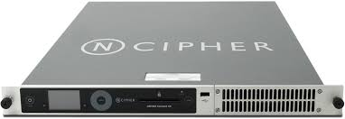
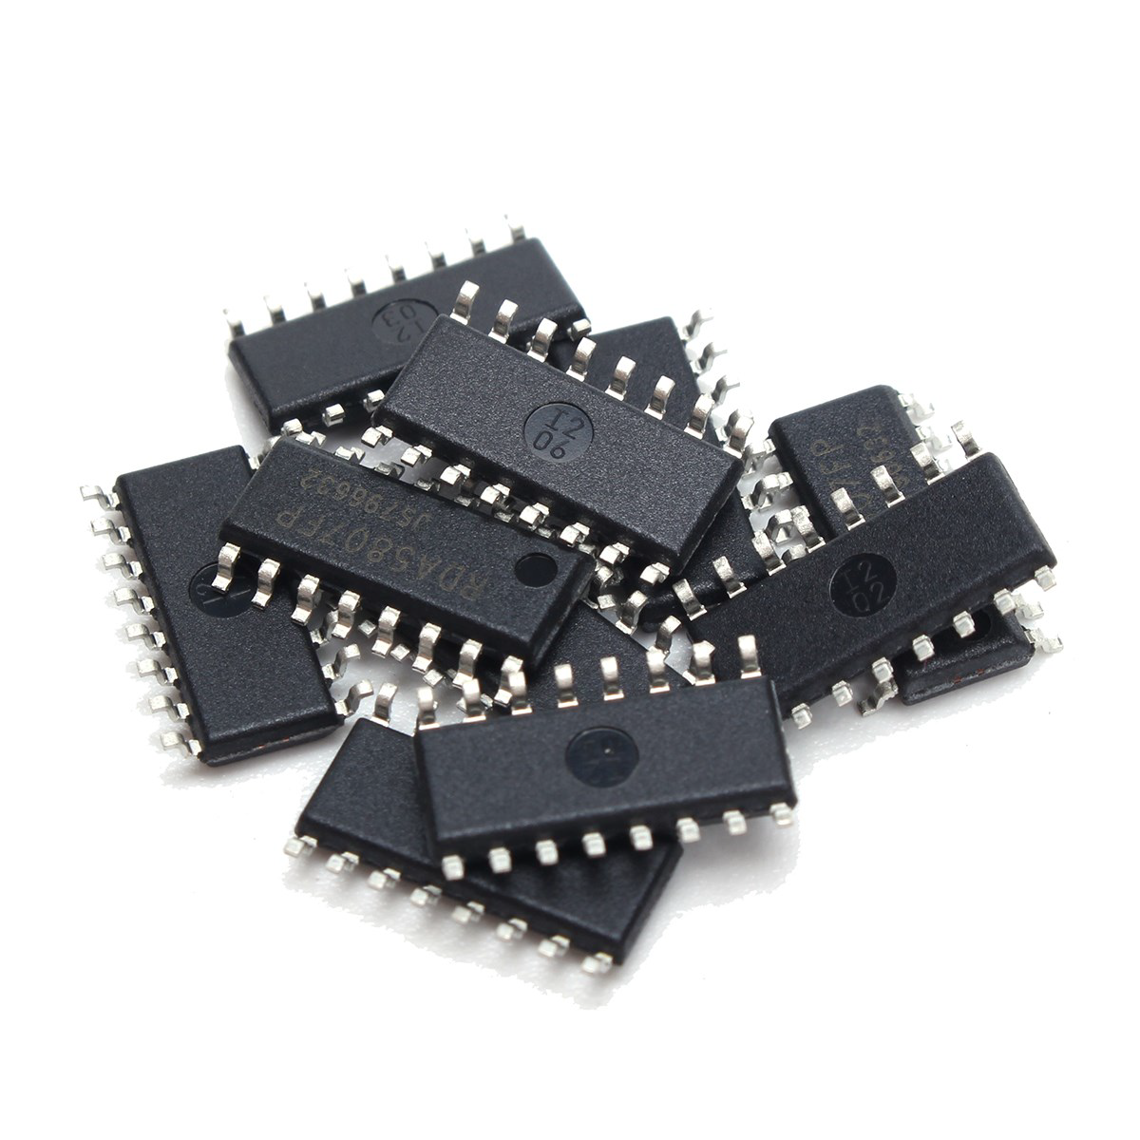
Cryptographic Key Protection
Online Payment Market
Hardware Security Module
Others........

Slide 4
But they are not convenient....
The biggest drawback to using an HSM is cost.
(Price: Thousand to many thousand bucks)

Slide 5
But they are not convenient....
The biggest drawback to using an HSM is cost.
(Price: Thousand to many thousand bucks)
Difficulty in upgrading. If a weakness is exposed
it is not easy to upgrade. Bugs, security flaws might occur.

Slide 6
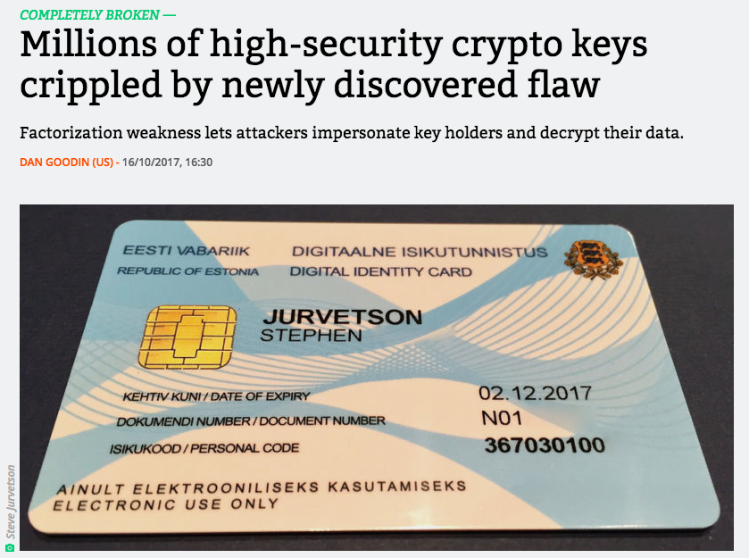
But they are not convenient....
ROCA Vulnerability, 2017
The biggest drawback to using an HSM is cost.
(Price: Thousand to many thousand bucks)
Difficulty in upgrading. If a weakness is exposed
it is not easy to upgrade. Bugs, security flaws might occur.
A bug in the firmware's prime-search algorithm used for RSA key generation results in RSA keys that are relatively cheap and inexpensive to factor. The bug impacts Infineon Trusted Platform Modules (TPMs) as well as many smartcards and Hardware Security Modules (HSMs) that use Infineon chips.

Slide 7
But they are not convenient....
ROCA Vulnerability, 2017
The biggest drawback to using an HSM is cost.
(Price: Thousand to many thousand bucks)
Difficulty in upgrading. If a weakness is exposed
it is not easy to upgrade. Bugs, security flaws might occur.
Overall long lifecycle but limited updates
A bug in the firmware's prime-search algorithm used for RSA key generation results in RSA keys that are relatively cheap and inexpensive to factor. The bug impacts Infineon Trusted Platform Modules (TPMs) as well as many smartcards and Hardware Security Modules (HSMs) that use Infineon chips.

Slide 8
Pure Software Based Apps
Cheaper, lesser testing, easier to update
Mobile Payment (HCE based):
- No hardware Secure Element (SE)
- Cloud Based Payment
- Imitate Secure Element
Digital Right Management
IoT Application without SE
Others . . . . . . .

Slide 9
Protecting Keys
If Attacker has access to the implementation
Analyze the code
Find the memory access instructions
Filter those instructions involving key bits
Scan memory for secret keys

Slide 10
Protecting Keys
If Attacker has access to the implementation code (binary executable)
Analyze the code
Find the memory access instructions
Filter those instructions involving key bits
Scan memory for secret keys
Adi Shamir and Van Someron: Find cryptographic keys from GigaBytes of datastream (Financial Crypto, 98)
Observation: Key information (in the middle of the figure) looks more noisy than the rest of the data

Slide 11
Protecting Keys
If Attacker has access to the implementation code (binary executable)
Analyze the code
Find the memory access instructions
Filter those instructions involving key bits
Scan memory for secret keys
Adi Shamir and Van Someron: Find cryptographic keys from GigaBytes of datastream (Financial Crypto, 98)
Observation: Key information (in the middle of the figure) looks more noisy than the rest of the data
Obfuscate the Code

Slide 12
Outline of the Talk
1 Intro
2 Obfuscation
3 White Box Crypto
4 White Box AES

Slide 13
Obfuscation
Obfuscation is a function/act of obfuscating a code that is difficult for humans to understand (Obfuscation takes P as input and outputs P’ = O(P)
Obfuscation makes a program unintelligible while preserving its functionality (P’ ≡ P, i.e., for all x, P’(x) = P(x))

Slide 14
Why Obfuscation?
To protect some secret inside a program
- Secret algorithm or key (e.g. a factoring program)
Efficient Factoring Algorithm
(factor n = pq)
Breaking RSA
- some private data used by the program (e.g. conditional data access)
Private: Data
Pwd, f
f(data)
If (pwd is correct) then f(data)

Slide 15
Why Obfuscation?
Create a Public Key Encryption from Symmetric Key Encryption
- Obfuscate EK with embedded K
Watermarking Software: Obfuscate the watermark
- A software designer is selling his software by individualizing his program to
each customer
OTT platform (say Netflix) can obfuscate the decryption function for the subscribers

Slide 16
What is Program?
Few Points
A word in language P ∈ L (some encoded string)
execute : L × D → R s.t out = execute (P, in)
P implements f: D → R, if for all a ∈ D, execute (P, a) = f(a), we say P ≡ f
P1 and P2 are functionally equivalent if for some f, P1 ≡ f ≡ P2,
we denote it P1 ≡ P2

Slide 17
Obfuscation
Obfuscator
An algorithm O with input P, such that
Functionality: P’=O (P) ≡ P
Efficiency: P’ is efficiently executable
(n to poly (n))
Security:
randomness
P
P’ ≡ P​
Next Slides

Slide 18
Virtual Black Box (VBB) Security
Interpretation
- O is a VBB obfuscator in the sense that anything one can efficiently compute given P’=O (P),
one could also efficiently compute given Black Box oracle access to P
- Simply: P’ reveals as little as possible about P

Slide 19
Strong VBB
An adversary A on P’ can be simulated with a black box access to P

Slide 20
Strong VBB
An adversary A on O (P) can be simulated with a black box access to P
P
P​(x)
x
P’
A
S
≃
n-bit
n-bit
⊥
Adversary
Simulator
{A(P’)}_{n} ≃ {S ^{P}(⊥)}_{n}

Slide 21
Strong VBB
Too Strong
- Consider an adversary A, such that A(P’) outputs P’
- S has black-box access to P and it is really hard to simulate P’, as S knows
only several input / output pairs corresponding to its queries to P
(P’ is nothing but an encoded string and it is in the language L)
- Weaker: Reduce the output length of A and S. Ex: Let A and S are predicates

Slide 22
VBB
An adversary A on P’ can be simulated with a black box access to P

Slide 23
VBB
An adversary A on P’ can be simulated with a black box access to P
P
P​(x)
x
P’
A
S
0
1
0
1
≃
⊥
Adversary
Simulator
{A(P’)}₁ ≃ {S ^{P}(⊥)}₁

Slide 24
Impossibility of VBB (Barak et al., CRYPTO, 2001)
“self-eating” programs
uint128_t cannibal ( prog P, uint128_t password )
{
uint128_t secret1 = 0xe075b4f4eabf4377c1aa7202c8cc1ccb ;
uint128_t secret2 = 0x94ff8ec818de3bd8223a62e4cb7c84a4 ;
if ( password == secret1 ) return secret2 ;
if ( execute (P, ⊥ , secret1 ) == secret2 ) return secret1 ;
return 0;
}

Slide 25
Impossibility of VBB
“self-eating” programs
uint128_t cannibal ( prog P, uint128_t password )
{
uint128_t secret1 = 0xe075b4f4eabf4377c1aa7202c8cc1ccb ;
uint128_t secret2 = 0x94ff8ec818de3bd8223a62e4cb7c84a4 ;
if ( password == secret1 ) return secret2 ;
if ( execute (P, ⊥ , secret1 ) == secret2 ) return secret1 ;
return 0;
}
O(cannibal) (O(cannibal); 0) = secret1

Slide 26
Impossibility of VBB
“self-eating” programs
uint128_t cannibal ( prog P, uint128_t password )
{
uint128_t secret1 = 0xe075b4f4eabf4377c1aa7202c8cc1ccb ;
uint128_t secret2 = 0x94ff8ec818de3bd8223a62e4cb7c84a4 ;
if ( password == secret1 ) return secret2 ;
if ( execute (P, ⊥ , secret1 ) == secret2 ) return secret1 ;
return 0;
}
(0 == secret1) is False
execute (O(cannibal), ⊥, secret1) will return secret2
O(cannibal) (O(cannibal); 0) = secret1

Slide 27
Impossibility of VBB
“self-eating” programs
uint128_t cannibal ( prog P, uint128_t password )
{
uint128_t secret1 = 0xe075b4f4eabf4377c1aa7202c8cc1ccb ;
uint128_t secret2 = 0x94ff8ec818de3bd8223a62e4cb7c84a4 ;
if ( password == secret1 ) return secret2 ;
if ( execute (P, ⊥ , secret1 ) == secret2 ) return secret1 ;
return 0;
}
(0 == secret1) is False
execute (O(cannibal), ⊥, secret1) will return secret2
O(cannibal) (O(cannibal); 0) = secret1
“A generic obfuscator does not exist, i.e., there exist programs that cannot be VBB-obfuscated.”

Slide 28
The Good News
The impossibility result does not apply to a specific encryption algorithm
VBB AES might exist
AES_{K}
C
M
O(AES_{K})
A
S
0
1
0
1
≃
⊥
Adversary
Simulator
Bad News: Hard to achieve

Slide 29
Indistinguishability Obfuscation (IO), a Reasonably Weak Notion
General purpose obfuscation is impossible
Weaker Notion but covers a lot: IO
For any P1 and P2, P1 ≡ P2 , implies O(P1) and O(P2) are indistinguishable
O (P1)
A
0
1
O (P2)
A
0
1
≃
{A(O(P1))}₁ ≃ {A(O(P2))}₁

Slide 30
Outline of the Talk
1 Intro
2 Obfuscation
3 White Box Crypto
4 White Box AES

Slide 31
What is White Box Crypto (WBC)?
Obfuscation restricted to a specific class of crypto primitives
“the attacker is assumed to have full access to the encrypting software and control of the execution environment”
“Our main goal is to make key extraction difficult.”
– Chow et al. (DRM 2002)

Slide 32
What is White Box Crypto (WBC)?
Obfuscation restricted to a specific class of crypto primitives
“the attacker is assumed to have full access to the encrypting software and control of the execution environment”
⇒ obfuscation restricted to encryption (or another crypto primitive)
“Our main goal is to make key extraction difficult.”
– Chow et al. (DRM 2002)

Slide 33
What is White Box Crypto (WBC)?
Obfuscation restricted to a specific class of crypto primitives
“the attacker is assumed to have full access to the encrypting software and control of the execution environment”
⇒ obfuscation restricted to encryption (or another crypto primitive)
“Our main goal is to make key extraction difficult.”
⇒ relaxed security requirements
– Chow et al. (DRM 2002)

Slide 34
What is White Box Crypto (WBC)?
White-box cryptography is obfuscation of crypto code​
randomness
K
[E_{K}] ≡ E_{K}(.)​
It is an obfuscator that only resists Key Extraction

Slide 35
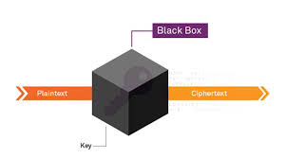
Why the Term "White Box"?
Black Box
- Zero visibility to code
- Visibility to external info
- Secure if the cipher has no weakness
https://www.slideshare.net/Iqrakhalil2/white-box-crytography-in-an-insecure-enviroment

Slide 36
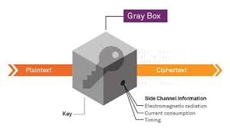
Why the Term "White Box"?
Black Box
- Zero visibility to code
- Visibility to external info
- Secure if the cipher has no weakness
Gray Box
- Partial physical access to key due to information leakage
Such as EM radiation, power consumption....
https://www.slideshare.net/Iqrakhalil2/white-box-crytography-in-an-insecure-enviroment
http://ijiet.com/wp-content/uploads/2017/05/31.pdf

Slide 37
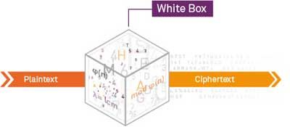
Why the Term "White Box"?
White Box
- Full visibility to code
- Input, output, memory, internal computations
- Traditional Crypto is not secure under white box visibility
https://semiengineering.com/26374-2/

Slide 38
Strongest possible WBC: VBB AES
VBB obfuscation restricted to AES
AES_{K}
C
M
WB-AES_{K}
A
S
0
1
0
1
≃
⊥
Adversary
Simulator
Impossibility result does not apply
The AES-LUT program achieves VBB : 10^{9.}10^{9.}10⁹ TB
Compact VBB-AES could be impossible

Slide 39
Weaker WBC: io AES
Is this a Good Obfuscator ?
- iO restricted to AES: Let O(P_{k}) ≃ O(P’_{k} ) for any P_{k} ≡ P’_{k} ≡ AES_{k}
- This is an iO AES
Good If key-extraction is difficult on some P_{k}
- key-extraction is still difficult on O (P_{k})
- key-extraction is difficult on any O (P_{k}) ≃ O (P'_{k})
Is iO-AES a right obfuscation notion?
- Not clear to the community
- iO security does not ensure that an iO-obfuscated
encryption program resists key extraction
1. k <- Extract-key(P_{k})​
2. return reference implementation AES_{k}

Slide 40
WBC Security Notions
Simple
AES
iO-
AES
VBB
AES
?
We need something
- relaxed compared to VBB
- meaningful compared to iO

Slide 41
WBC Security Notions
Simple
AES
iO-
AES
VBB
AES
Further WB Security
Notions
Obfuscation Scale
We need something
- relaxed compared to VBB
- meaningful compared to iO further notions

Slide 42
WBC Security Notions
Unbreakability: Keys can not be extracted
Basic requirement but not sufficient depending on applications
What will happen if the adversary lifts AES_{k} instead of K
White-Box Security Notions for Symmetric Encryption Schemes (SAC 2013)
Towards Security Notions for White-Box Cryptography (ISC 2009)
WB-AES_{K}
A
K

Slide 43
WBC Security Notions
Incompressibility: hardness of compression
Prevents Code-Lifting. Makes sharing the code at a large scale less convenient
Some primitives based on this idea
- Block-ciphers based on large tables (ASIACRYPT 2016)
- Big-key cipher (CRYPTO 2016)
WB-AES_{K}
_{> 10 GB}
A
AES_{K}
< 10 KB

Slide 44
WBC Security Notions
One-Wayness: hardness of inversion
Turns AES into a public-key cryptosystem
Application: Public Key crypto with light-weight private operations
m
WB-AES_{K}
A
m
c

Slide 45
Outline of the Talk
1 Intro
2 Obfuscation
3 White Box Crypto
4 White Box AES

Slide 46
White Box AES (Chow et al., SAC 2002)
My Assumption: AES is Known to Everyone
First significant work on White-box AES
Two steps:
- First step: represent AES as a network of look-up tables
- Randomize the look-up tables (with random encodings)
- Intuition: encoded tables bring no information on the key

Slide 47
White Box AES (Chow et al., SAC 2002)
AES: Key Add, SBox S, SR, MC (Total 9.5 Rounds) + Key Add
Nonlinear Op: SBox (Implemented by LUT)

Slide 48
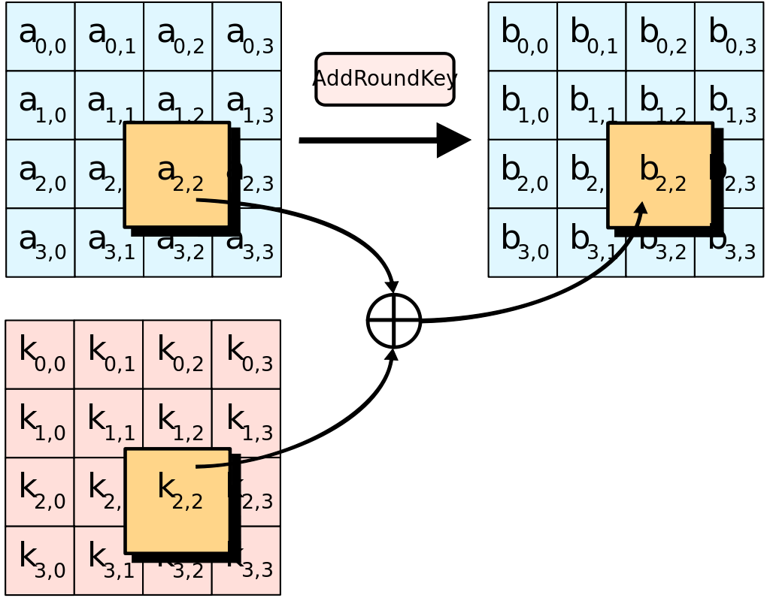
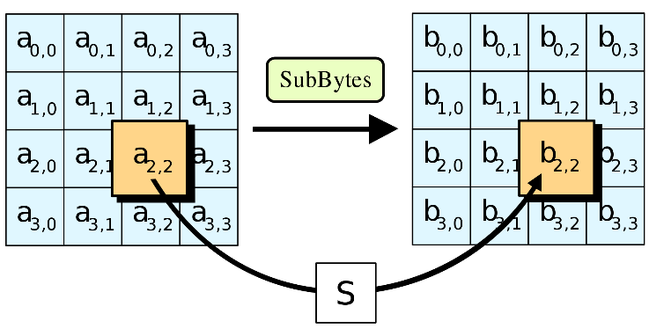
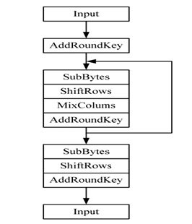
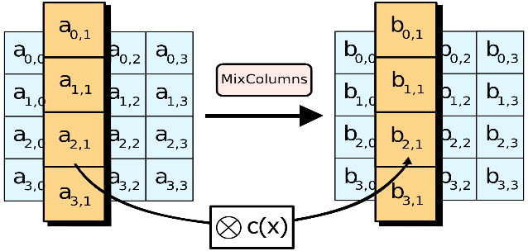
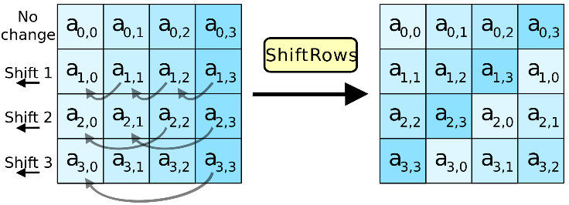
AES
One Round AES

Slide 49
White Box AES (Chow et al., SAC 2002)
AES: Key Add, SBox S, SR, MC (Total 9.5 Rounds) + Key Add
Nonlinear Op: SBox (Implemented by LUT)
WB-AES plays the Trick
- Use TBox_{k} (instead of SBox)
k
k
S
T
x
y
x
y

Slide 50
White Box AES (Chow et al., SAC 2002)
AES: Key Add, SBox S, SR, MC (Total 9.5 Rounds) + Key Add
Nonlinear Op: SBox (Implemented by LUT)
WB-AES plays the Trick
- Use TBox_{k} (instead of SBox)
- Overall:
T^{r}_{i,k}(x) = S(x + k^{r-1}[i]), i = 0, …, 15, r = 1, …, 9 (144 tables)
T¹⁰_{i,k}(x) = S(x + k⁹[i] + k¹⁰[i]), i = 0, …, 15 (16 tables)
Total 160 tables: 8 bits to 8 bits
k
T_{i}
x
y

Slide 51
White Box AES (Chow et al., SAC 2002)
T_{yi} Tables for MixColumns
02 03 01 01 x0 02 03 01 01
01 02 03 01 x1 = x0 01 + x1 01 + x2 03 + x3 01
01 01 02 03 x2 01 01 02 03
03 01 01 02 x3 03 02 01 02

Slide 52
White Box AES (Chow et al., SAC 2002)
T_{yi} Tables for MixColumns
02 03 01 01 x0 02 03 01 01
01 02 03 01 x1 = x0 01 + x1 01 + x2 03 + x3 01
01 01 02 03 x2 01 01 02 03
03 01 01 02 x3 03 02 01 02
Table T_{y0} (x) = x [02 01 01 03]^{T}, similar for T_{y1} (x), T_{y2} (x), T_{y3} (x)
One Column: T_{y0} (x0) + T_{y1} (x1) + T_{y2} (x2) + T_{y3} (x3)

Slide 53
White Box AES (Chow et al., SAC 2002)
T_{yi} Tables for MixColumns
02 03 01 01 x0 02 03 01 01
01 02 03 01 x1 = x0 01 + x1 01 + x2 03 + x3 01
01 01 02 03 x2 01 01 02 03
03 01 01 02 x3 03 02 01 02
Table T_{y0} (x) = x [02 01 01 03]^{T}, similar for T_{y1} (x), T_{y2} (x), T_{y3} (x)
One Column: T_{y0} (x0) + T_{y1} (x1) + T_{y2} (x2) + T_{y3} (x3)
Total 144 tables: 36 (9 rounds, 4 columns) tables for each T_{yi} (x)

Slide 54
White Box AES (Chow et al., SAC 2002)
XOR Tables: XOR (x, y) = x + y
Total 864 tables (8 bit to 4 bit tables, x and y are 4 bits)

Slide 55
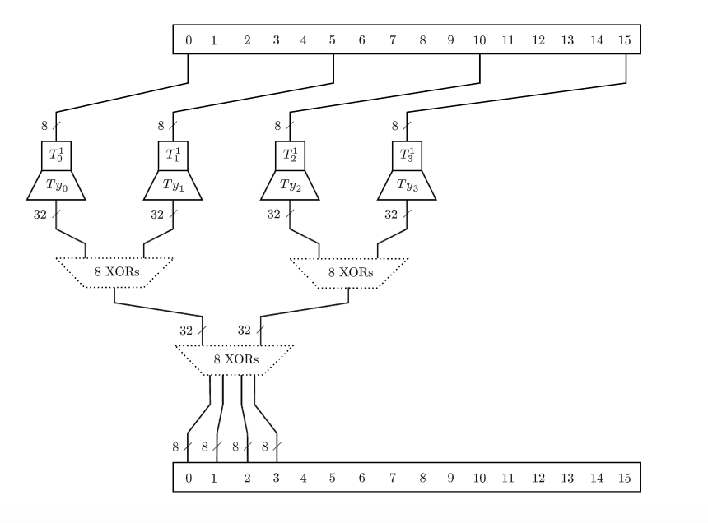
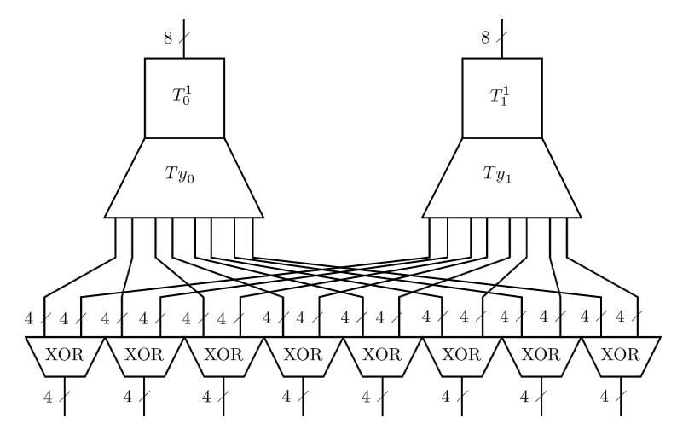
White Box AES (Chow et al., SAC 2002)

Slide 56
White Box AES (Chow et al., SAC 2002)
Randomize each table T by
T' = g T f⁻¹, where g and f⁻¹ are random encodings
For two connected tables T and S,
T' = g T f⁻¹
S' = h S g⁻¹
S' T' = h (S T) f⁻¹
Intuition: encoded tables bring no information on the key
- True for a single table
- h (Tn Tn-1 …... T1) f⁻¹
- Not true for a larger picture (Attacks exist)

Slide 57
Attacks on Orginal WB-AES and Attempts
Many attacks on the original design:
- First break: BGE attack (Billet et al. SAC 2004)
- Generic attack on WB SPN ciphers (Michiels et al. SAC 2008)
- Improved BGE attack (Lepoint et al. SAC 2013)
- Collision attack (Lepoint et al. SAC 2013)
- Classical fault attacks (e.g. Piret-Quisquater, CHES 2003)
- Dierential Computational Analysis (Bos et al. CHES 2016)
Attempts
- Perturbed WB-AES using MV crypto (Bringer et al. ePrint 2006)
broken (De Mulder et al. INDOCRYPT 2010)
- WB-AES based on wide linear encodings (Xiao-Lai et al. CSA 2009)
broken (De Mulder et al. SAC 2012)
- WB-AES based on dual AES ciphers (Karroumi, ICISC 2010)
broken (Lepoint et al. SAC 2013)

Slide 58
Documents Needed for this Presentation
- A Tutorial on White-box AES, James A Muir, https://eprint.iacr.org/2013/104.pdf
- White Box Crypto, Matthieu Rivain, https://www.matthieurivain.com/files/slides-cardis17.pdf
- Keynote: White-Box Cryptography, Matthieu Rivain,
https://www.matthieurivain.com/files/slides-phisic16.pdf
- White-box Cryptography – New Challenges and Research Directions,
https://www.ecrypt.eu.org/csa/documents/D1.3-WhiteboxCrypto-1.0.pdf
- On the (Im)possibility of Obfuscating Programs, Barak Et al.,
https://www.iacr.org/archive/crypto2001/21390001.pdf
- White-Box Cryptography and an AES Implementation, Chow et al.,
https://www.researchgate.net/publication/221274739_White-Box_Cryptography_and_an_AES_Implementation

Slide 59
Thank You

