Slide 1
Homology Based Sequence Annotation Algorithms
Presented by: Ruhul Amin, PhD
Assistant Professor
Department of CIS
Fordham University

Slide 2
Outline of the Talk
My Personal Journey Until Now
Re-annotation of 16S rRNA 3’ Ends of Bacterial Organisms
DeepAnnotator: Algorithms for Genome Annotation with Deep Learning
Future Research Agenda

Slide 3
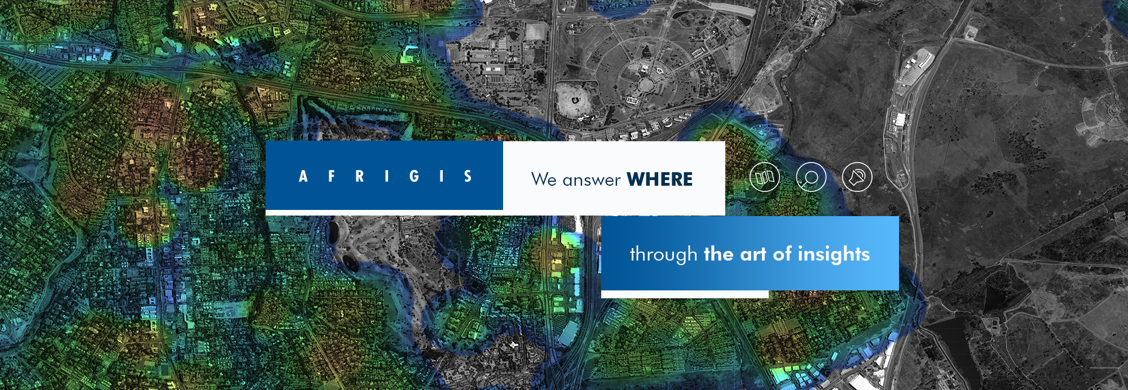
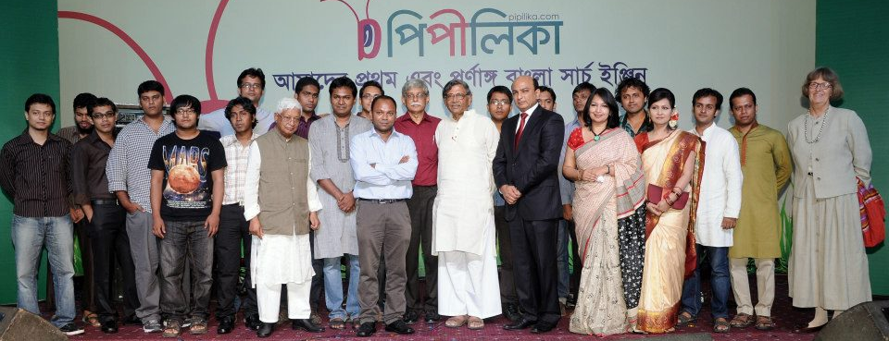
My Personal Journey Until Now
2007-2009
Team Lead of iSearch at AfriGIS
2009-2013
Faculty at Shahjalal University
2013
Launched Pipilika Search Engine from Bengali-IR Lab

Slide 4
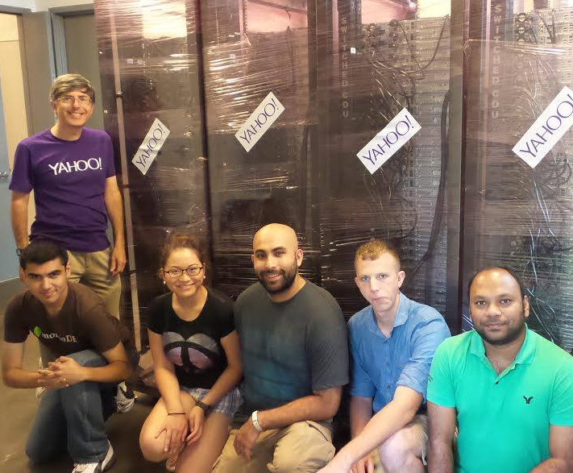
My Career in a Nutshell
2013-Now
PhD in Computer Science
2014 and 2015
Research Assistant Intern in Biological Data Science
2017 and 2018
Research Scientist Intern in AI

Slide 5
Graduate Research Fellow at IACS (2017-Now)
Leading two collaborative research projects in Big Data and Deep Learning.
Enabled high performance computing research in Social Science and Applied Math and Statistics department
My affiliation allows me to use: 164x28 Cores, 164x128 GB Ram and 8x8 GPUS
Notes:
Talk about IACS in the next slide
American association for the advancement of science

Slide 6
Research Contributions
Bioinformatics
Information Retrieval
Nano
BLASTer
Data Driven Approaches
Deep Learning
Big Data
N-gram
Model
SHMPrep
Spell
Check
Word
Embedding
Deep
Annotator
MiRANN
Keyword
Extraction
Crowd
sourcing
Computational Social Science
Information Security
Anomaly
Detection
User
Behavior
Modeling
Stereotypes
Biases
Biases
In AI
Gender
Association
CADENCE
Notes:
Add photos and animation

Slide 7
Research Impact
NanoBLASTer appears in Anaconda Cloud
SHMPrep is being used in three medical schools
DeepAnnotator will be launched as online service
Amazon SageMaker will include CADENCE
Pipilika search serves ~3,000 queries per day
Prime Minister’s
Award for Screen
Reading Software:
Mongol Dip

Slide 8
Outline of the Talk
My Personal Journey Until Now
Re-annotation of 16S rRNA 3’ Ends of Bacterial Organisms
DeepAnnotator: Algorithms for Genome Annotation with Deep Learning
Future Research Agenda

Slide 9
Genome Annotation
Protein Coding Sequence
Intergenic
Promoter
RBS
ATGATTACAGATTACAGATTAG
Intergenic
Transcription Start
Transcription Termination
Annotation: Labeling DNA sequence of an organism with its biological features
DNA Sequence
Notes:
Promoter sequences are DNA sequences that definewhere transcription of a gene by RNA polymerase begins. Promoter sequences are typically located directly upstream or at the 5' end of the transcription initiation site.
A ribosome binding site, or ribosomal binding site (RBS), is a sequence of nucleotides upstream of the start codon of an mRNA transcript that is responsible for the recruitment of a ribosome during the initiation of protein translation.

Slide 10
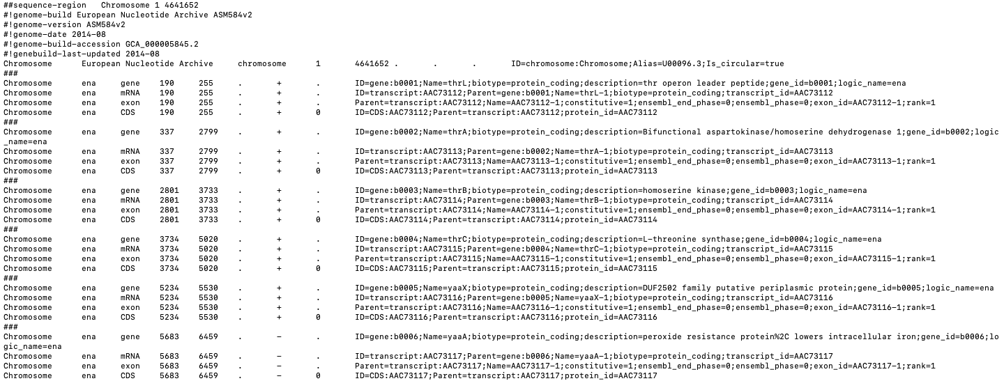
Genome Annotation
Labels
Start and End of Features
Genome Fragment
Details
Biological features are described in annotation file
Notes:
Genome Feature Format file describes annotation. Fragment range -> Labels. Essentially a classification problem.

Slide 11
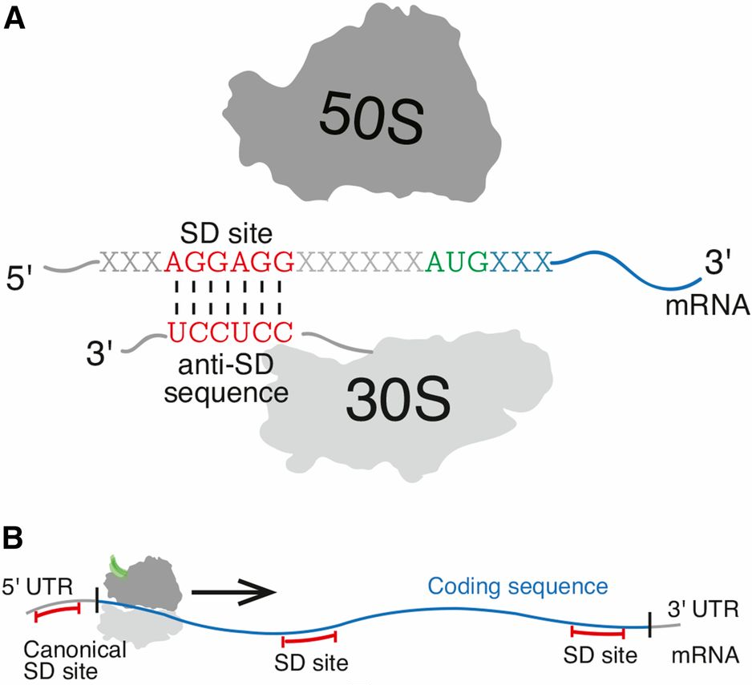
Translation Initiation in Bacteria
SD sequences in the 5′ UTR of mRNA are known to facilitate translation initiation in bacteria via binding to the anti-SD sequence on the 3′ tail of the 16S ribosomal RNA.
Source: https://www.ncbi.nlm.nih.gov/pubmed/27605518
Notes:
The last 24 nucleotides of helix 45 are in italics (yellow box), followed by the 13 nucleotide “tail” (underlined, red box). The anti-Shine-Dalgarno sequence CCTCCT is underlined and in bold. The terminal 3’ “A” residue is indicated with an asterisk. The 10 genomic nucleotides following the end of the tail are shown in lower case (blue box). The overall positioning of this region of the 16S rRNA is indicated (red line).

Slide 12
Sequence of E. coli 16S rRNA 3’-end
helix 45 (highly conserved)
16s tail (highly conserved)
Following 10 bases
Annotation End
Example of 16S rRNA annotation description in plain text
Notes:
Ribosomal ribonucleic acid (rRNA) is the RNA component of the ribosome, and is essential for protein synthesis in all living organisms. Look at the end part of it. Last 37 bases. We divide them in three section.
Sequence of 3’ 37 nucleotides of E. coli 16S rRNA gene and it’s Annotation
The last 24 nucleotides of helix 45 are in italics (yellow box), followed by the 13 nucleotide “tail” (underlined, red box). The anti-Shine-Dalgarno sequence CCTCCT is underlined and in bold. The terminal 3’ “A” residue is indicated with an asterisk. The 10 genomic nucleotides following the end of the tail are shown in lower case (blue box). The overall positioning of this region of the 16S rRNA is indicated (red line).

Slide 13
Problems With Current 16S rRNA Annotations
Bacteria Name | Helix 45 | 16S rRNA Tail | Following 10 Bases
Actinobacillus pleuropneumoniae serovar | TAACCGTAGGGGAACCTGCGGTTG | GATCACCTCCT | TACCAGAAAT
Aggregatibacter aphrophilus | TAACCGTAGGGGAACCTGCGGTTG | GATCACCT | CCTTACCGAA
Arsenophonus symbiont of Lipoptena fortisetosa | TAACCGTAGGGGAACCTGCGGTTG | GATCACCTCCTT | ACTTAAGTAT
Notes:
Just show the sequence 16S tail

Slide 14
Correcting Annotations Improve Motif Detection
Frequency of Bases
Frequency of Bases
Re-annotation of 12,495 prokaryotic 16S rRNA 3’ ends and analysis of Shine-Dalgarno and anti-Shine-Dalgarno sequences. Mohammad Ruhul Amin, Alisa Yurovsky, Yuping Chen, Steve Skiena, Bruce Futcher. PLOS One 2018.
Notes:
Correcting annotations improves motif detection and alignments. The 16S RNA tail alignment consensus from uncorrected NCBI annotations (top) comes into focus only after our homology-based 3′-end correction (bottom)
The fact that some organisms do not seem to have or use Shine-Dalgarno motifs supports the idea that prokaryotes have other robust mechanisms for recognizing start codons for translation.

Slide 15
Summary of Re-annotations.
Re-annotation increases the number of known anti-Shine-Dalgarno sequences from 8069 to 20,495
Is Shine-Dalgarno mechanism the only way for protein synthesis initiation?

Slide 16
Application of Tompa Algorithms to Find Shine-Dalgarno Motifs in front of ORF
Tompa finds short motifs that only occur in a fraction of the input sequences with greatest z-scores.
Tompa identifies mRNA 5’ untranslated sequence that is recognized by the ribosome during initiation of protein synthesis.
We chose 222 examples from diverse phyla for organisms that had a 13 base tail containing CCUCCU in their 16S rRNA. Therefore we used the approach of Tompa to ask what sequences are enriched in front of open reading frames of various example prokaryotes.
Notes:
https://homes.cs.washington.edu/~tompa/papers/rbs.pdf

Slide 17
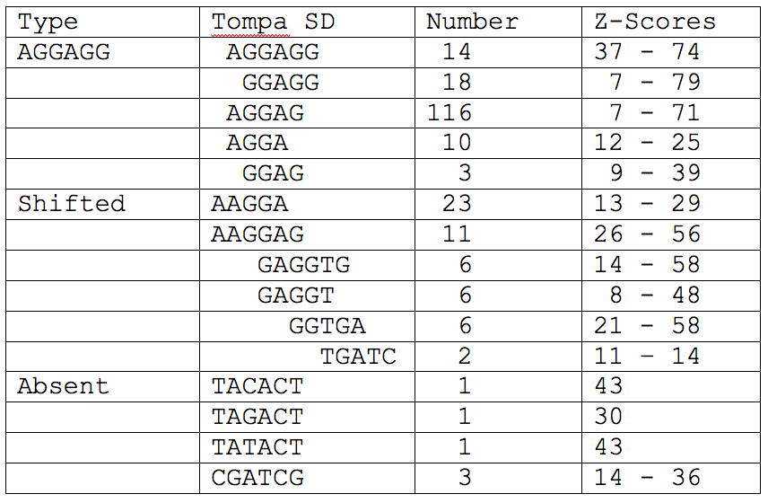
For CCTCCT AntiSDs, Examples of Shine-Dalgarno Motifs in 222 Prokaryotes
Notes:
Tompa is looking for the motif in front of an ORF, and computes the significance of the motif based on all the

Slide 18
Presence of Tompa Shine-Dalgarno as Function of AntiSD
The general impression from these 128 organisms is when the classic and exact CCUCCU antiSD is not present in the 13 base tail, then an SD sequence is not present in front of the open reading frames.
Notes:
This proves that SD mechanism is not the only method for the ribosome to star potien synthesis initiation
There is alternative mechanism independent of targeting SD sequences to initiate protein translation

Slide 19
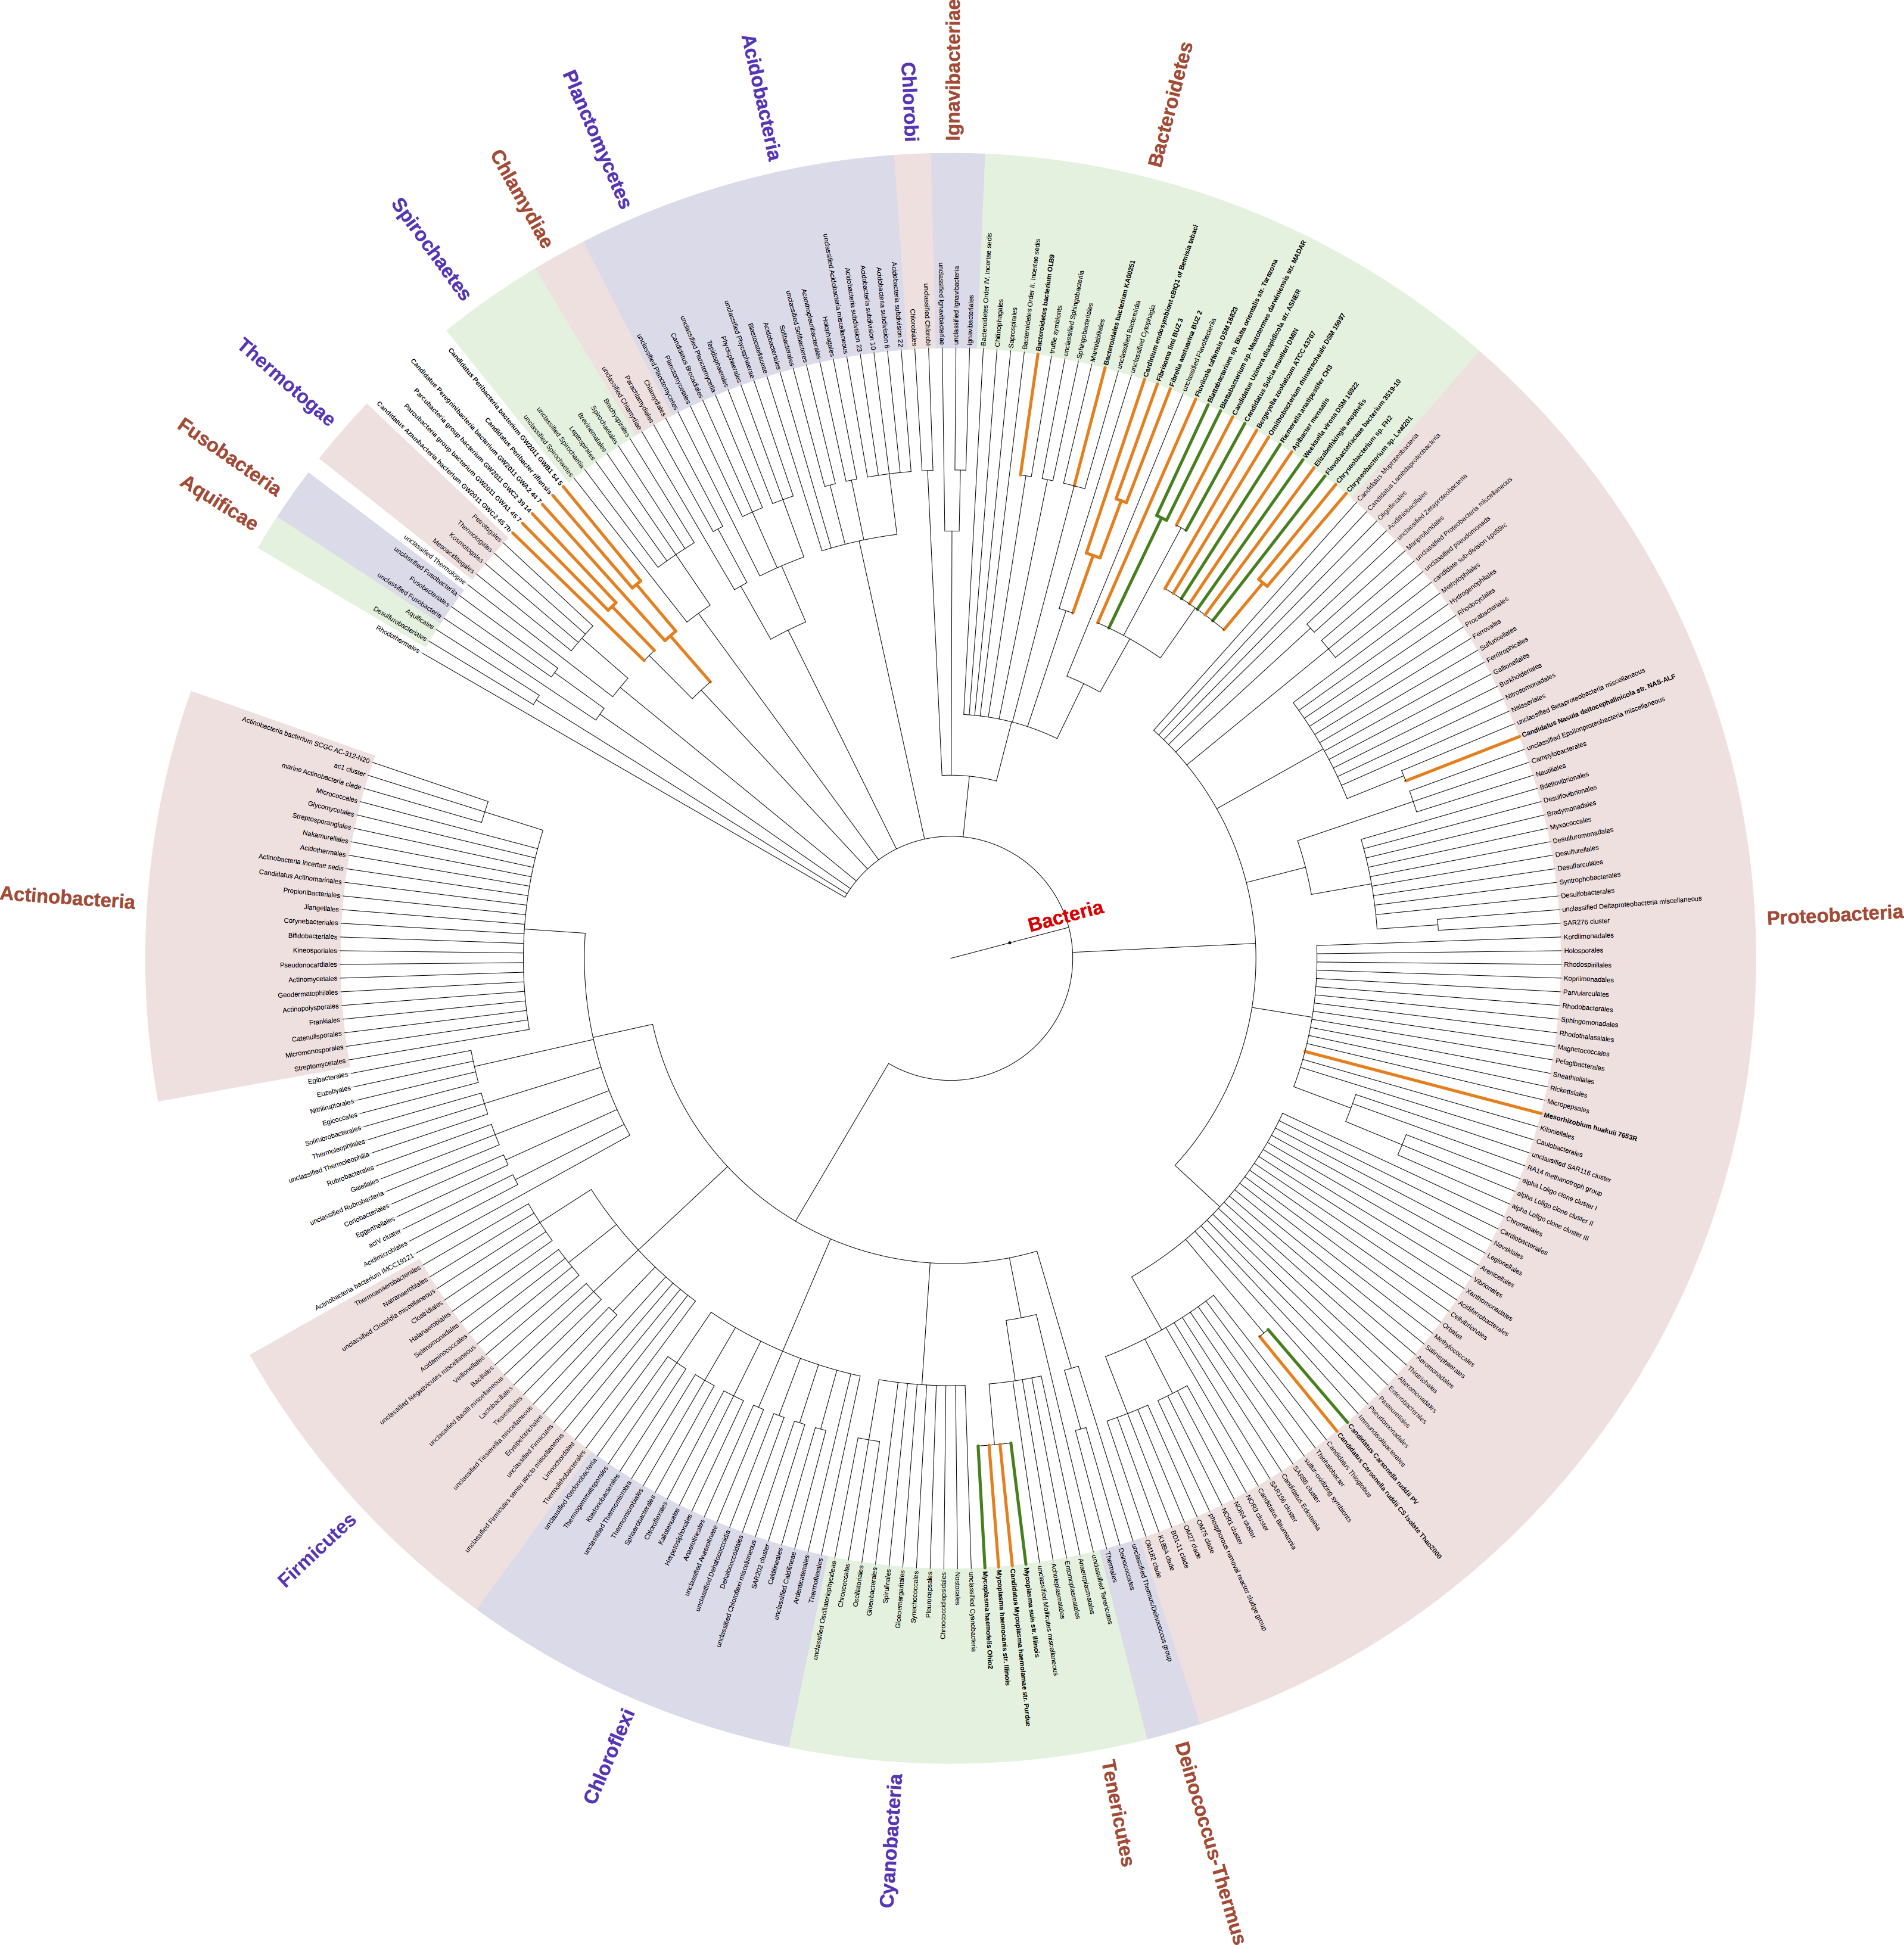
Summary of Re-annotation
Phylogenetic tree showing the Distribution of the 128 Species that lack a CCUCCU AntiSD in their 13 Base Tails
Prokaryotic coding regions have little if any specific depletion of Shine-Dalgarno motifs. Alisa Yurovsky, Mohammad Ruhul Amin, Yuping Chen, Steve Skiena, Bruce Futcher. PLOS One 2018.
Notes:
Phylogenetic tree (low resolution) showing the distribution of the 128 species that lack a CCUCCU antiSD in their 13 b tails. Green lines indicate the phylogenetic positions of the 15 species previously identified by Lim et al. (2012) (and also identified here); orange lines show the other 113 species uniquely identified here. Because of the low resolution of this tree, individual species are not visible (i.e., there are fewer than 128 colored lines).
In the evolutionary process, the SDs are getting lost in multiple sub tree of Bactria ToL

Slide 20
Outline of the Talk
My Personal Journey Until Now
Re-annotation of 16S rRNA 3’ Ends of Bacterial Organisms
DeepAnnotator: Algorithms for Genome Annotation with Deep Learning
Future Research Agenda

Slide 21
Research Contributions
K-mer embeddings for prokaryotic sequence
Deep neural network model for label prediction
Scoring algorithm for genome annotation
Notes:
Use 3 pics to show these three things.

Slide 22
K-mer Embeddings
K-mer refers to all the possible substrings of length K from a string.
Co-occurrence Matrix
Low Dimension Vector Space (d=2)
 | GAT | ATT | TTA | TAC | ACA
GAT | 0 | 1 | 1 | 0 | 0
ATT | 1 | 0 | 1 | 1 | 0
TTA | 1 | 1 | 0 | 1 | 1
TAC | 0 | 1 | 1 | 0 | 1
ACA | 0 | 0 | 1 | 1 | 0
G A T T A C A
GAT
ATT
G A T
TTA
TAC
A T T
T T A
ACA
T A C
A C A
3-mers are referred as codons
Learning representation is learning a mapping -- $φ:V→ℛ^{d}$
Notes:
May be connect by arrows from GAT to others

Slide 23
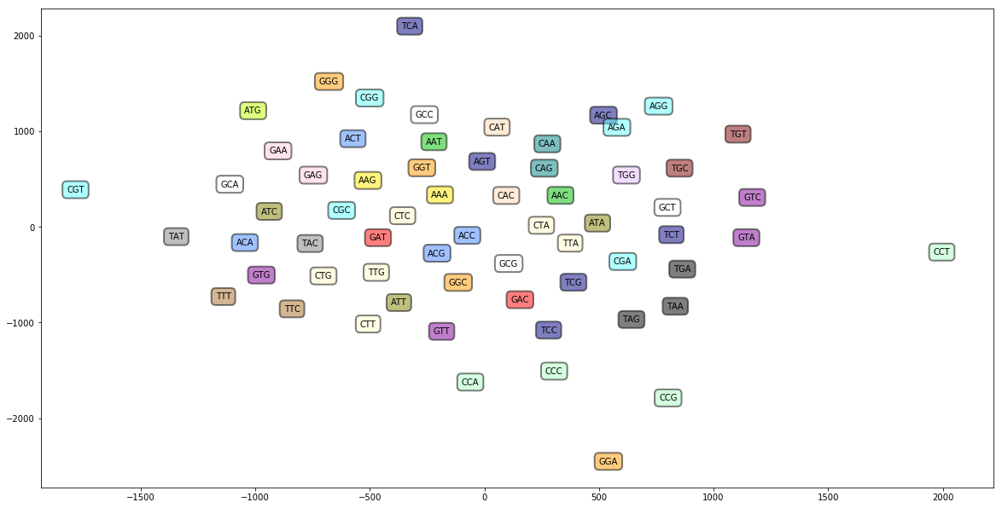
K-mer Embeddings
Colors ~ Classes (20)
Start Codons: ATG, GTG, TTG, CTG, ATT, ATC
Stop Codons:
TAG, TAA, TGA
K-mer embeddings of codons (3-mers) as visualized in 2D space
Notes:
Of the 20 amino acids in your body's proteins, nine are essential to your diet because your cells cannot manufacture them: histidine, isoleucine, leucine, lysine, methionine, phenylalanine, threonine, tryptophan and valine.

Slide 24
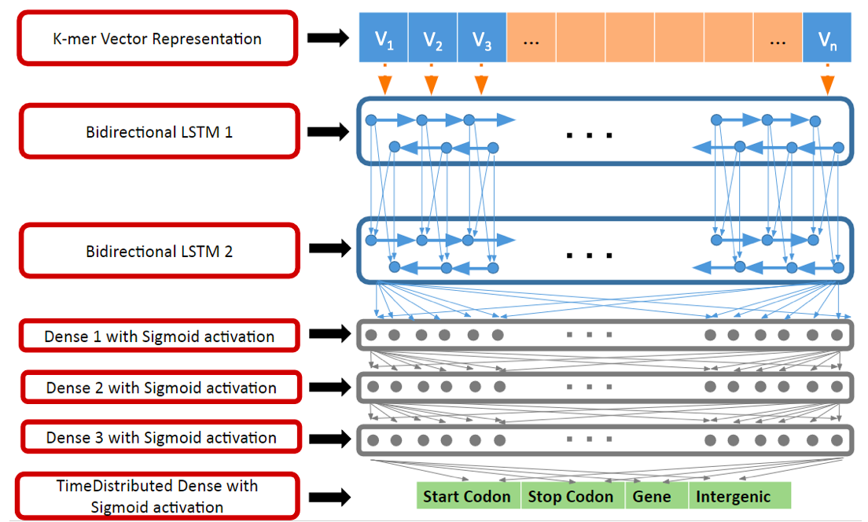
Deep Learning Model for Genome Annotation
Deep Neural Network Architecture

Slide 25
End-to-End Genome Annotation
Output Cell
LSTM Cell
Input Cell
Score each ORF using the model predictions
Intergenic
Gene
Intergenic
Filter wrong genes and print annotations in GFF format
Training the model for contiguous sequence of whole genome

Slide 26
Training/Testing Accuracy for End-to-End Genome Annotation Model
Training Accuracy as a Function of K-mer
Testing Accuracy as a Function of K-mer
Accuracy (%)
Accuracy (%)
Epoch
Epoch

Slide 27
Evaluation of End-to-End Genome Annotation using Deep Networks

Slide 28
Workflow of DeepAnnotator Algorithms
Train 3 models:
- Classify start codon
- Classify stop codon
- Classify protein coding nucleotides
Model-3 predicts if a nucleotide belongs to protein coding sequence
Scoring algorithm for genome annotation
Intergenic
Promoter
RBS
Start
Protein Coding Sequence
Stop
Intergenic
Model-1 Identifies Start of gene
Model-2 Identifies Stop of gene
Notes:
Change the gene sequence with the previous one
Missing the scale of the dataset

Slide 29
Training Dataset for Whole Genome Annotation
Positive Dataset:
Cut 101 bases around each coding sequence base within gene to train ${Deep}_{CD}$
Intergenic
Promoter
RBS
Start
After Start
Protein Coding Sequence
Before Stop
Stop
After Stop
Intergenic
Cut 101 bases around each start codon for training ${Deep}_{start}$
Cut 101 bases around each stop codon for training ${Deep}_{stop}$
DNA Sequence
Notes:
Change the gene sequence with the previous one
Missing the scale of the dataset

Slide 30
Training Deep Learning Model
Training and Testing Accuracy of ${Deep}_{start}$, ${Deep}_{stop}$, and ${Deep}_{CD}$
Notes:
3 models have > 90% accuracy which is very striking. So the network must have learned the representation of protein synthesis sequences.
Create table

Slide 31
DeepAnnotator Scoring Scheme
Model-3 predicts if a nucleotide within an ORF belongs to protein coding sequence
Score each ORF using the model predictions
Intergenic
Start
Sequence of Codons
Stop
Intergenic
Filter wrong genes and print annotations
Model-1 Identifies Start of gene
Model-2 Identifies Stop of gene
An Open Reading Frame (ORF) is any sequence of codons start with start codon and ends with stop codon. Some ORFS are gene.
Notes:
geometric mean is a mean or average, which indicates the central tendency or typical value of a set of numbers by using the product of their values (as opposed to the arithmetic mean which uses their sum). The geometric mean is defined as the nth root of the product of n numbers
Log(start) + log(end) + 1/n sum( log(cds) )

Slide 32
ORF Score of Gene
Score of an ORF
ORF Coverage

Slide 33
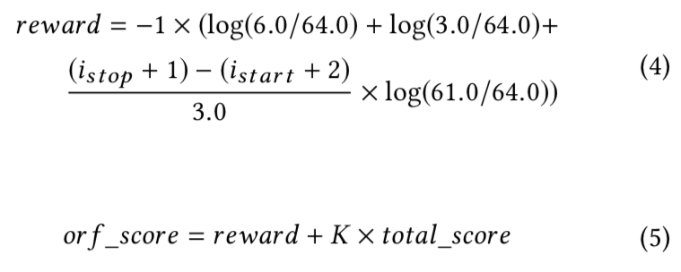
ORF Score of Gene
(a) Cumulative Count of ORF and Gene from Reverse Direction
Total Log Score of an ORF to be gene
10⁸
ORF
Gene
Count in Log
10⁴
10⁰
ORF Score
Sequence Length in Log
(b) Ratio of ORF to Gene Count
Ratio in Log
Sequence Length in Log

Slide 34
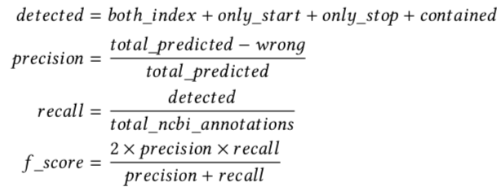
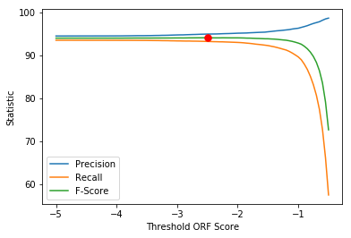
Tuning DeepAnnotator Threshold
(a) Precision, Recall and F-Score at different Threshold
Statistic (%)
Threshold ORF Score in Log

Slide 35
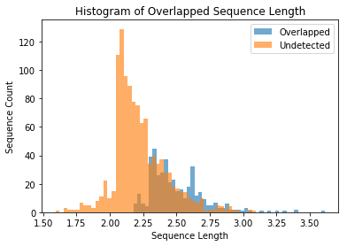
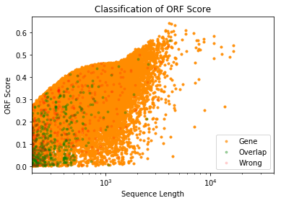
DeepAnnotator Annotation Quality
(b) Histogram of Overlap and Undetected Sequence Length
(c) Visualization of Predicted Annotations based on Score
Sequence Count
Probability
Sequence Length in Log
Sequence Length in Log

Slide 36
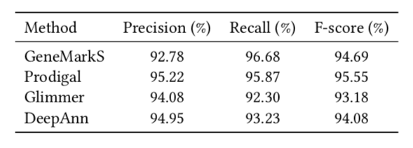
DeepAnnotator VS Popular Annotation Algorithms
DeepAnnotator: Genome Annotation with Deep Learning. Mohammad Ruhul Amin, Alisa Yurovsky, Yingtao Tian, Steve Skiena. ACM BCB 2018.
Notes:
It does not any prior biological knowledge as other hmm based tools do, still achieve comparable performance.
Equivalent time complexity.
Create table

Slide 37
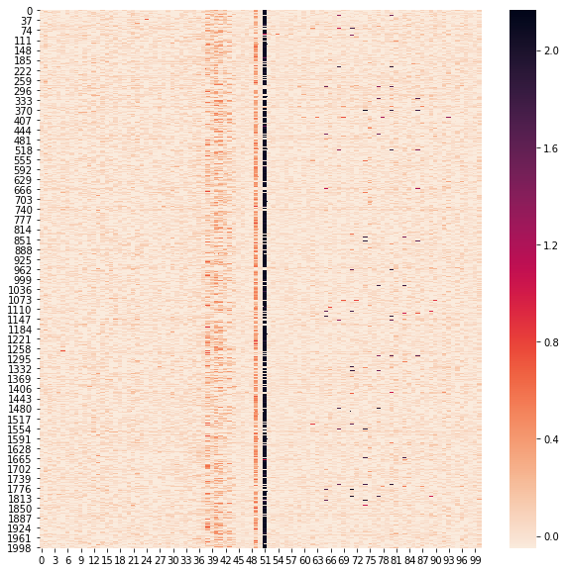
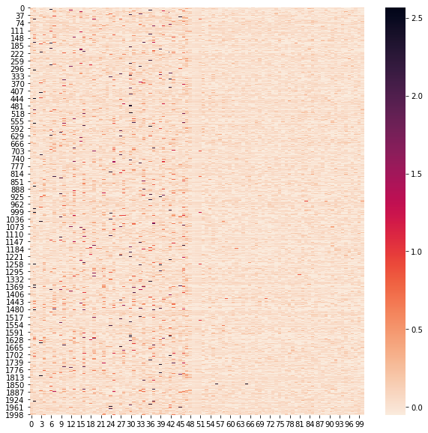
Deep Learning for Genomics
Intergenic
Promoter
RBS
Start
After Start
Protein Coding Sequence
Before Stop
Stop
After Stop
Intergenic
$$w_{promoter}$$
$$w_{RBS}$$
$$w_{start}$$
$$w_{stop}$$
Notes:
Semantics derived automatically from language corpora contain human-like biases
Link: http://science.sciencemag.org/content/356/6334/183
We used the Implicit Association Test (IAT) as our primary source of documented human biases (5). The IAT demonstrates enormous differences in response times when subjects are asked to pair two concepts they find similar, in contrast to two concepts they find different.

Slide 38
Outline of the Talk
Who Am I? – My Personal Journey Until Now
Re-annotation of 16S rRNA 3’ Ends of Bacterial Organisms
DeepAnnotator: Algorithms for Genome Annotation with Deep Learning
Future Research Agenda

Slide 39
Deep Learning for Genomics
Observations:
We are sequencing billions of nucleotides (biological data) every day
Understanding these data and discovering features are beyond human capability
Deep learning shows promises to discover biological features from sequences
By product
Codon Embeddings
Notes:
Semantics derived automatically from language corpora contain human-like biases
Link: http://science.sciencemag.org/content/356/6334/183
We used the Implicit Association Test (IAT) as our primary source of documented human biases (5). The IAT demonstrates enormous differences in response times when subjects are asked to pair two concepts they find similar, in contrast to two concepts they find different.

Slide 40
Deep Learning for Genomics
Challenges:
Deep learning model should be able to handle high cardinality heterogenous features
The model should capture the underlying mechanism of biological significance
The model should be interpretable in terms of its learned representations
We should be able to reuse a trained model weights in a second related task
Intergenic
Promoter
RBS
Start
After Start
Protein Coding Sequence
Before Stop
Stop
After Stop
Intergenic
$$w_{promoter}$$
$$w_{RBS}$$
$$w_{start}$$
$$w_{stop}$$
As we train deep network to predict the probability of a gene, we learn the weights of genomic features that help model for accurate prediction
Notes:
Semantics derived automatically from language corpora contain human-like biases
Link: http://science.sciencemag.org/content/356/6334/183
We used the Implicit Association Test (IAT) as our primary source of documented human biases (5). The IAT demonstrates enormous differences in response times when subjects are asked to pair two concepts they find similar, in contrast to two concepts they find different.

Slide 41
Deep Learning for Genomics
Proposed Research 1:
Learning K-mer embeddings for DNA Sequences, Peptides and Proteins
Learning phylogeny based species embeddings from Tree of Life (2.3 Million species)
Proposed Research 2:
Create interpretable deep neural network for genome annotations, antibody sequence annotations and protein-protein interaction prediction
Interpreting individual weights of the deep neural network to discover novel sequences as biological features
Notes:
When peptides form a long chain of amino acids, they become proteins. When they are in a short chain of amino acids, they are able to penetrate the top layer of our skin and send signals to our cells to let them know how to function. One important protein in our skin is collagen.
Protein: any of a class of nitrogenous organic compounds that consist of large molecules composed of one or more long chains of amino acids and are an essential part of all living organisms, especially as structural components of body tissues such as muscle, hair, collagen, etc., and as enzymes and antibodies.

Slide 42
Deep Learning for Genomics
Proposed Research 3:
Predict functional dependency of genomic features using deep learning model
Transfer learning in bioinformatics: create a deep network for interpreting genome sequence that can be reused in a different but related problem
Funding Source:
NSF : Infrastructure Innovation for Biological Research Program in the Division of Biological Infrastructure
NIH: Research Grant, Career Development Award
Notes:
Functional dependency is a relationship that exists when one attribute uniquely determines another attribute. If R is a relation with attributes X and Y, a functional dependency between the attributes is represented as X->Y, which specifies Y isfunctionally dependent on X.

Slide 43
Nano
BLASTer
Word
Embedding
N-gram
Model
Spell
Check
SHMPrep
MiRANN
Deep
Annotator
Biases in AI
Keyword
Extraction
Anomaly
Detection
Crowd
sourcing
User
Behavior
Modeling
Stereotypes Bias
Gender
Association
CADENCE
Data Driven Approach
Big Data
Deep Learning
Thank You
Notes:
Add photos and animation

