Slide 1

Vulnerabilities in Federated Learning Networks
Prasant Mohapatra
Department of Computer Science
University of California, Davis

Slide 2
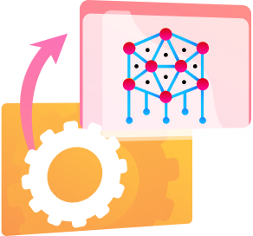
Traditional Perspective of
Machine Learning
Collect Data
Training
Serve Clients Requests

Slide 3
Deep Learning
Computationally expensive – Needs special hardware.
Issues of Privacy – Users are required to give consent to access their private data for training a model.
Needs lots of data to build a good model – Puts smaller startups at disadvantage / Market monopolization.
Centrally trained – Gathering training data is costly / Risks and responsibilities associated with data storage.
Security aspects – Large flows of data creates more vulnerabilities

Slide 4
Federated Learning

Slide 5
Federated Learning
  Federated Learning enables distributed devices to collaboratively learn a shared prediction model while keeping all their training data on device.
1
Decentralized learning
2
Privacy by default
3
Collaborative learning

Slide 6
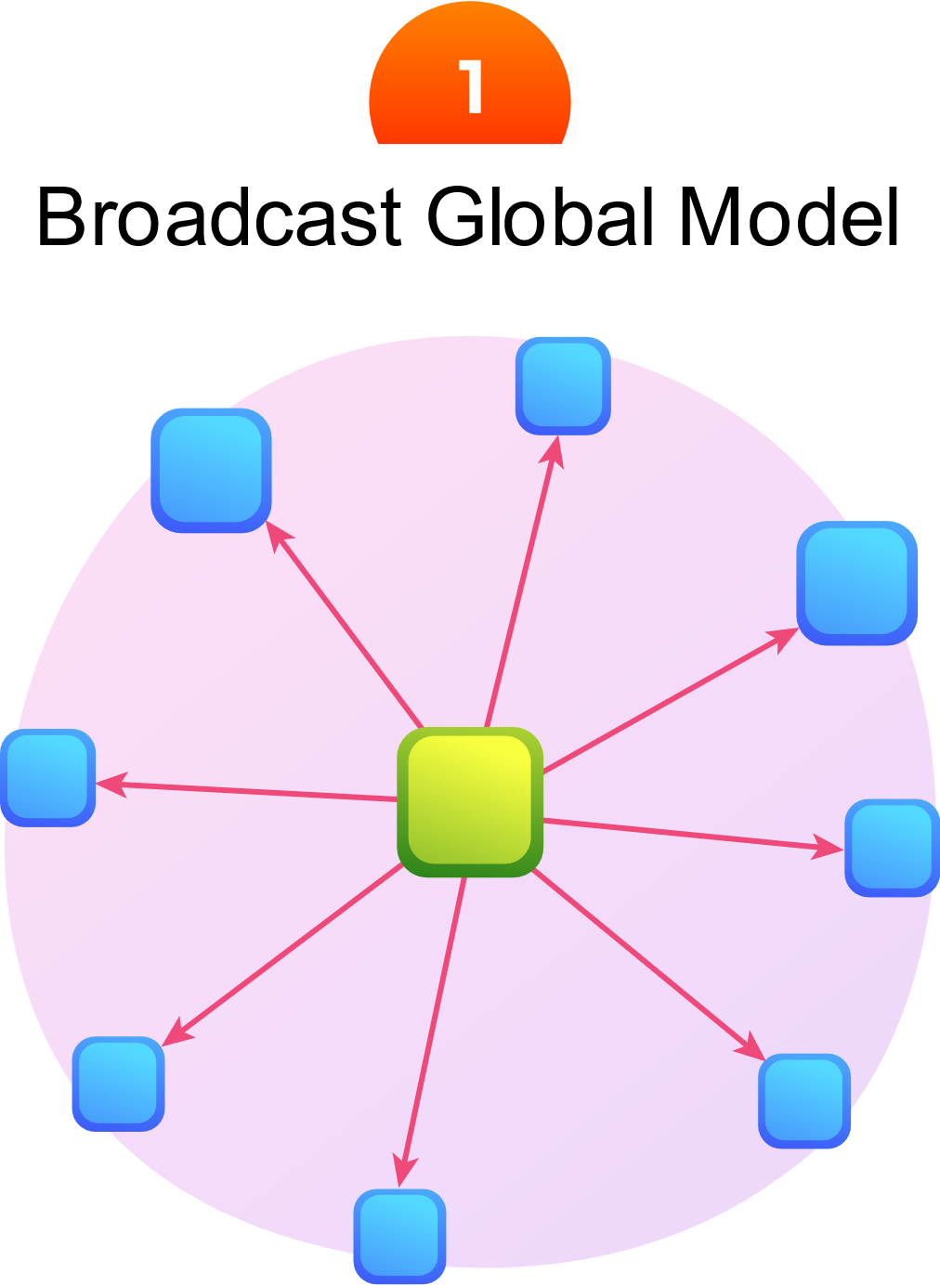
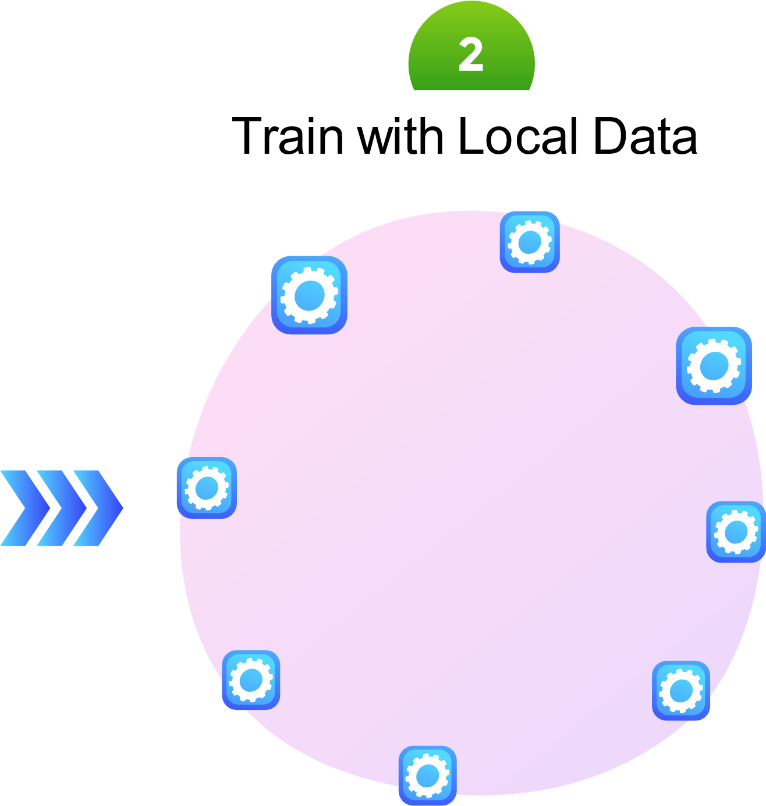
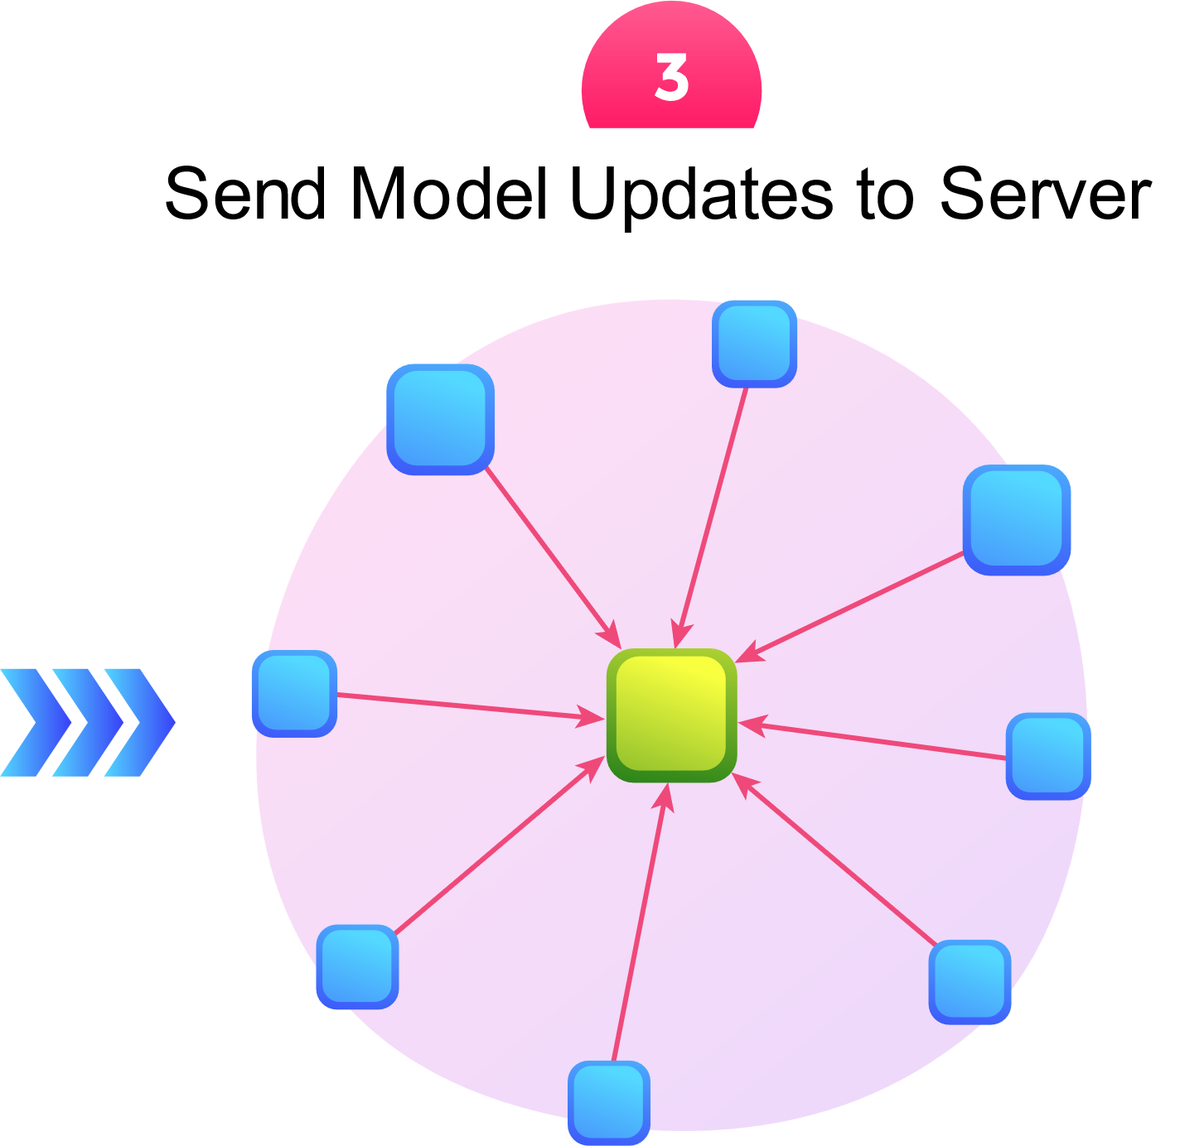
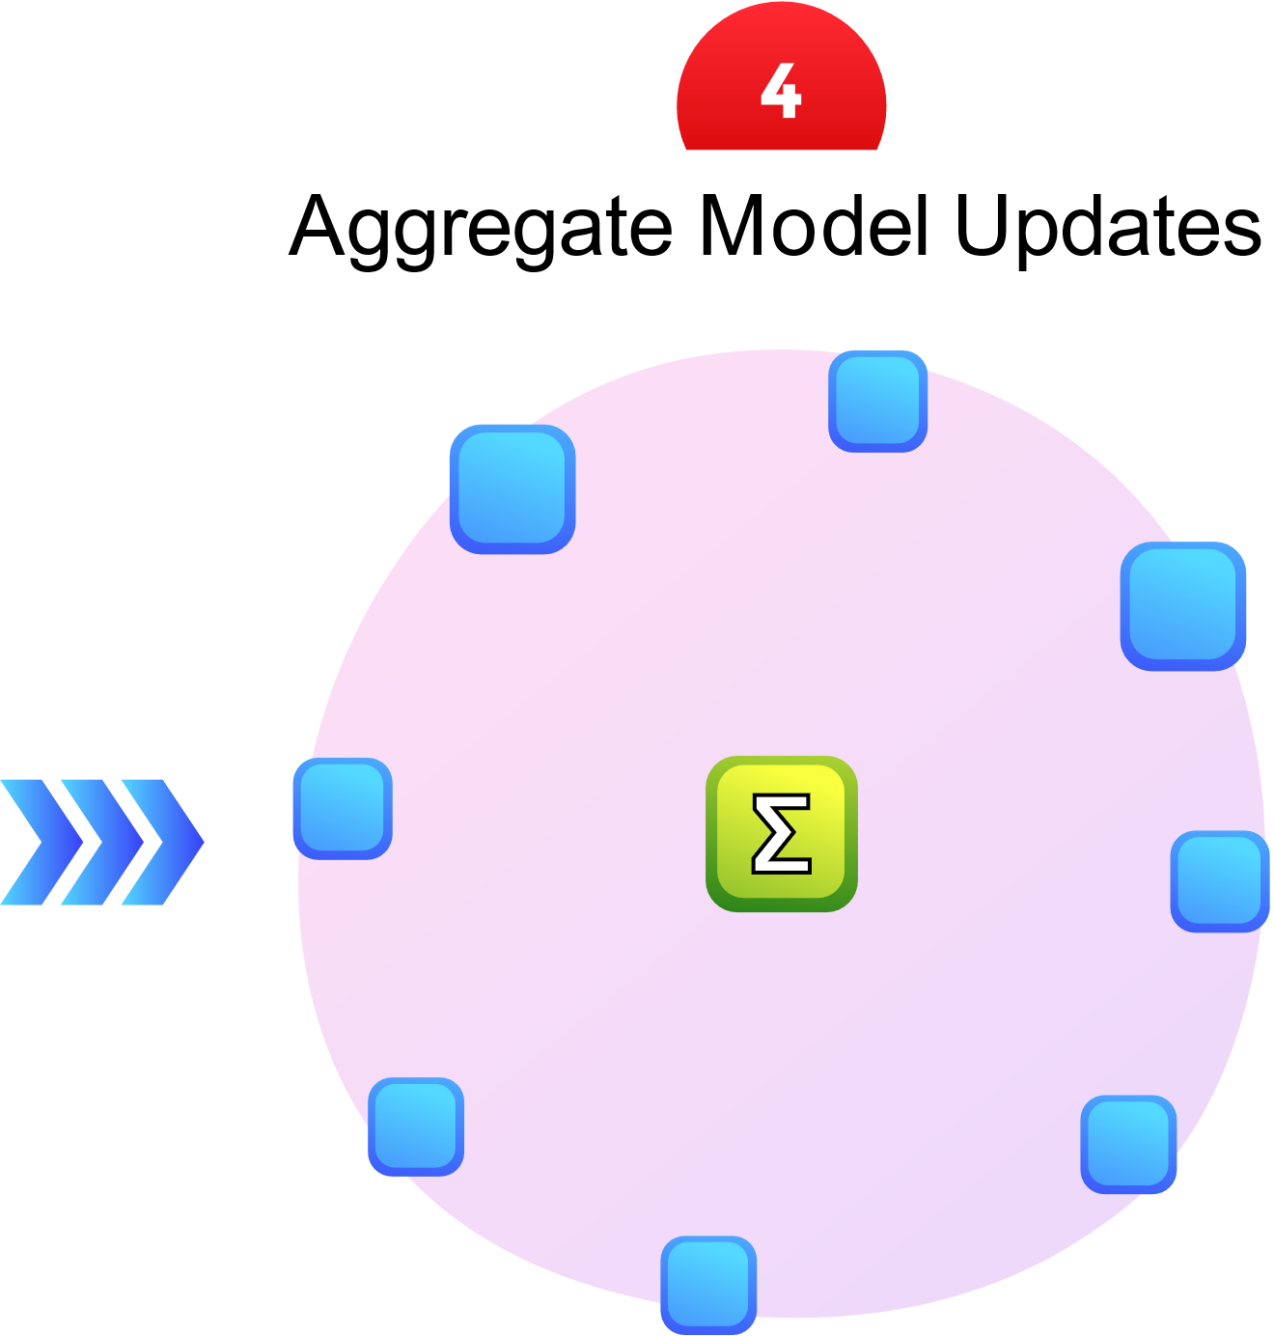
New Paradigm

Slide 7

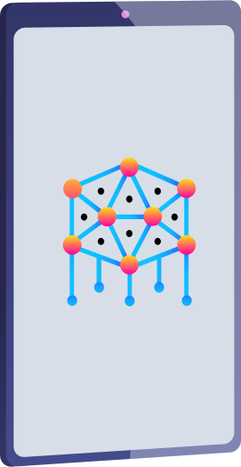
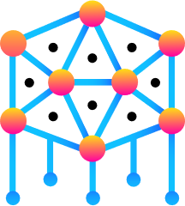

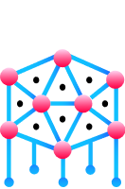
Architecture of Federated Learning
Prediction
Local Model
Aggregation
Global Model
Server
Model Deployment

Slide 8
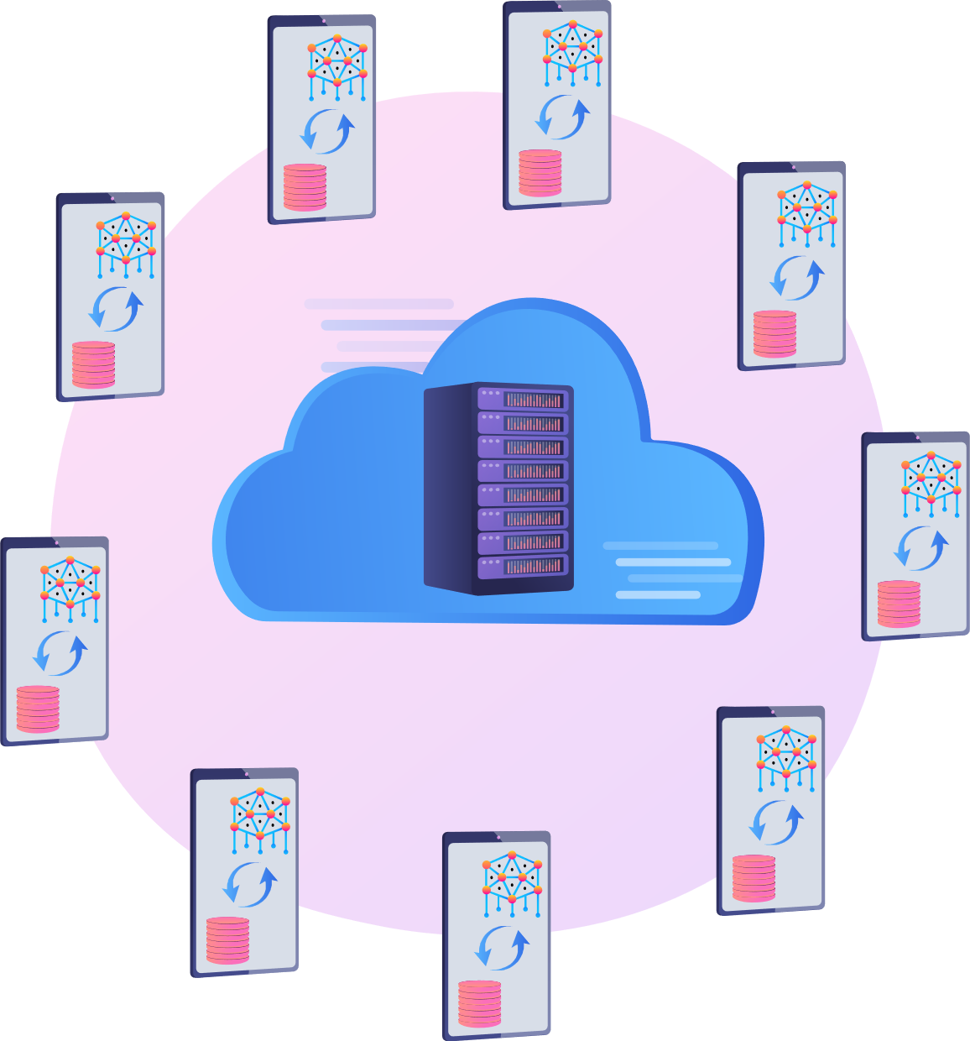

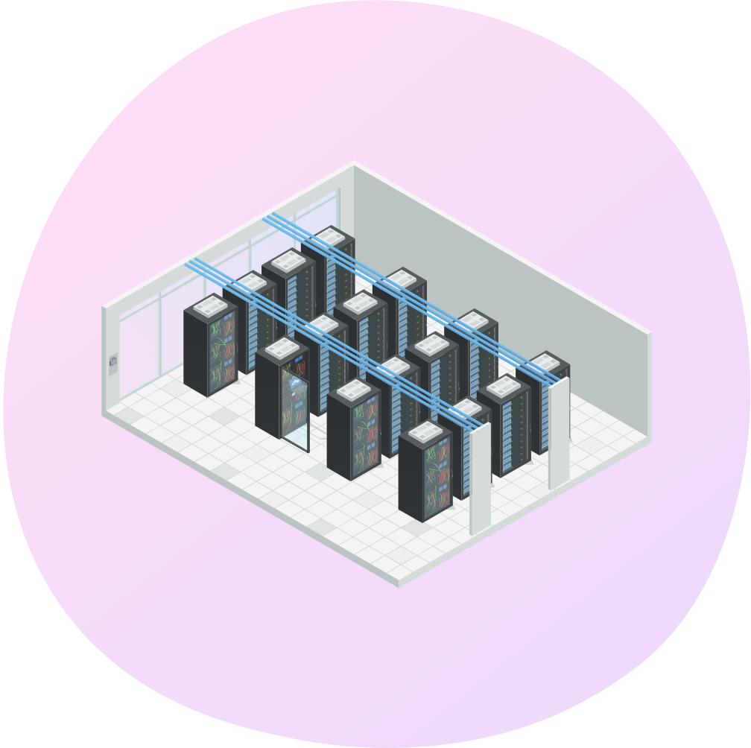
Characteristics of Federated Learning
Cross-device FL
Cross-silo FL
Distributed Learning

Slide 9
Threat Model under Federated Learning

Slide 10
Capabilities of Adversaries
Adversaries | Capabilities
Clients | Can observe the global model. Can send malicious model updates. Can corrupt the data or the local training procedure.
Server | Can examine all model updates of the clients. Has the ability to inspect and alter the parameters of the global model directly. Can temper with the aggregation algorithm and control the view of the participants.
Outsiders | Can intercept communications between the server and the clients. Can carry out inference-time attacks.

Slide 11

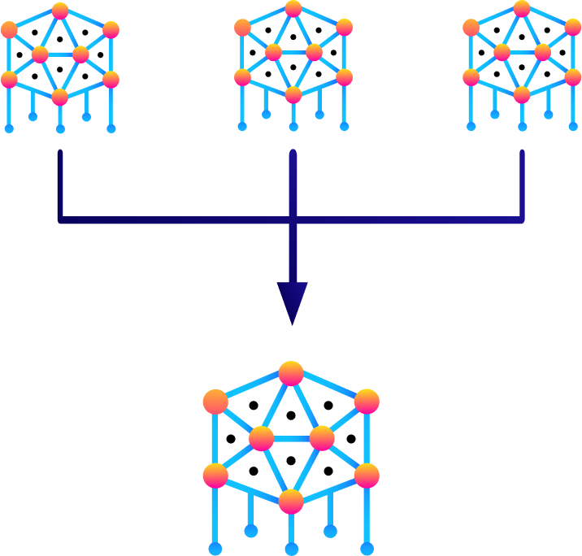
Threat Model
Prediction
Global Model
Aggregation
Model
Update
Clients
Cloud Server
Sever
Outsiders
Model Training
Model Deployment

Slide 12
Vulnerabilities in Federated Learning

Slide 13
Vulnerabilities in Federated Learning
Conventional Deep Learning
Federated Learning
⚡ Source of data are identified and can be inspected.
⚡ Limited to a static attack wherein the poisoned data is supplied before the training begins.
⚡ Training process is centralized and transparent to the engineering team.
⚠Clients are anonymized and often selected randomly.
⚠No way to detect malicious ones by relying solely on their security guarantees.
⚠Adversaries will try to deviate from FL protocol by corrupting or replacing messages.
⚠A malicious client continuously participates in FL and can launch an attack throughout the training process.
Notes:
The problem with non-IID environments is that the average loss function is calculated over different clients from one round to another. So, comparing two average losses from two different training rounds is not reliable because the global model can get biased and does perform the same with regards to all local datasets in the clients.

Slide 14

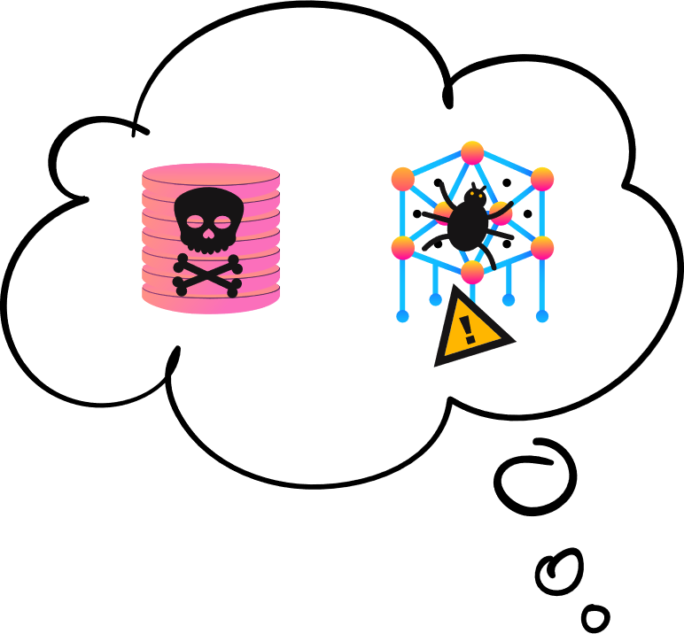



Vulnerabilities in Federated Learning Overview
Model Evasion
Gradient Leakage
Eavesdroppers
Aggregation
Compromised Client
Compromised Server
Client drops out
Model Training
Model Deployment

Slide 15

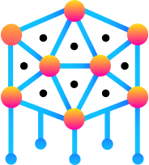
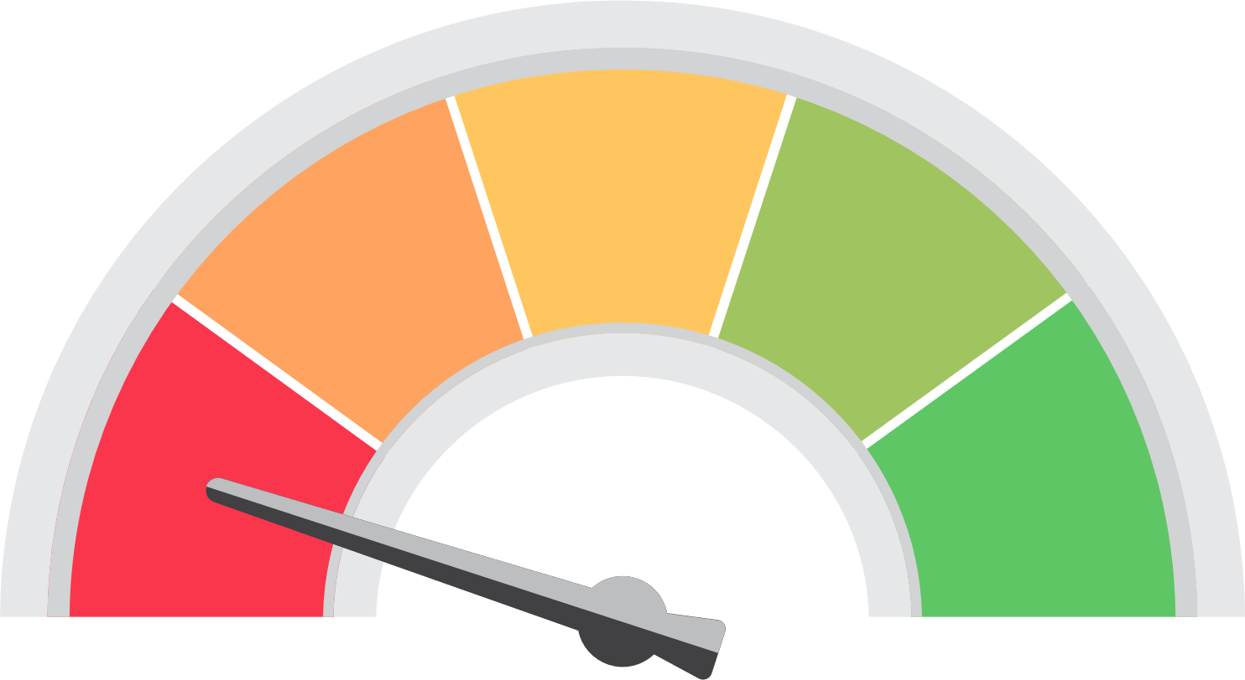
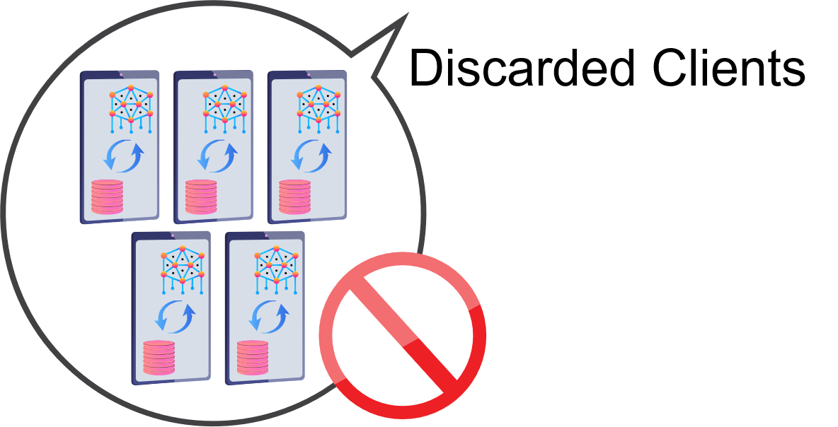

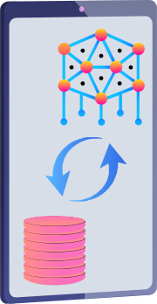


Other Vulnerabilities: Communication
Server
Noisy Update
Compression

Slide 16

Other Vulnerabilities: Distributed Nature of FL
+
+
=
Server
Colluding clients

Slide 17
Attacks in Federated Learning

Slide 18
Attacks in Federated Learning
Attacks in Federated Learning
Attacks Focused on Data
Attacks Focused on Algorithms
Attacks Focused on Federation
Poisoning Attacks
Non-Robust Aggregation
Inference Attacks
Backdoor Attacks
Training Rules Manipulation
GAN Reconstruction Attacks
Evasion Attacks
Compromised Distributed Computation
Malicious Server
Free-Riding Attacks
Man-in-the-Middle Attacks

Slide 19
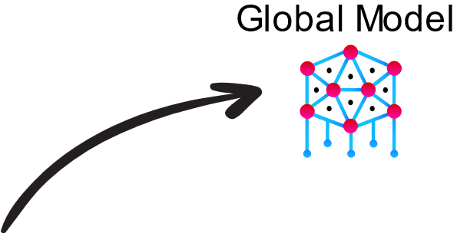
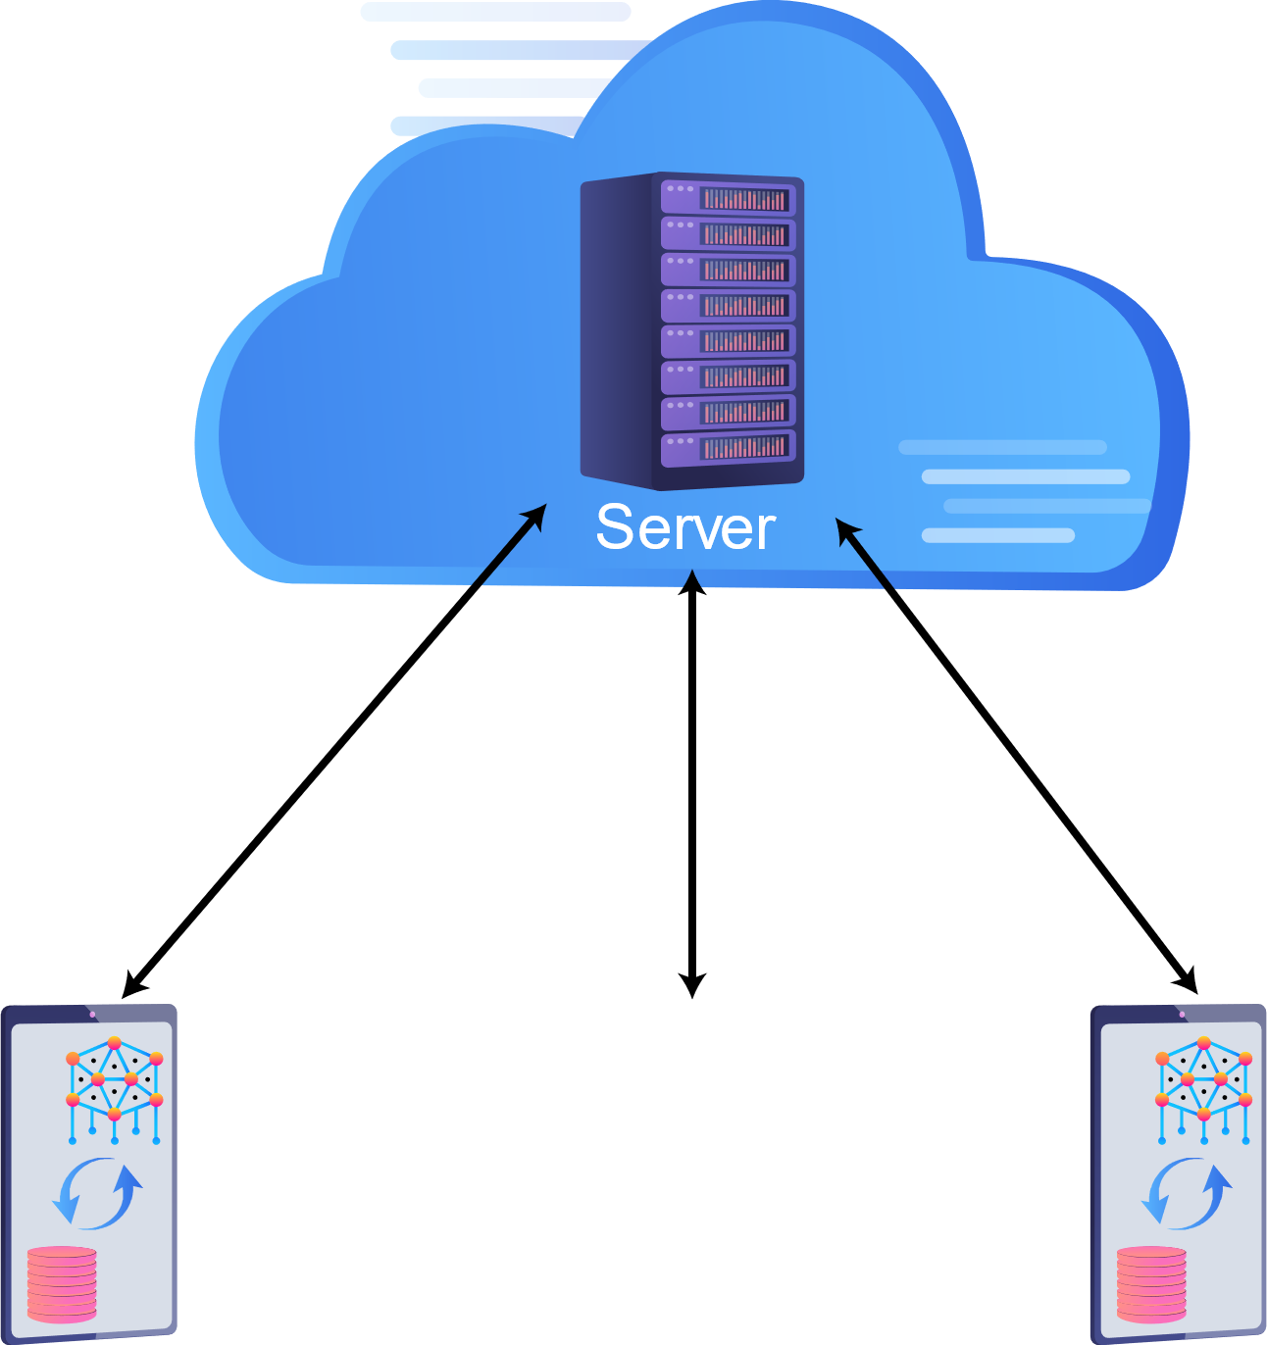
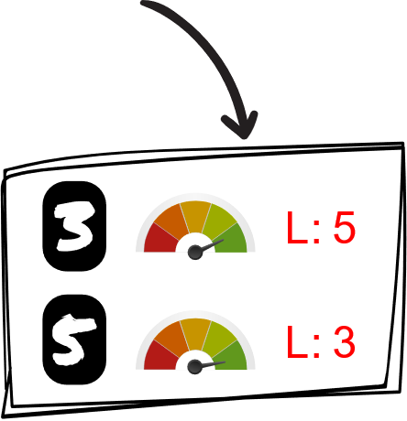

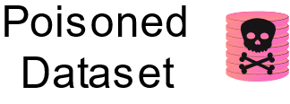
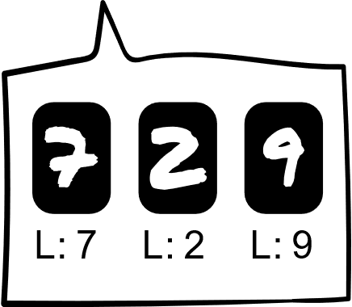
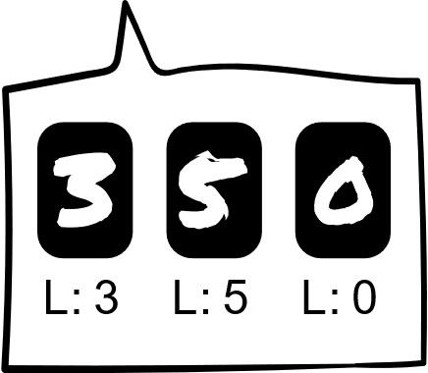
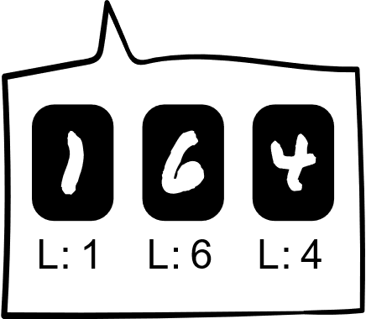
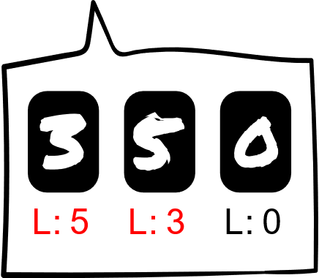
Data Poisoning Attack
Manipulate client data by flipping labels or modifying specific features of the data.
Sources:
Compromised Clients
Flipping Labels

Slide 20
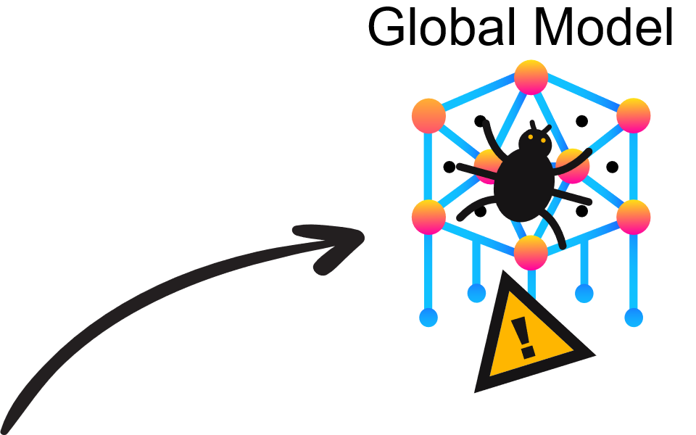
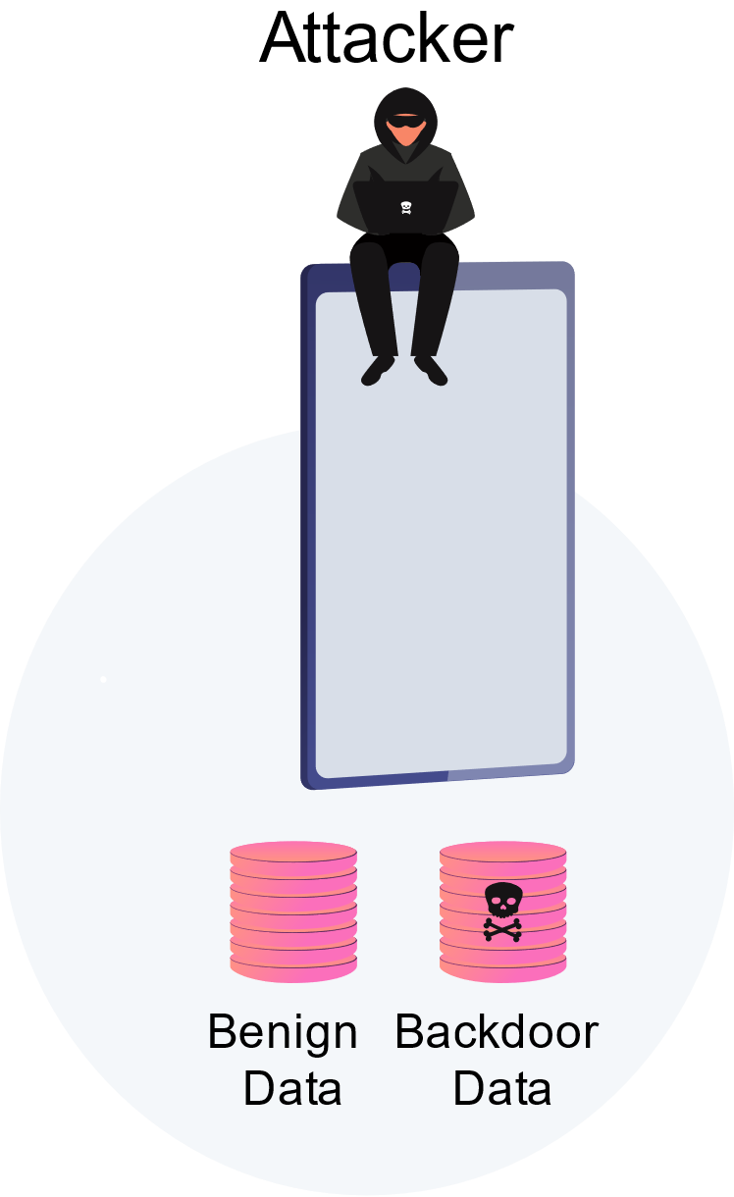
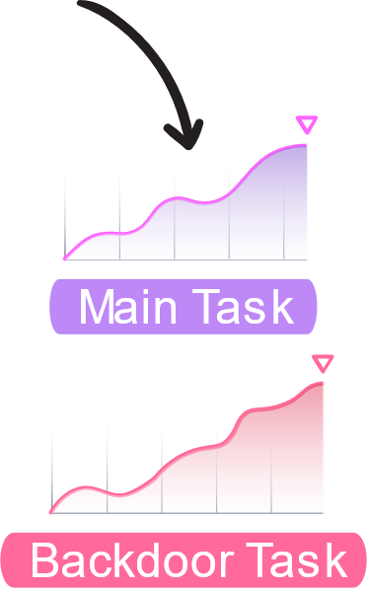
Backdoor Attack
Insert hidden backdoors into the global model while retaining the accuracy of the main task.
Sources:
Compromised Clients
Server
Training
Backdoored Model

Slide 21
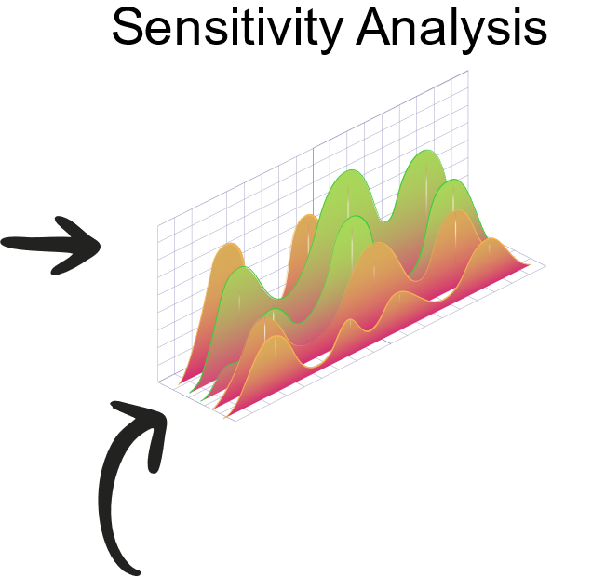
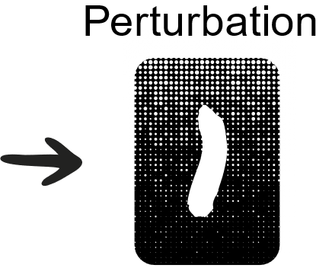
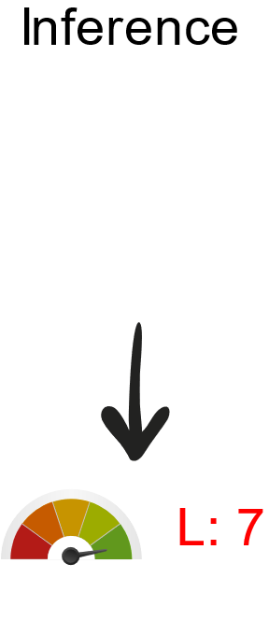
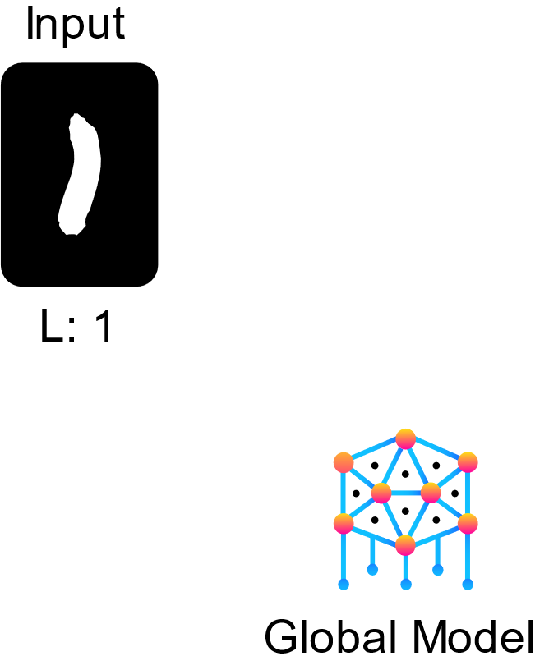
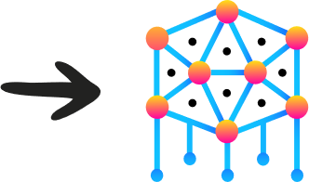
Evasion Attack
Circumvent a deployed model by carefully manipulating the data samples fed into it.
Sources:
Compromised Clients

Slide 22
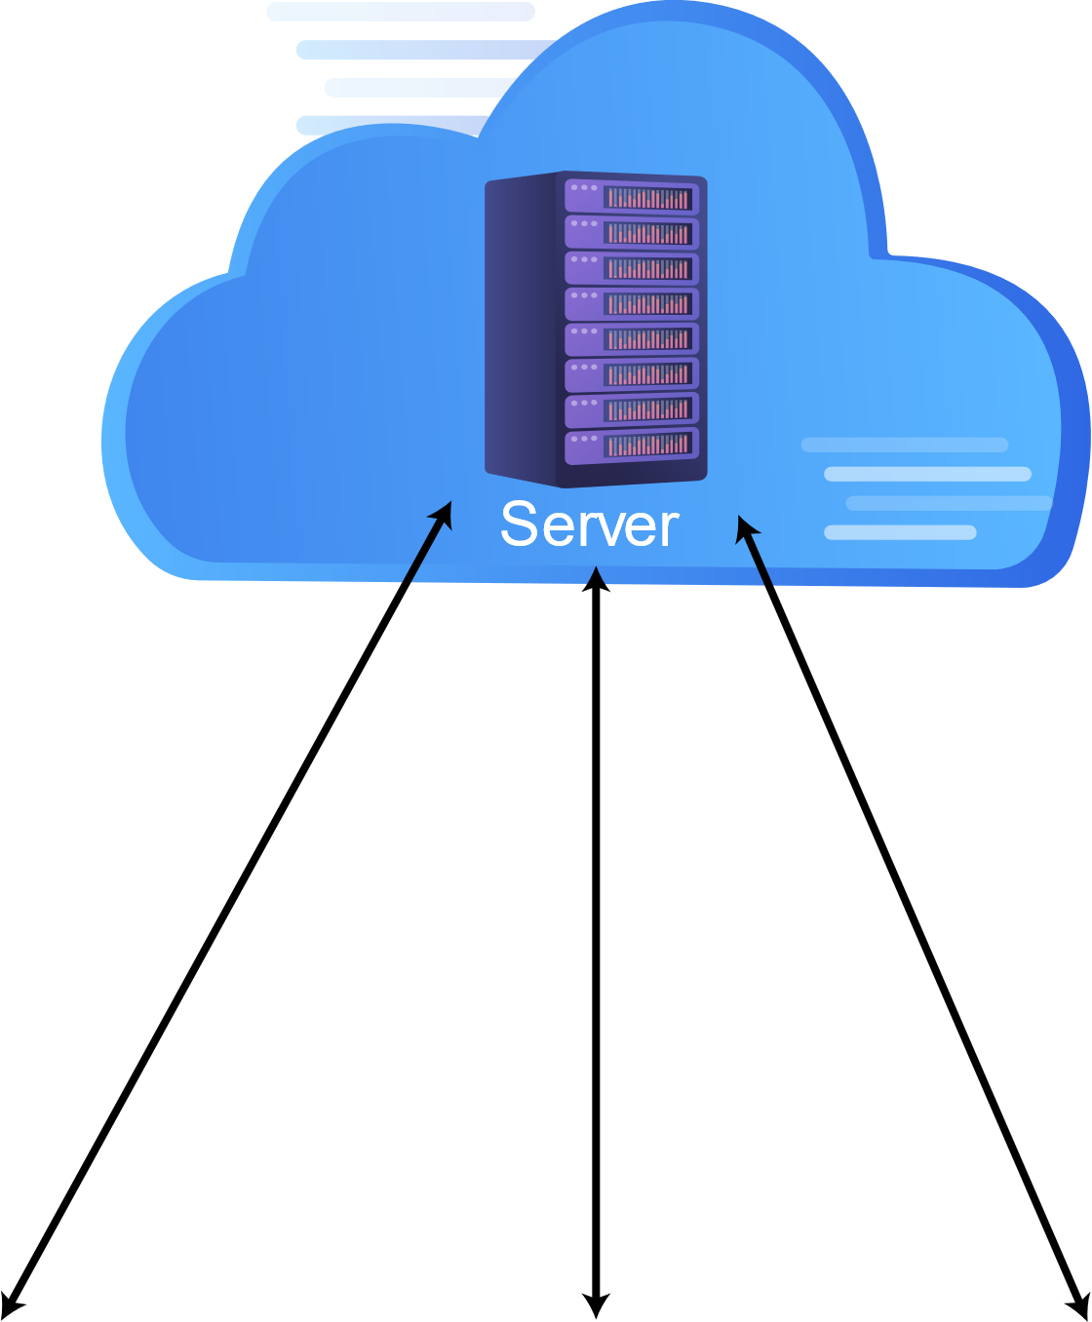

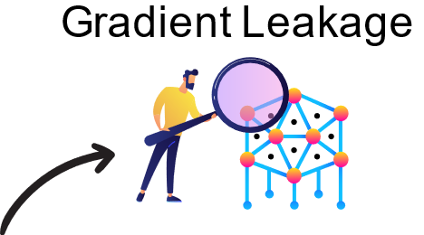
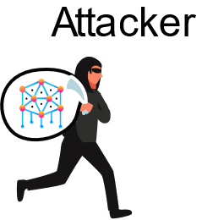
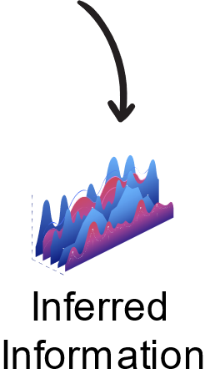
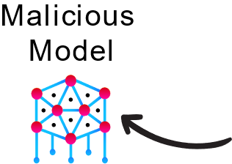
Inference Attack
Analyze information leaked about participants to illegitimately gain knowledge about federated data and use this knowledge to craft an attack.
Sources:
Compromised Server
Communication

Slide 23
Other Attacks
Attacks | Description | Sources
Non-Robust Aggregation | Aggregation algorithms with ill-disposed reweighting schemes. | Aggregation Algorithm
Training Rules Manipulation | Manipulating training hyperparameters to prevent convergence or introduce bias. | Compromised Clients Distributed Nature of FL
Compromised FL Distributed Computation | Diverging from executing the wanted behavior of distributed FL computation to generate unreliable intermediate results. | Compromised Clients Compromised Server Distributed Nature of FL
Free-Riding Attacks | Dissimulate participation in FL with the goal of obtaining the final model without contributing to the training process. | Compromised Clients

Slide 24
Defenses in Federated Learning

Slide 25
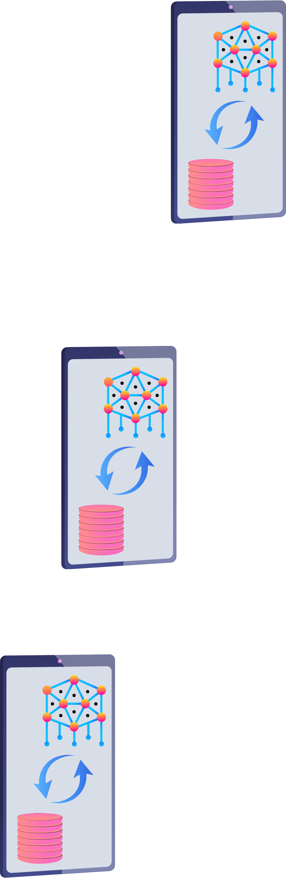
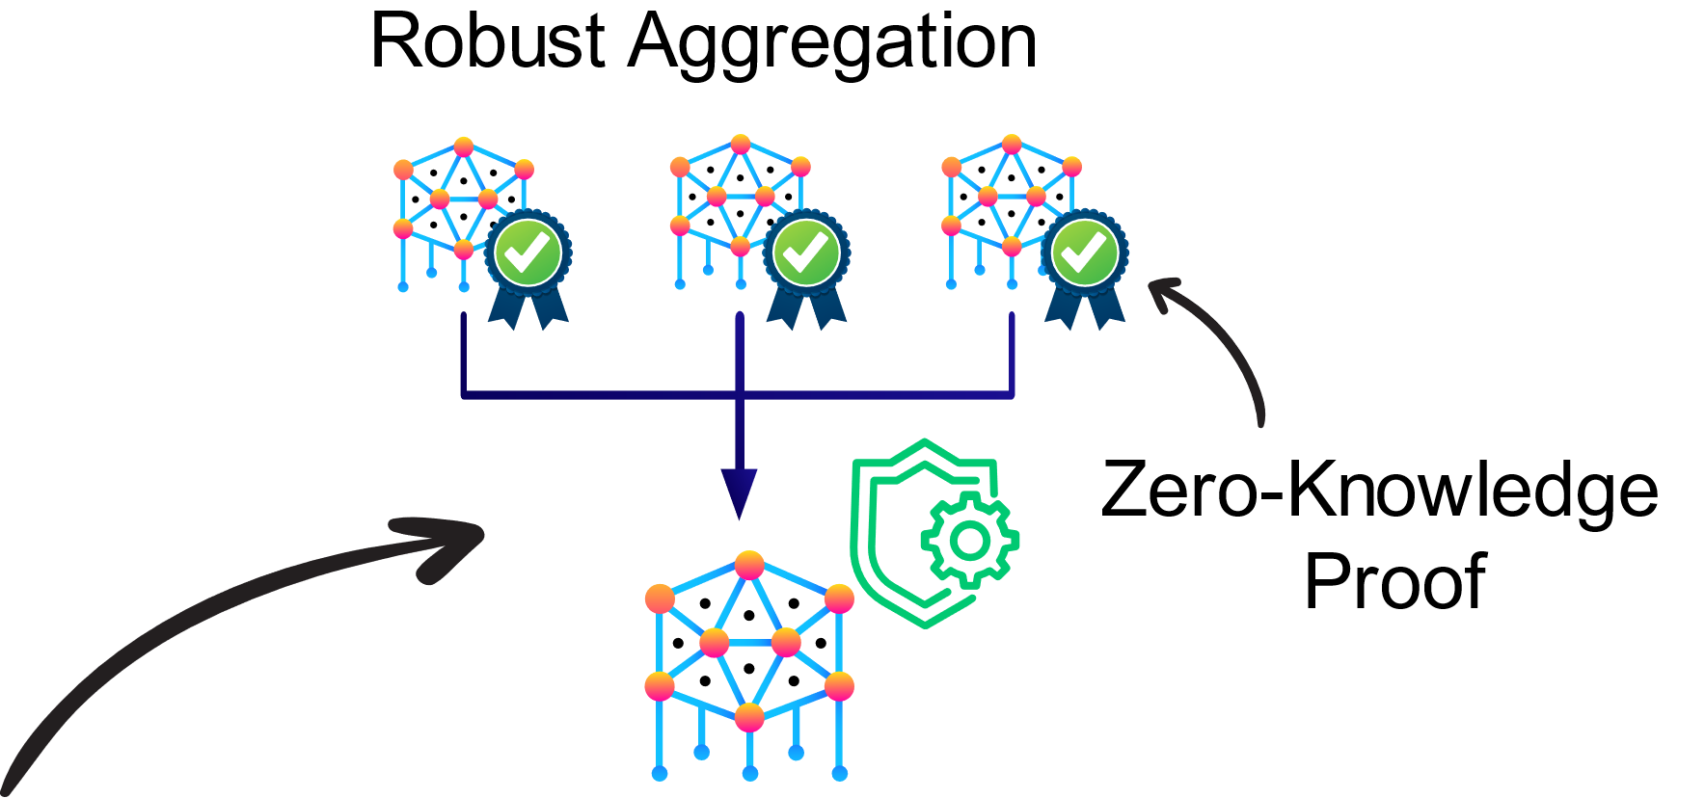
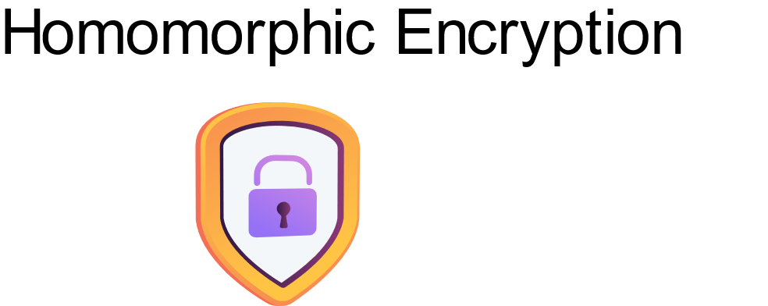
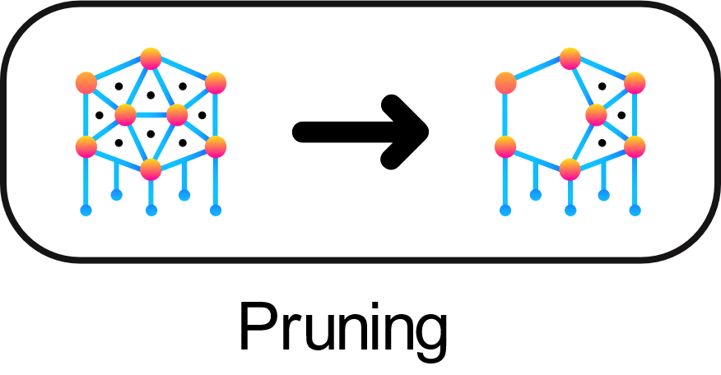
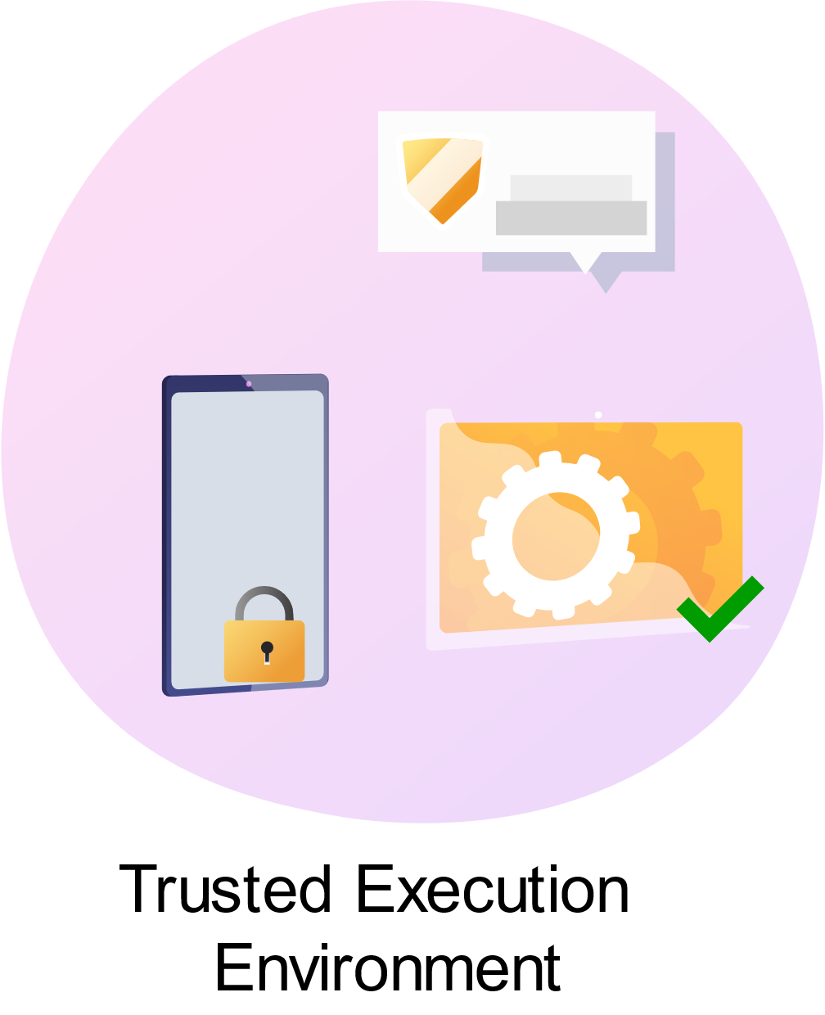
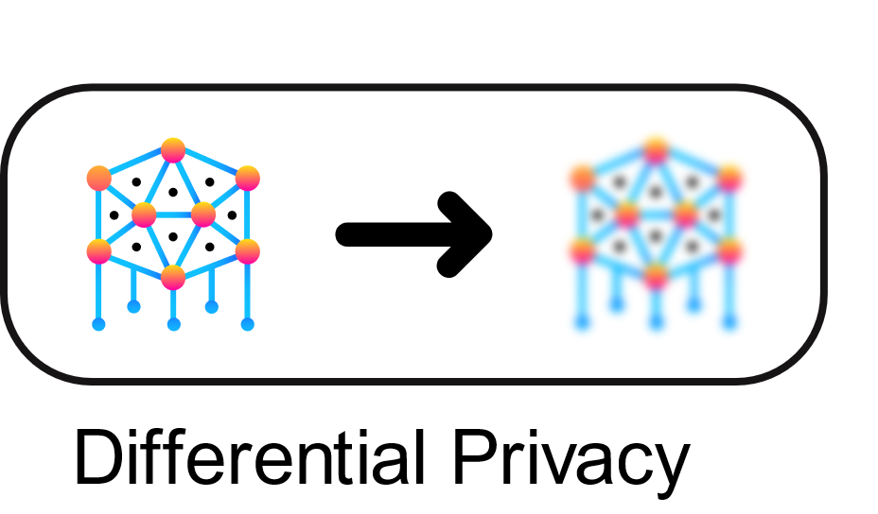
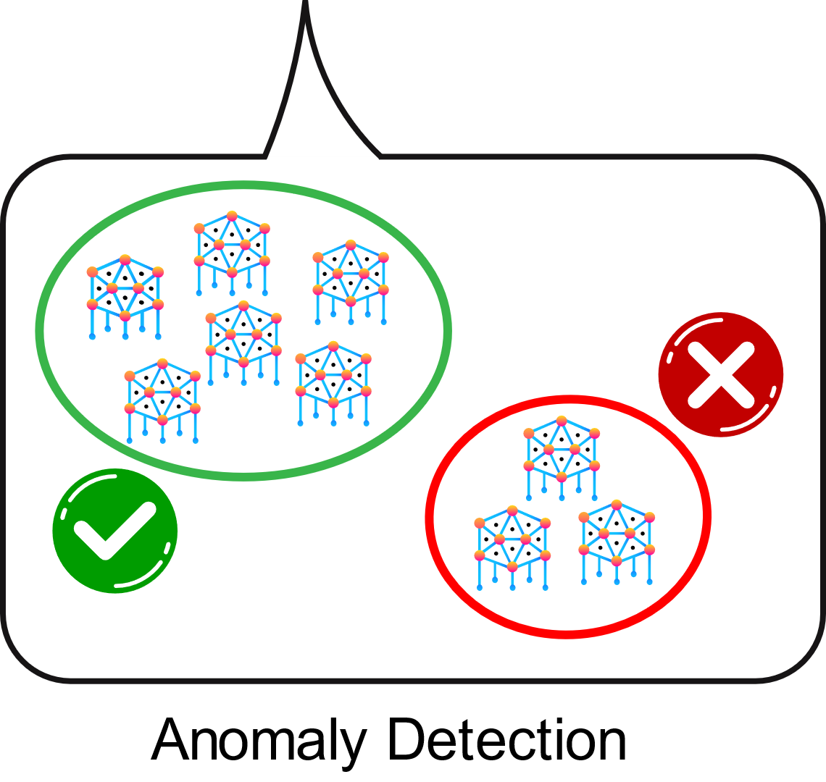
Defenses in Federated Learning
Server
Clients

Slide 26
Other Defenses
Defenses | Description | Attacks
Federated Multi-Task Learning | Learn models for multiple related tasks simultaneously to ensure fault tolerance. | Dropout of Clients Communication Bottlenecks
Moving Target Defense | Randomize FL system modules to reduce the likelihood of successful attacks and shorten their lifetime by adding new dynamics. | Inference Attacks Man-in-the-Middle Attacks
Federated Distillation | Transfer knowledge from a fully trained teacher model to another student model. Knowledge sharing instead of weights sharing enhances the robustness of FL. | Inference Attacks Communication Bottlenecks Man-in-the-Middle Attacks

Slide 27
Trust in Federated Learning

Slide 28






Trust Measure and Crowd-Sourced Models
Prediction
Aggregation
Server
Model Deployment

Slide 29
Trust Measure and Crowd-Sourced Models
We can eliminate many attacks by establishing the level of trust for each actor.
We define trust as a quantitative measure.
Trust measure represents the health status of each device.
Trust is renewed with every training round.
More flexible and efficient than anomaly detection.
  Instead of removing outliers, we measure how much the server trust the clients.
  Not vulnerable to non-IID data, non-smooth loss function, bounded model updates, etc.

Slide 30




A Profiling Approach to Build Trust Models
Collect User Information
Local model parameters.
Cosine Similarity to Global Model.
Sensitivity to different classes.
Performance metrics on chosen small test dataset.
Predict Trust
Client Profile
Learn a Trust Model
Auto-encoder

Slide 31
Purely Offline Approach
Collect User Information
Local model parameters.
Cosine Similarity to Global Model.
Sensitivity to different classes.
Performance metrics on chosen small test dataset.
Predict Trust
OFFLINE
ONLINE
Client Profile
Learn a Trust Model
OFFLINE
OFFLINE
OFFLINE
Auto-encoder

Slide 32
Hybrid Approach: Meta-Learning
Many problems with the offline approach
  Poor generalization ability of the trust model.
  A lot of engineering needed to perform the offline learning.
A hybrid approach: Meta-Learning
  Learn an optimizer for trust models offline.
  Learn an adaptation online at the beginning of the training.

Slide 33
Meta-Learning Motivation
Current deep learning techniques often require huge amounts of data
Humans don’t need so much data to learn
Humans transfer knowledge between tasks
How can we make ML techniques do the same?

Slide 34
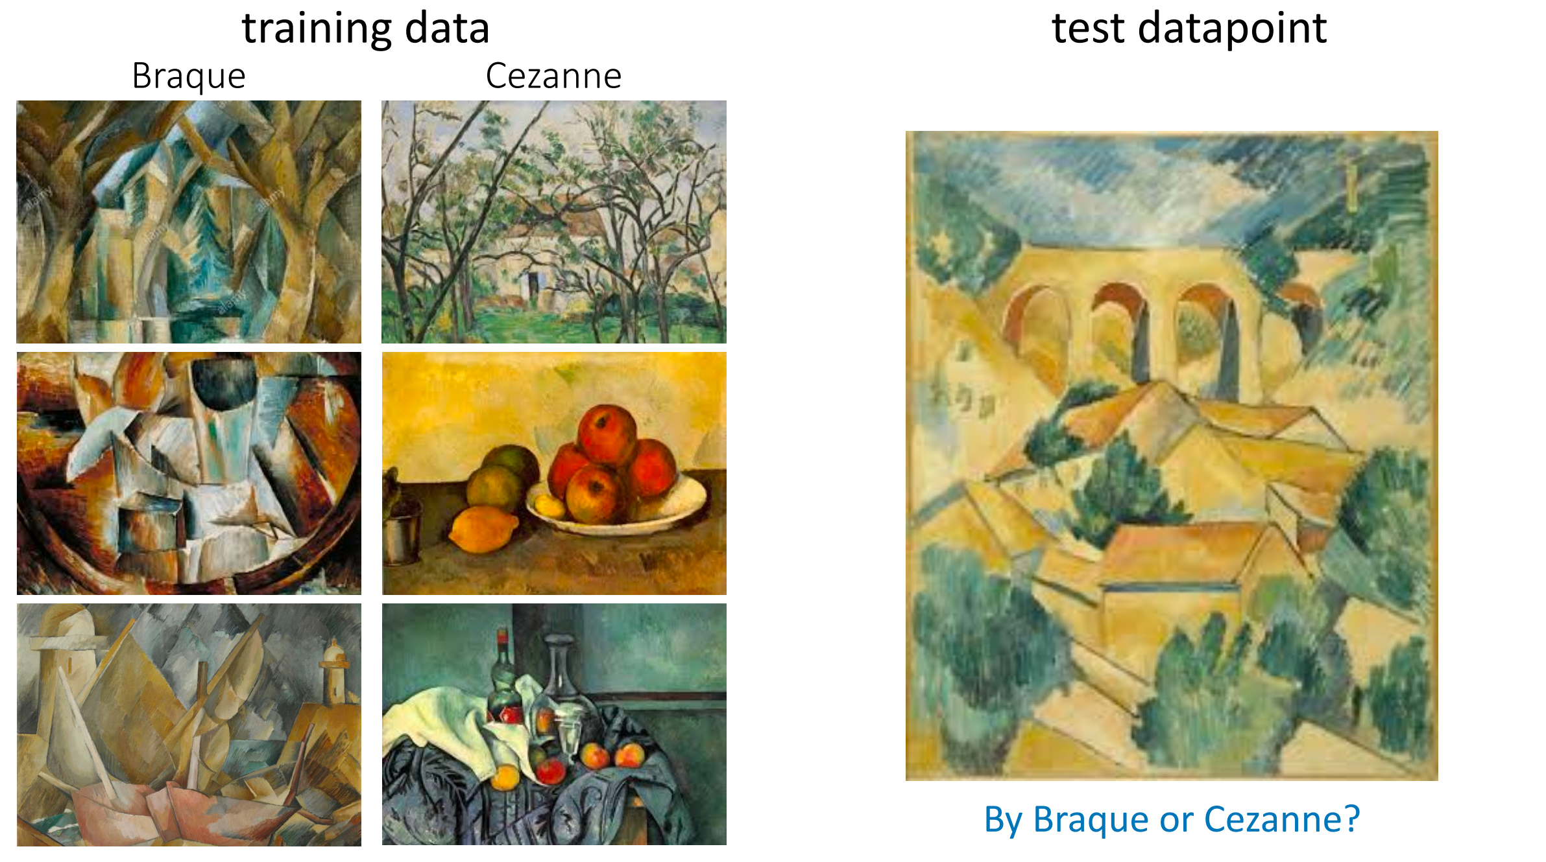
Example: Paintings

Slide 35
Goal
Reuse knowledge from previous experiences when faced with a new task.
Learn wide variety of tasks with similar methods of featuring an input.

Slide 36
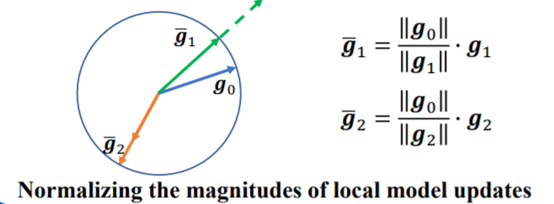
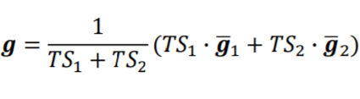
Trust Prediction
Prediction
Aggregation
Server
Model Deployment

Slide 37
Concluding Thoughts
Federated Learning (FL) has the potential to revolutionize the domain of artificial intelligence with shifting training to the edge.
However, it leaves several open questions about how to safeguard the system against the new vulnerabilities.
We discussed the key challenges in designing solutions for secure robust FL and the critical pieces for a design that resolves each of these challenges.
Federated systems should ensure that the data embodied in the model is protected against any potential future attacks.

Slide 38
Thank you

