Slide 1



Rugged Pseudorandom Permutations and Their Applications
Jean Paul Degabriele, Vukašin Karadžić, Alessandro Melloni, Jean-Pierre Münch, Martijn Stam
Notes:
This talk is based on two separate works one with VK, and another with AM, JPM, and MS where the notion of a Rugged PRP was developed in parallel in these two works.

Slide 2
Outline
Defining Rugged PRPs
The UIV Construction
Transforming Rugged PRPs into AEAD
Tor and CGO
Notes:
I’ll start by defining RPRPs and describing a construction.
Then I’ll show how we can turn a Rugged PRP into an AEAD with differing security properties.
I’ll introduce a generalisation of AEAD called Nonce-Set AEAD, how it can be constructed from RPRPs, and its application to Order-resilient Channels.
Very briefly I’ll outline how Tor can benefit from Rugged PRPs.

Slide 3
Defining Rugged PRPs
Notes:
Let’s start by defining what is a Rugged PRP

Slide 4
What is a Rugged PRP?
Security of a Tweakable Cipher (Variable Length)
AEAD Security
SPRP
Robust AEAD
Encode-then-Encipher
Paradigm
RPRP
MRAE or RUPAE
Less Efficient Schemes
PRP
IND-CPA Only
Notes:
A clear separation between security and fucntionality
The support predicate is agnostic as to how we represent the ciphertexts and in particular we can use the nonces used during encryption to identify each ciphertext, then informally what is required from the NSP is that it faithfully reflects the support predicate logic over the nonces.
A protocol designer Best-possible security for that support predicate

Slide 5
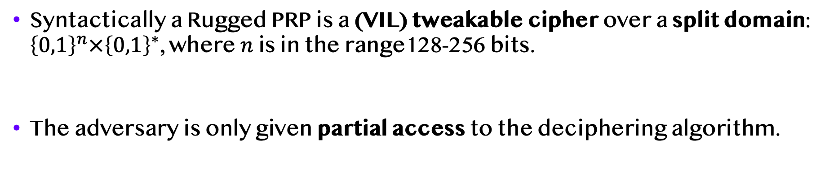
Rugged Pseudorandom Permutations [DK22]
T
X_{L}
X_{R}
X_{L}
X_{R}
E_{K}
D_{K}
Y_{L}
Y_{R}
T
Y_{L}
Y_{R}
Syntactically a Rugged PRP is a (VIL) tweakable cipher over a split domain: ${\left\{0,1\right\}}^{n}×{\left\{0,1\right\}}^{∗}$, where $n$ is in the range128-256 bits.
The adversary is only given partial access to the deciphering algorithm.
Notes:
Syntactically a Rugged PRP is a variable-input-length tweakable cipher over a split domain, that is, a domain over string pairs where the left string is of fixed size n and the right part is of variable length.
So the enciphering algorithm takes a tweak T and a pair (X_L, X_R) to return (Y_L,Y_R) and the deciphering algorithm D reverses this process.
In terms of security a Rugged PRP sits right in between a PRP and a Strong PRP. Intuitively we will achieve this by giving the adversary full oracle access to the enciphering algorithm but only partial access to the deciphering algorithm.

Slide 6


Rugged Pseudorandom Permutations
Real World
T
X_{L}
X_{R}
X_{L}
X_{R}
E_{K}
De Oracle
D_{K}
En Oracle
Y_{L}
Y_{R}
T
Y_{L}
Y_{R}
FORWARD
REPEAT
Deciphering can be accessed via two separate oracles:
De - restricted queries, full output.
Gu – unrestricted queries, 1-bit output.
True/False
$$\begin{matrix}? \\ =\end{matrix}$$
X’_{L}
X_{L}
X_{R}
Gu Oracle
D_{K}
T
Y_{L}
Y_{R}
Notes:
To define security, we start from the SPRP definition and impose two restrictions on the Deciphering queries.
-The first is that no deciphering query can be made that include a left value Y_L that was previously returned by the enciphering oracle.
-The second is that no deciphering query can repeat a left value from a previous deciphering query for all possible values of the tweak and right part.
These two restrictions are quite limiting, and we therefore provide an additional alternative way of accessing the deciphering algorithm ---- we add a Guess oracle which additionally takes an extra input X’_L as its guess of the deciphered partial output X_L.
In summary – two oracles one has significantly restricted inputs and the other has unrestricted inputs but only returns a single bit of information.

Slide 7
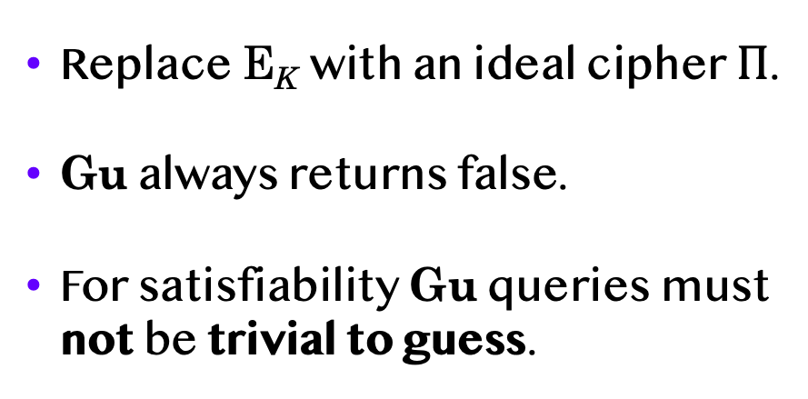



Rugged Pseudorandom Permutations
Ideal World
T
X_{L}
X_{R}
X_{L}
X_{R}
$$Π$$
De Oracle
$$Π^{−1}$$
En Oracle
Y_{L}
Y_{R}
T
Y_{L}
Y_{R}
FORWARD
REPEAT
Replace E_{K} with an ideal cipher $Π$.
Gu always returns false.
For satisfiability Gu queries must not be trivial to guess.
False
True/False
$$\begin{matrix}? \\ =\end{matrix}$$
X’_{L}
X_{L}
X_{R}
X’_{L}
Gu Oracle
Gu Oracle
Gu Oracle
$$Π^{−1}$$
USED
T
Y_{L}
Y_{R}
Notes:
In the IDEAL WORLD we replace the actual scheme with an Ideal Cipher. For an Ideal Cipher the adversary can only make a successful guess query with negligible probability.
Accordingly, we simplify it further by replacing it with a dummy oracle that always returns False, and for satisfiability we need to require that all queries must be unused as they would be trivial to guess.
NOTE the asymmetry in the definition: Enciphering is stronger than Deciphering.

Slide 8
Notes on the Definition
The term rugged is meant to reflect the intermediate overall security and the asymmetry in security between enciphering and deciphering.
In [DK23] we added two weaker notions called RPRPd and RPRPg where:
RPRPd = En + De only (No Gu oracle)
RPRPg = En + Gu only (No De oracle)
For some applications these weaker notions are sufficient.
Any SPRP is automatically an RPRP, so all applications can be instantiated with an SPRP at the cost of efficiency.
Notes:
2nd bullet – not block ciphers
4th bullet – may appear unnatural but it is more natural when seen in the context of the encode-then-encipher paradigm

Slide 9
The UIV Construction
Notes:
Let’s start by defining what is a Rugged PRP

Slide 10
Protected IV [ShrTer13]
X_{L}
X_{R}
PIV is a (VIL) tweakable cipher construction that is SPRP secure.
Shown here as consisting of a VOL-PRF F_{K2} and two FIL tweakable cipher instances E_{K1}.
An instantiation of F_{K2} is AES-CTR with a Universal Hash mapping the Input to the IV.
E_{K1}
T
F_{K2}
T
E_{K1}
Y_{L}
Y_{R}
Notes:
Let’s now see a construction for a Rugged PRP
The PIV construction, shown here, yields a VL tweakable cipher that is a strong PRP. It requies three layers of processing consisting of two FIL tweakable ciphers with large tweaks and a VOL-PRF which can be instantiated using Counter mode.

Slide 11
Unilaterally-Protected IV
X_{L}
X_{R}
UIV is obtained simply by dropping the third layer and it can be shown to be RPRP secure.
It can be instantiated with GCM components leading to a performance similar to GCM-SIV.
It is closely related to MiniCTR [Min15] and GCM-RUP [ADL17].
E_{K1}
T
F_{K2}
Y_{L}
Y_{R}
Notes:
Truncating the third layer from PIV yields the UIV construction. It does not suffice for a Strong PRP but it can be shown to be a secure Rugged PRP.
It can be instantiated with GCM components, in which case its performance is very similar to GCM-SIV
And it is closely related to GCM-RUP by Ashur, Luyks, and Dunkelmann from 2017, but more on that later on.

Slide 12
Other RPRP Constructions
In [DK23] we proposed another construction called Hash-Encipher-Counter (HEC) and proved it to be RPRP secure.
HEC is related to HCTR by dropping the last layer and adding a light masking operation.
Furthermore, we showed that two variants of the three-round Feistel achieve the weaker RPRP notions.
3-round Feistel (ECE) is RPRPd but not RPRPg
3-round Feistel (CEC) is RPRPg but not RPRPd
Notes:
3 round feistel is not just a PRP but an RPRP!

Slide 13
Transforming RPRPs into AEAD
Notes:
OK so what’s a Rugged PRP good for? For one thing we can easily turn them in AEAD schemes.

Slide 14
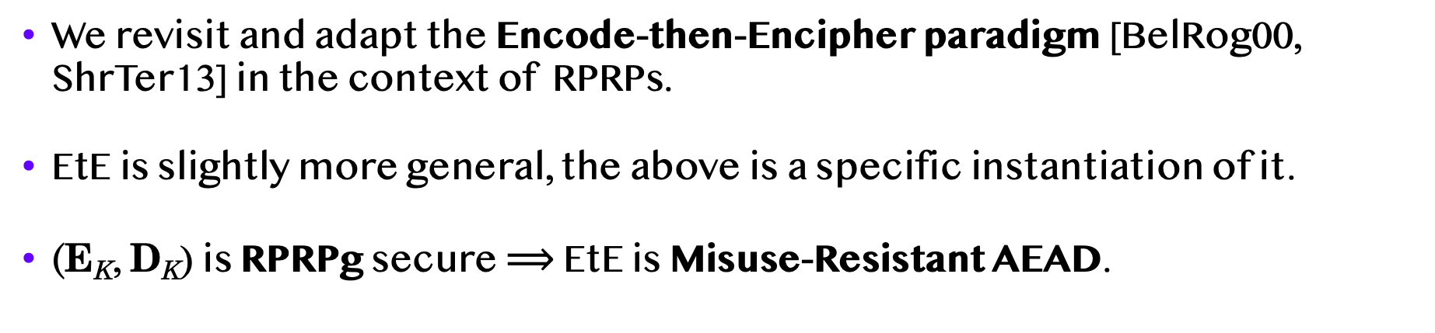

The EtE Transform
$$\begin{matrix}? \\ =\end{matrix}$$
N,H
T
0^{n}
X_{L}
M
X_{R}
0^{n}
X’_{L}
M’
Enc(N,H,M)
Dec(N,H,C)
E_{K}
E_{K}
D_{K}
C₁
Y_{L}
C₂
Y_{R}
N,H
C₁
C₂
EtE instantiation
We revisit and adapt the Encode-then-Encipher paradigm [BelRog00, ShrTer13] in the context of RPRPs.
EtE is slightly more general, the above is a specific instantiation of it.
(E_{K}, D_{K}) is RPRPg secure $⟹$ EtE is Misuse-Resistant AEAD.
Notes:
So remember that a Rugged PRP is a tweakable cipher, and the problem of turning a cipher into AEAD was already considered in the encode-then-encipher paradigm by Bellare and Rogaway which was later revisited by Shrimpton and Terashima. However, whereas prior treatments required the cipher to be a Strong PRPs we will make do with just a Rugged PRP.
So in our first construction, the EtE transform, we simply place the nonce and header in the tweak and set the left input to a fixed string of zeros.
To decrypt we then simply apply the deciphering algorithm and check that the left output is equal to the all-zero string. The crucial aspect is that the redundant bits need to be placed in the left input.
Not only does this yield a secure AEAD scheme but it is also misuse-resistant!

Slide 15
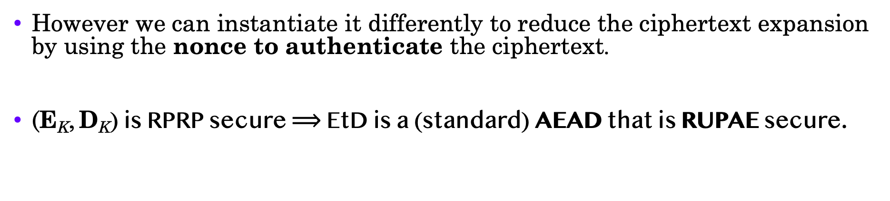
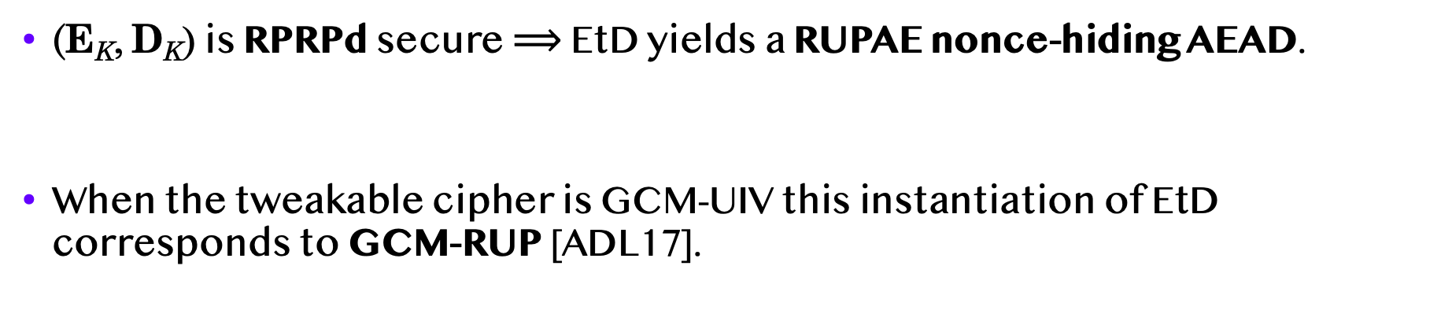



The EtD Transform
$$\begin{matrix}? \\ =\end{matrix}$$
$$\begin{matrix}? \\ =\end{matrix}$$
N,H
M
H
N
M$∥$0^{n}
N’
M’
N
M’$∥Z$ 0^{n}
Enc(N,H,M)
Dec(N,H,C)
Dec(H,C)
D_{K}
E_{K}
C₁
C₂
H
N,H
C₁
C₂
EtD instantiation 2
EtD instantiation 1
However we can instantiate it differently to reduce the ciphertext expansion by using the nonce to authenticate the ciphertext.
(E_{K}, D_{K}) is RPRP secure $⟹$ EtD is a (standard) AEAD that is RUPAE secure.
(E_{K}, D_{K}) is RPRPd secure $⟹$ EtD yields a RUPAE nonce-hiding AEAD.
When the tweakable cipher is GCM-UIV this instantiation of EtD corresponds to GCM-RUP [ADL17].
Notes:
Now the asymmetry in the security of Rugged PRPs prompts us to consider an alternative construction, the EtD transform, where we use deciphering to encrypt and enciphering to decrypt.
Recall that RPRP security prohibits us from repeating the left input to the deciphering algorithm and thus the NONCE is the only plausible candidate! But in this case the REDUNDANT bits can go in the RIGHT input.
Decryption proceeds in the natural way, AND this CONSTRUCTION yields a scheme that beyond standard AEAD security it is also secure under the release of unverified plaintext
When instantiatied with GCM-UIV we recover the GCM-RUP scheme from [ADL17]
However we can instantiate EtD a bit differently inorder to reduce the ciphertext expansion. Essentially, we can get rid of the zero bits and use the NONCE itself for AUTHENTICATION, which gives us RUP-secure AEAD scheme with more compact ciphertexts than GCM-RUP

Slide 16
Application to Tor: CGO
Notes:
Finally RPRPs are very relevant in the context of Tor.

Slide 17
Tor Overview
Four components:
Link protocol (TLS)
Circuit Extend protocol
Relay protocol
Stream protocol
K3
Onion Proxy
xyz.com
K1
K1
K2
K3
K2
Tor network composed of Onion Routers

Slide 18
Relay Cell Format and Processing
Cells are 514 bytes (v4+)
CircID: Circuit Identifier
CMD: Cell type - RELAY (3) or RELAY_EARLY (9)
Rx: Recognised field (0x0000)
Digest: seeded running hash (truncated SHA-1)
4
1
509
CircID
CMD
Cell Payload
4
1
1
2
2
4
2
498
CircID
CMD
rCMD
Rx
SID
Digest
Len
Data
AES-CTR (K3)
AES-CTR (K1)
CircID
CMD
Encrypted Cell Payload
18

Slide 19
Tor is Susceptible to Tagging Attacks
Assume the adversary controls some onion routers.
OR1 flips a bit in a cell and forwards it over.
OR3 flips that bit back and tests if decryption succeeds.
If yes, the adversary has confirmed that the two edges (CircIDs) belong to the same circuit.
OR3
OP
xyz.com
OR1
OR2
19
Notes:
A clear separation between security and fucntionality
The support predicate is agnostic as to how we represent the ciphertexts and in particular we can use the nonces used during encryption to identify each ciphertext, then informally what is required from the NSP is that it faithfully reflects the support predicate logic over the nonces.
A protocol designer Best-possible security for that support predicate

Slide 20
Requirements
Prop 202: Protect against Tagging Attacks, Non-expanding encryption, Stronger integrity protection, Not MAC-then-Encrypt.
Forward Security and support for Associated Data.
Support Tor’s existing Leaky Pipes functionality, where the OP can communicate with any OR in the circuit (in either direction).
Be able to operate heterogeneously with the old scheme during the transition period.

Slide 21












CGO (High-Level): Forward Direction
OR-Dec($ρ3$,AD,T₃,C₃) $→$M
$$\begin{matrix}? \\ =\end{matrix}$$
T₄
M’
N₃
C₄=M
$σ=$[(K₁,N₁,T’₂), (K₂,N₂,T’₃), (K₃,N₃,T’₄)]
OP-Enc($σ$,d,AD,M)$→$T₁,C₁
$ρ1=$(K₁,N₁,T’₂), $ρ2$=(K₂,N₂,T’₃), $ρ3$=(K₃,N₃,T’₄)
T’₄$∥$AD
E_{K}
N₃
M
M$∥$0^{n}
T₃
C₃
T’₄$∥$AD
D_{K3}
OR-Dec($ρ1$,AD,T₁,C₁) $→$T₂,C₂
$$\begin{matrix}? \\ =\end{matrix}$$
T’₃$∥$AD
D_{K2}
T₂
M’
N₁
C₂
T’₂$∥$AD
D_{K1}
T’₂$∥$AD
E_{K}
T₁
C₁
T₁
C₁
Notes:
T’ init to random and gets last T used
Deciphering to encrypt and enciphering to decrypt – explain in next slide

Slide 22












CGO (High-Level): Backward Direction
$ρ=[$(K₁,N₁,T’₁), (K₂,N₂,T’₂), (K₃,N₃,T’₃)]
OR-Enc($σ3$,AD,M ) $→$T₃,C₃
N₃
M
$σ1=$(K₁,N₁,T’₁),$σ2$=(K₂,N₂,T’₂),$σ3$=(K₃,N₃,T’₃)
M$∥$0^{n}
OP-Dec($ρ$,AD,T₁,C₁)$→$M,s=3
T’₃$∥$AD
E_{K}
$$\begin{matrix}? \\ =\end{matrix}$$
N₃
T₄
C₄=M
T₃
C₃
T’₃$∥$AD
D_{K3}
OR-Proc($σ1$,AD,T₂,C₂) $→$T₁,C₁
T’₂$∥$AD
D_{K2}
T₂
M’
C₂
T’₁$∥$AD
D_{K1}
T’₁$∥$AD
E_{K}
T₁
C₁
T₁
C₁
Notes:
Tag j used in layer j – unlike forward direction
OP-Dec should return source of cell
Enciphering is always on the wire

Slide 23
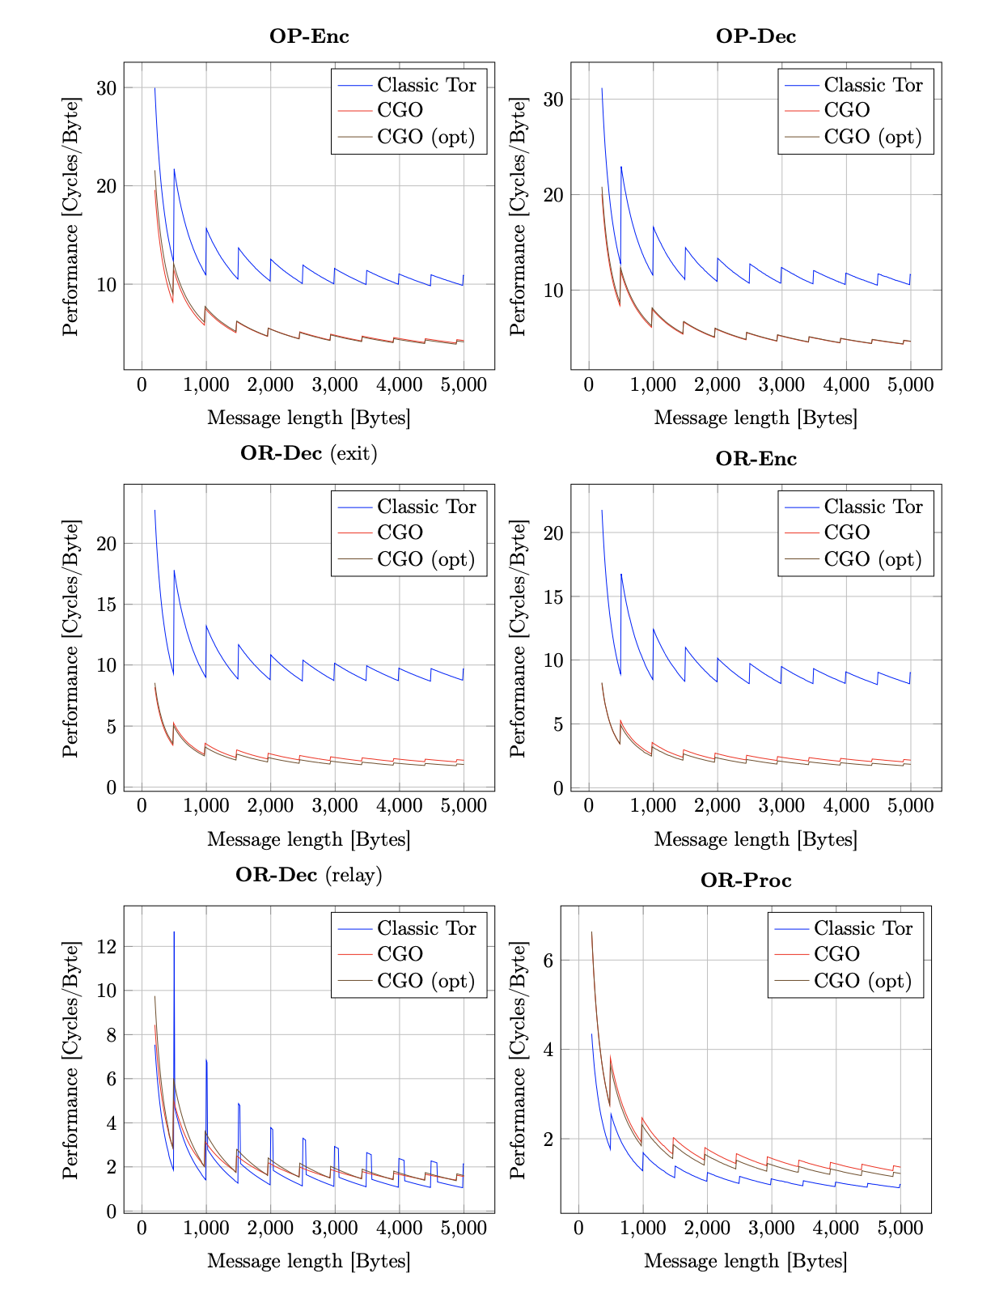
CGO Performance
In CGO the Updatable RPRP is instantiated with GCM-UIV+ using AES-CTR and POLYVAL.
CGO outperforms Classic Tor at the endpoints OP and exit OR.
Slightly slower at middle ORs as they consists of only AES-CTR in Classic Tor.
Notes:
Sawtooth behaviour due to splitting the message in fixed-size chunks

Slide 24
Concluding Remarks

Slide 25
Summary
Rugged PRPs strike a new tradeoff between security and performance.
In particular, we have shown that the Encode-then-Encipher paradigm can be made to work with weaker variable-length ciphers than SPRPs.
Each RPRP constructions automatically yields 4 AEAD schemes: MR-AEAD, RUPAE, Nonce-Hiding MRAE, and Nonce-Hiding RUPAE.
Similarly, CGO can be instantiated from any RPRP + PRF (for key updates).
Another application is to build Nonce-Set AEAD for realizing Order-Resilient Channels like QUIC/DTLS.
Notes:
We believe Nonce-Set AEAD draws the right abstraction boundary as the main building block for constructing Order-Resilient Channels.
2nd bullet – UIV was considered and dismissed by ShrTer and was somewhat implicit in GCM-RUP but never

Slide 26
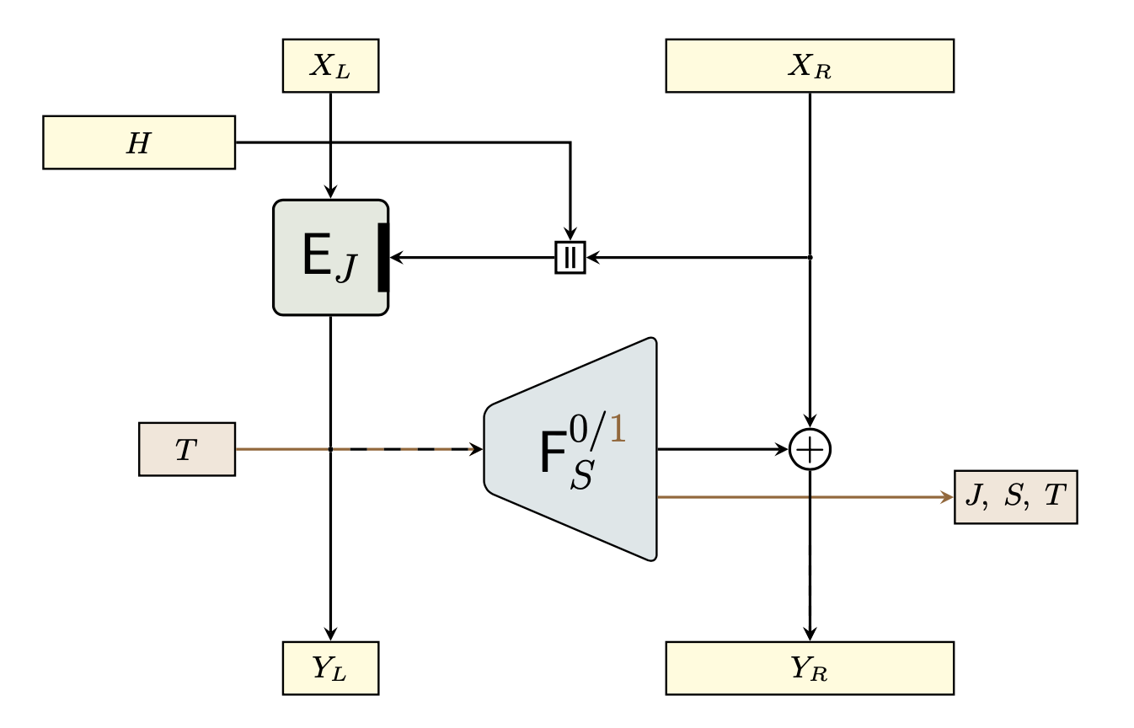
The UIV+ Updatable RPRP Construction

Slide 27
Nonce-Set AEAD
Notes:
Another application of RPRPs is to build a sligthly more general primitive, that we call Nonce-Set AEAD.

Slide 28

The AwN Transform
$$\begin{matrix}? \\ ∋\end{matrix}$$
$$\begin{matrix}? \\ =\end{matrix}$$
H
N
M
N’
M’
W
N’
M’
N
Enc(N,H,M)
Dec(W,H,C)
Dec(N,H,C)
E_{K}
D_{K}
D_{K}
C₁
C₂
H
C₁
C₂
H
C₁
C₂
EtE variant
AwN transform
We can also use the nonce to authenticate in the EtE transform and obtain a nonce-hiding AEAD (E_{K} = UIV ⥲ MiniCTR [Min15]).
We can generalize this further by testing the nonce for set membership instead of equality, yielding the AwN transform.
AwN transforms an RPRP into a Nonce-Set AEAD that is Misuse-Resistant.
Notes:
Our last trick of using the nonce to authenticate can also be used in the EtE transform.
We can generalize this further by giving the DECRYPTION algorithm a set of nonces and testing whether the RECOVERED NONCE is in that SET, assuming the SIZE of the set is RESTRICTED.
We call this the AwN Transform and it yields this non-standard primitive that we call Nonce-Set AEAD which is also misuse-resistance.
Efficient representation of the set and efficient test for set membership

Slide 29
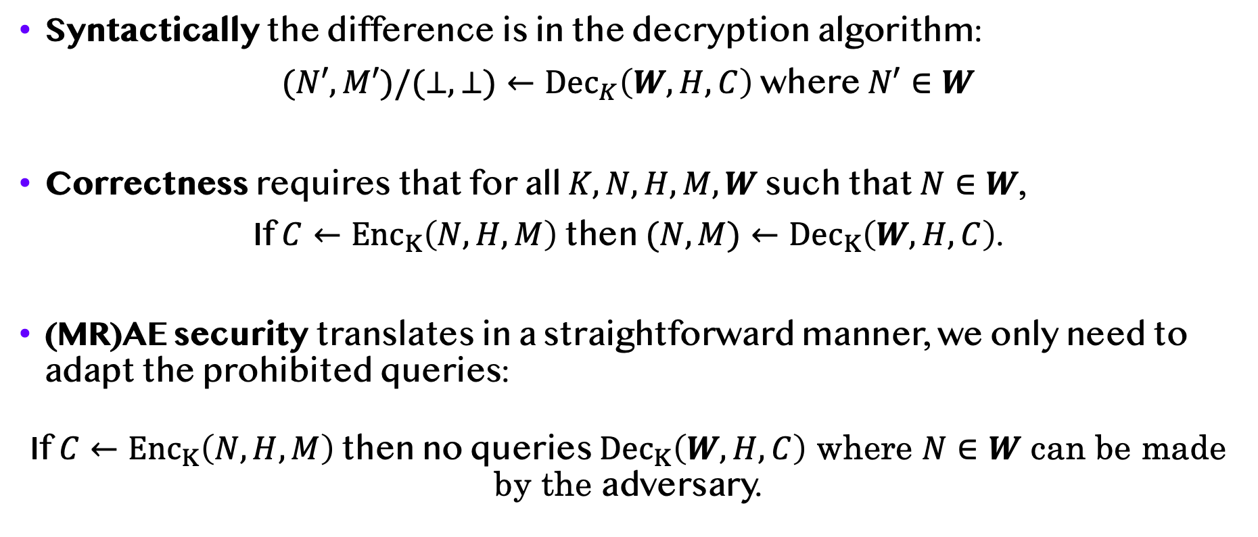
Nonce-Set AEAD Formally
Syntactically the difference is in the decryption algorithm:
$(N′,M′)/(⊥,⊥)←{Dec}_{K}\left(W,H,C\right)$ where $N′∈W$
Correctness requires that for all $K,N,H,M,W$ such that $N∈W$,
If $C←{Enc}_{K}\left(N,H,M\right)$ then $(N,M)←{Dec}_{K}\left(W,H,C\right)$.
(MR)AE security translates in a straightforward manner, we only need to adapt the prohibited queries:
If $C←{Enc}_{K}\left(N,H,M\right)$ then no queries ${Dec}_{K}\left(W,H,C\right)$ where $N∈W$ can be made by the adversary.
Notes:
1st BULLET -- The nonce-set tells the decryption algorithm which ciphertexts are “acceptable”
When decryption succeeds it must hold that the recovered nonce was in W
At the end mention that restricting |W|=1 effectively recovers standard AEAD (with a redundant output)

Slide 30
Why Nonce-Set AEAD?
It is a natural primitive in the context of order-resilient channels such as QUIC and DTLS which employ window mechanisms.
Nonce-Set AEAD serves as a stepping stone from which a variety of secure channel functionalities can be easily realized.
Nonce-Set AEAD can also be constructed from any nonce-hiding AEAD via a straightforward generic transform.
However AwN realizes Nonce-Set AEAD directly resulting in more compact ciphertexts than this generic transform.

Slide 31
Order-Resilient Channels
Notes:
OK so let’s now delve into how is NS-AEAD useful to OR-channels

Slide 32
Order-Resilient Channels
QUIC and DTLS realize secure channels over UDP and need to handle out-of-order delivery.
Several possibilities arise for handling reorderings, replays, modifications, and deletions, and how much of each to tolerate.
Typical constructions employ one or more window mechanisms, which add complexity—making them hard to understand and analyze.
In general, it is unclear how these additional mechanisms interact with AEAD and what the overall security of the channel is.
Notes:
Mathematically the functionality of such channels can be characterised through a support predicate, which in turn permeates all aspects such as correctness, securiy, and robustness

Slide 33
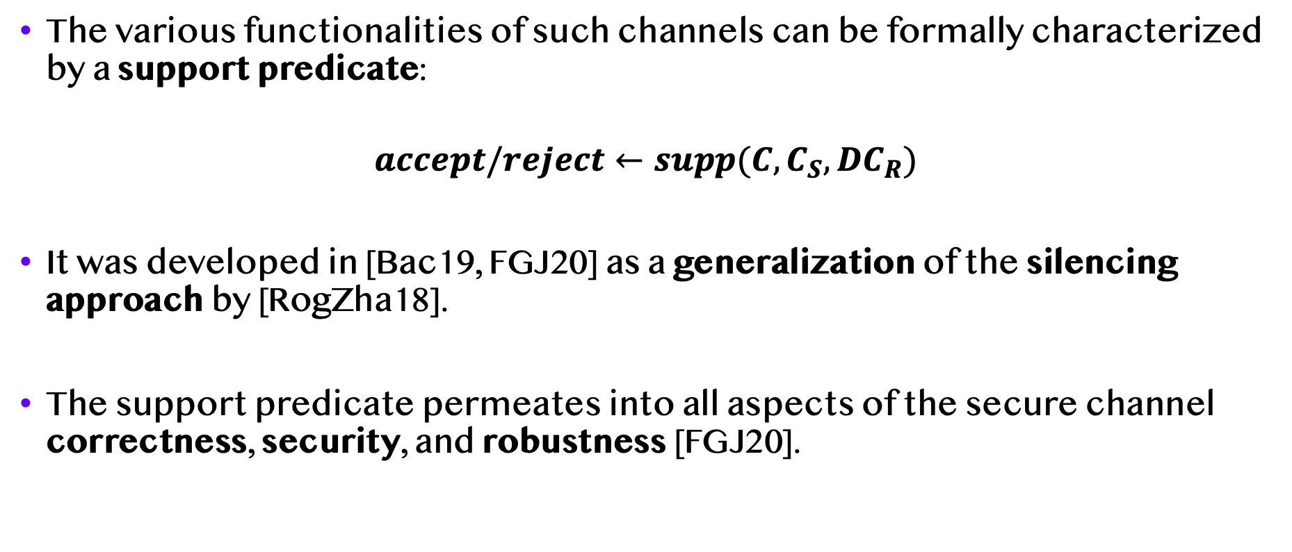
The Support Predicate
The various functionalities of such channels can be formally characterized by a support predicate:
$$accept/reject←supp(C,C_{S},DC_{R})$$
It was developed in [Bac19, FGJ20] as a generalization of the silencing approach by [RogZha18].
The support predicate permeates into all aspects of the secure channel correctness, security, and robustness [FGJ20].

Slide 34
Order-Resilient Channels from NS-AEAD
We present a universal and generic channel construction from Nonce-Set AEAD for any desired support predicate!
The construction consists of a Nonce-Set AEAD (blue) scheme and a tuple of Nonce-Set Processing (NSP) scheme (red).
Notes:
Explain nonce-processing algorithms and the faithfulness requirement
The nonce-set processing algorithms translate the support predicate to simple operations over nonces
Security comes from nonce-set AEAD, and nonce-set processing provides the required functionality by mapping the support predicate into nonce processing

Slide 35
Order-Resilient Channels from NS-AEAD
We prove this channel construction correct, robust, and secure.
We only require that the Nonce-Set AEAD is secure and that the NSP scheme satisfy a functionality property called faithfulness.
Informally, faithfulness says that the NSP scheme accurately reproduces the support predicate logic over the nonces.
One can simply tune the NSP to the desired functionality and plug in their favourite Nonce-Set AEAD and security/robustness will be automatic.
Notes:
A clear separation between security and fucntionality
The support predicate is agnostic as to how we represent the ciphertexts and in particular we can use the nonces used during encryption to identify each ciphertext, then informally what is required from the NSP is that it faithfully reflects the support predicate logic over the nonces.
A protocol designer Best-possible security for that support predicate

