Slide 1
Self-testing based on Chained Bell Inequality: Certified Randomness and secure key rate
arXiv: 2025.04??
Alok Kumar Pan
Coauthor
Rajdeep Paul
Sneha Munshi
Indirect contribution:
Ritesh Singh
Souradeep Sasmal
Department of physics
IIT Hyderabad

Slide 2
Outline
Device Independent (DI) Self-testing
Chained Bell Inequality and robust self-testing
Robust certification of randomness
Robust certification key-rate

Slide 3
What is self-testing ?
y
Can we certify the characterize the device
from input-output statistics.
The observed statistics ${\left\{ p\left(b | y\right) \right\}}_{ }$
b

Slide 4
What is DI self-testing ?
y
Strongest certification procedure that uniquely characterizes the quantum device based on the observed statistics.
The observed statistics are characterized $by,$
$${\left\{ p\left(b | y\right) \right\}}_{ }$$
b

Slide 5
Statistics in Quantum Theory
$$B_{y}$$
In Quantum Theory:
(a) State : $ρ | ρ≥0, Tr\left[ρ\right]=1$
(b) Measurement: POVM -
$$B_{y}≡\left\{B_{+1|y},B_{−1|y} |B_{+1|y},B_{−1|y}≥0;B_{+1|y}+B_{−1|y}=I\right\}$$
If $B_{y}$is Projective Measurement: $B_{b|y}^{2}=B_{b|y}$
The observed statistics: $p\left(b | y\right)=Tr[ρ B_{b|y}]$
$$ρ$$
$b∈${+1,-1}

Slide 6
Classicality: Realist model
Realism: Ontic variable $λ$ (with a distribution $μ\left(λ\right)$)fixes the outcome probability, that may be pre-determined.
The observed statistics in a realist model: $\{p\left(b | y,λ\right)$}
If this $λ$model can reproduce Quantum Statistics:
$$p\left(b | y\right)=Tr\left[ρ B_{b|y}\right]=∫μ\left(λ\right) p\left(b | y,λ\right) dλ$$
$μ\left(λ\right)$ is a probability distribution of $λ, satisfying ∫μ\left(λ\right) dλ=1$
y = {1,2}
$$λ$$
b= {+1,-1}
Bell: Qubit statistics can be simulated by a $realist$ model

Slide 7
DI certification in two black-box scenarios
$$x∈\{1,2\}$$
$$y∈\{1,2\}$$
$$λ/ρ_{AB}$$
Alice
Bob
$$a∈\{+1,−1\}$$
$$b∈\{+1,−1\}$$
Bell experiment
I. Supic and J. Bowles, Quantum, 4, 337 (2020).

Slide 8
DI certification
$$x∈\{1,2\}$$
$$y∈\{1,2\}$$
$$ρ_{AB}$$
Alice
Bob
$$a∈\{+1,−1\}$$
$$b∈\{+1,−1\}$$
In Quantum theory:
$$p\left(a,b | x,y,ρ\right)=Tr\left[ρ_{AB}\left(A_{a|x}⊗B_{b|y}\right)\right] \left(Born Rule\right)$$
In realist theory: {$p\left(a,b | x,y,λ\right)\}$
Reproducibility condition: $p\left(a,b | x,y,ρ\right)$ = $∫μ\left(λ\right) p\left(a,b | x,y,λ\right) dλ$

Slide 9
Quantum violation of CHSH-inequality: qubit scenario
$$Δ_{}=A_{1}⊗B_{1}+A_{1}⊗B_{2}+A_{2}⊗B_{1}−A_{2}⊗B_{2}$$
In a local realist model: ${⟨Δ}_{λ}⟩=≤2$
$A_{1}=\frac{σ_{x}+σ_{z}}{√2}$ , $A_{2}=\frac{σ_{x}−σ_{z}}{√2}$
$B_{1}=σ_{x},B_{2}=σ_{z}$
$\left|ψ\right\rangle =\frac{\left|00\right\rangle +|11⟩}{√2}$ maximally entangled state.
CHSH expression,
$Δ=\left(A_{1}+A_{2}\right)⊗B_{1}+\left(A_{1}−A_{2}\right)⊗B_{2}$
${\left\langle Δ\right\rangle }_{Q}=Tr[ρ_{ψ} Δ]$ = $2\sqrt{2}$
The CHSH value $2\sqrt{2}$is obtained for two-qubit state.
Is it possible to go beyond $2\sqrt{2}$, by increasing dimension?
B. S. Cirel’son, Lett. Math. Phys. 4, 93 (1980).
J. Bell, Physics 1, 195 (1964)

Slide 10
Optimal Quantum CHSH value: sum-of-square (SOS) approach
Consider a Positive operator:
$$η=\frac{1}{2}\left(ω_{1}L_{1}^{ϯ}L_{1}+ω_{2}L_{2}^{ϯ}L_{2}\right)≥0$$
$ω_{1} and ω_{2}$are positive numbers .
$$Δ_{}=A_{1}⊗B_{1}+A_{1}⊗B_{2}+A_{2}⊗B_{1}−A_{2}⊗B_{2}$$
$$L_{1}=\frac{A_{1}+A_{2}}{ω_{1}}⊗I−{I⊗B}_{1}$$
$$L_{2}=\frac{A_{1}−A_{2}}{ω_{2}}⊗I−I⊗B_{2}$$
$$ω_{1}=||A_{1}+A_{2}||$$
$$ω_{2}=||A_{1}−A_{2}||$$
$η$ = ${(ω}_{1}+ω_{2})I−Δ$
$${\left\langle Δ\right\rangle }_{Q}^{opt}=\max{(ω_{1}+ω_{2})}$$
$\left\{A_{1},A_{2}\right\}=0$ $ω_{1}=ω_{2}=√2$
$${\left\langle Δ\right\rangle }_{Q}^{opt}=2√2$$
Entangled state: $ρ=\frac{1}{d^{2}}[I⊗I+\sum_{i=1}^{d^{2}−1}{B_{i}⊗B_{i}]}$
P. Roy and A. K. Pan, New Journal of Physics 25, 013040 (2023)

Slide 11
Chained Bell Inequality
$$A_{x∈[n]}$$
$$B_{y∈[n]}$$
$${λ/ρ}_{AB}$$
Alice
Bob
$$a∈\{+1,−1\}$$
$$b∈\{+1,−1\}$$
$${\left\langle 𝒞_{n}\right\rangle }_{λ}≤(2n−2)$$
$$𝒞_{n}=\sum_{i=1}^{n}{(A_{i}+A_{i+1})}⊗B_{i}$$
$$(A_{n+1}=−A_{1})$$
${\left\langle 𝓒_{n}\right\rangle }_{Q}$ is calculated by using two-qubit system
$${\left\langle 𝒞_{n}\right\rangle }_{Q}=2n\cos{\frac{π}{2n}}$$
S. L. Braunstein and C M Caves, Annals of Physics 1, 202, 22-56 (1990)

Slide 12
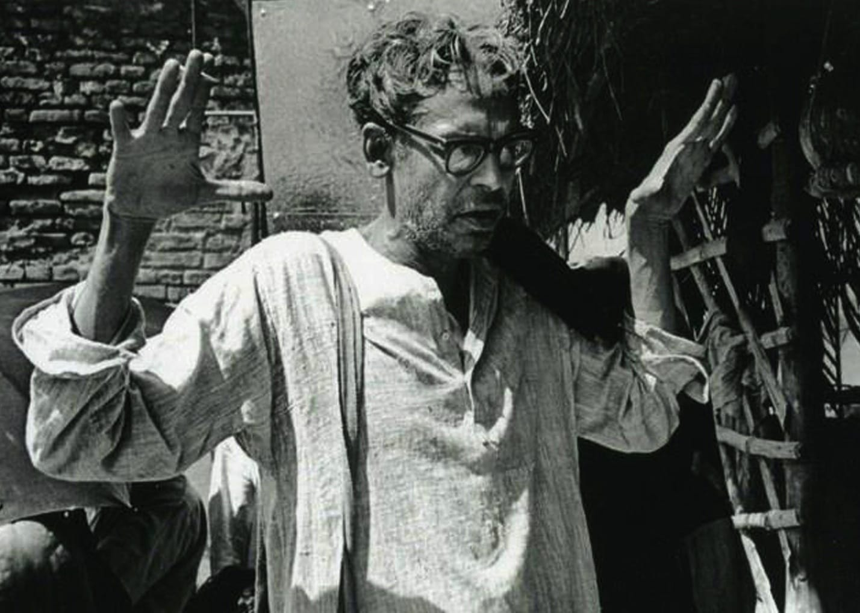
SOS technique
Defined
Rewriting $γ$
$$γ=\frac{1}{2}\sum_{i=1}^{n}{ω_{i} L_{i} L_{i}^{ϯ} }$$
$$γ=\sum_{i=1}^{n}{ω_{i} }−\left(A_{i}+A_{i+1}\right)⊗B_{i}$$
$$L_{i}=\frac{A_{i}+A_{i+1}}{ω_{i}}⊗I_{d}−I_{d}⊗B_{i}, { ω}_{i}={\left|\left|A_{i}+A_{i+1}\right|\right|}_{ρ_{AB}}$$
$${\left(𝒞_{n}\right)}_{Q}^{Opt}=Tr\left[𝒞_{n}ρ_{AB}\right]=\max\left(\sum_{i=1}^{n}{ω_{i} }\right)−Tr[γρ_{AB}]$$
$${\left(𝒞_{n}\right)}_{Q}^{Opt}=\max\left(\sum_{i=1}^{n}{ω_{i} }\right)=2 n Cos\frac{π}{2 n}$$
$$Tr\left[γρ_{AB}\right]=0⇒Tr\left[γL_{i}\right]=0⇒Tr\left[𝒜_{i}⊗B_{i}{ ρ}_{AB}\right]=1$$
$$𝒜_{i}=\frac{A_{i}+A_{i+1}}{ω_{i}}$$

Slide 13
Self-testing Statements
Quantum optimal value,
$${\left(𝒞_{n}\right)}_{Q}^{Opt}=2 n Cos\frac{π}{2 n}$$
Relation between the observables
$${\left\langle \left\{O_{i} , O_{i+x}\right\}\right\rangle }_{ρ_{AB}}=2 Cos\frac{πx}{n} ∀x∈\left[n−1\right], O∈\{A,B\}$$
State of the system is
$$ρ_{AB}=\frac{ 1}{d^{2}}\left[I_{d}⊗I_{d}+\sum_{i=1}^{d^{2}−1}{C_{i}⊗C_{i}}\right]$$
Where ${\left\langle [C_{i}⊗C_{i},C_{j}⊗C_{j}]\right\rangle }_{ρ_{AB}}=0 ∀i≠j$

Slide 14
State construction
State of the system is
$$ρ_{AB}=\frac{ 1}{d^{2}}\left[I_{d}⊗I_{d}+\sum_{i=1}^{d^{2}−1}{C_{i}⊗C_{i}}\right],{\left\langle [C_{i}⊗C_{i},C_{j}⊗C_{j}]\right\rangle }_{ρ_{AB}}=0, ∀i≠j$$
Odd “n”
Even“n”
$$C_{1}⊗ C_{1}=𝒜_{\frac{n+1}{2}}⊗ B_{\frac{n+1}{2}}$$
$$C_{2}⊗ C_{2}=\frac{1}{\left\lfloor \frac{n}{2}\right\rfloor }\sum_{i=1}^{\left\lfloor \frac{n}{2}\right\rfloor }{\frac{{(𝒜}_{i}−𝒜_{n+1−i})⊗(B_{i}−B_{n+1−i})}{\sqrt{2−{\left\langle \left\{B_{i},B_{n+1−i}\right\}\right\rangle }_{ρ_{AB}}}}}$$
$$C_{3}⊗C_{3}=\left(C_{1}⊗C_{1}\right).(C_{2}⊗C_{2})$$
$$C_{1}⊗ C_{1}=A_{1}⊗β_{1}$$
$$C_{2}⊗C_{2}=A_{\frac{n}{2}+1}⊗β_{\frac{n}{2}+1}$$
$$C_{3}⊗C_{3}=\left(C_{1}⊗C_{1}\right).(C_{2}⊗C_{2})$$

Slide 15
Swap-circuit for self-testing
$${\left|0\right\rangle }_{A^{′}}$$
H
H
$$Z_{A}$$
$$X_{A}$$
$${\left|ψ\right\rangle }_{AB}$$
$${\left|χ\right\rangle }_{AB}$$
$${\left|ψ\right\rangle }_{A^{′}B^{′}}$$
$$Z_{B}$$
$$X_{B}$$
$${\left|0\right\rangle }_{B^{′}}$$
H
H
Odd “n”
Even“n”
$$Z_{A}=𝒜_{\frac{n+1}{2}}, X_{A}=\frac{1}{⌊\frac{n}{2}⌋}\sum_{i=1}^{⌊\frac{n}{2}⌋−1}{\frac{𝒜_{i+1}−𝒜_{n−i}}{\sqrt{2−{\left\langle \left\{𝒜_{i+1}, 𝒜_{n−i}\right\}\right\rangle }_{ρ_{AB}}}}}$$
$$Z_{A}=\frac{2}{n}\sum_{i=1}^{⌊\frac{n}{2}⌋−1}{\frac{𝒜_{i+1}+𝒜_{n−i}}{\sqrt{2+{\left\langle \left\{𝒜_{i+1}, 𝒜_{n−i}\right\}\right\rangle }_{ρ_{AB}}}}}, X_{A}=\frac{2}{n}\sum_{i=1}^{⌊\frac{n}{2}⌋−1}{\frac{𝒜_{i+1}−𝒜_{n−i}}{\sqrt{2−{\left\langle \left\{𝒜_{i+1}, 𝒜_{n−i}\right\}\right\rangle }_{ρ_{AB}}}}}$$
$$Z_{B}=B_{\frac{n+1}{2}}, X_{A}=\frac{1}{⌊\frac{n}{2}⌋}\sum_{i=1}^{⌊\frac{n}{2}⌋−1}{\frac{B_{i+1}−B_{n−i}}{\sqrt{2−{\left\langle \left\{B_{i+1}, B_{n−i}\right\}\right\rangle }_{ρ_{AB}}}}}$$
$$Z_{B}=\frac{2}{n}\sum_{i=1}^{⌊\frac{n}{2}⌋−1}{\frac{B_{i+1}+B_{n−i}}{\sqrt{2+{\left\langle \left\{B_{i+1}, B_{n−i}\right\}\right\rangle }_{ρ_{AB}}}}}, X_{B}=\frac{2}{n}\sum_{i=1}^{⌊\frac{n}{2}⌋−1}{\frac{B_{i+1}−B_{n−i}}{\sqrt{2−{\left\langle \left\{B_{i+1}, B_{n−i}\right\}\right\rangle }_{ρ_{AB}}}}}$$

Slide 16
Earlier works
Acin 2012: Demonstrated that a tailored CHSH inequality can achieve 2 bits of randomness, though its robustness remains uncertain.
Acin, Massar and Pironio , Phys. Rev. Lett. 108, 100402 (2012).
Wooltorton 2022: 2 bits of randomness is possible using a tilted bipartite inequality, but at the cost of reduced nonlocality.
Wooltorton, Brown and Colbeck, Phys. Rev. Lett. 129, 150403 (2022)
Wooltorton2024: Demonstrated that perfect key is achievable, through a tilted Bell inequality. No robustness analysis.
Wooltorton, Brown and Colbeck, Phys. Rev. Lett. 132, 210802 (2024)
Farkas2024: Showed that perfect key generation is possible with minimal nonlocality using a d-outcome Bell inequality, but state and observables are not self-tested. Also, no robustness analysis against noise.
Farkas, Phys. Rev. Lett. 132, 210803 (2024)

Slide 17
We show 2 bit of randomness and 1 bit of secure key using optimal quantum violation of Chained Bell inequality.
We also provide the robustness of our protocols.

Slide 18
Robust Self-testing
Experimental Scenario
State
Observables
$$0≤\left|\left|{\tilde{L}}_{i}\right|\right|≤ε_{i}⇒Tr\left[ \tilde{γ} ρ_{AB}\right]=\frac{1}{2}\sum_{i=1}^{n}{ω_{i} }ε_{i}^{2}=ξ⇒\tilde{𝒞_{n}}=𝒞_{n}−ξ$$

Slide 19
Certifying Maximum Randomness
$$R_{min}=Log_{2}\left[\frac{4}{1+Cos\left(\frac{π}{2 n}\right)}\right]$$
$$R_{min}$$
$$Number of measurement settings (n)$$
$$R_{max}=2 ∀ A_{i} and B_{i+\frac{n−1}{2}} ,n=odd ,i∈[n]$$

Slide 20
Secure key-Rate
$$Key−rate (r)$$
$$Number of measurement settings (n)$$
$$r≥2+\frac{\sum_{y=0}^{1}{\left(1+{\left(−1\right)}^{y}Cos\left(\frac{π}{2 n}\right)\right) Log_{2}\left(\frac{1+{\left(−1\right)}^{y}Cos\left(\frac{π}{2 n}\right)}{4}\right)}}{2}$$

Slide 21
Robustness: Randomness and Key-Rate
Randomness
$$R_{min}=Log_{2}\left[\frac{4}{1+χ^{2}+Cos\left(\frac{π}{2 n}\right)}\right]$$
$$R_{max}=Log_{2}\left[\frac{4}{1±χ^{2}}\right]$$
Key rate
$$r≥2+\frac{\sum_{y=0}^{1}{\left(1+{\left(−1\right)}^{y}\left(χ^{2}+Cos\left(\frac{π}{2 n}\right)\right)\right) Log_{2}\left(\frac{1+{\left(−1\right)}^{y}\left(χ^{2}+Cos\left(\frac{π}{2 n}\right)\right)}{4}\right)}}{2}$$
Where $\left|\left|\tilde{O_{i}}−O_{i}\right|\right|≤χ, ∀ O∈\left\{A,B\right\} and χ=F(ξ)$

Slide 22
Summary
I introduced dimension independent optimal quantum violation of Chained
Bell inequality, enabling self-testing of state and observables.
We provide swap-circuit for the self-testing to prove the existence of local isometries
where a reference experiment mimic the physical experiment. We also discussed the
robustness of self-testing scheme from swap circuit
We derived certified randomness and secure key rate and its robustness to noise
and imperfection.

Slide 23
Thank You

