Slide 1
Experiments in Quantum Communication
Ayan Biswas, Anindya Banerjee, Rupesh Kumar,
Pooja Chandravanshi, M.V. Jabir, Nijil Lal, Ali Anwar, Sarika Mishra, Anju Rani, Tanya Sharma, Vardaan Mongia, Sandeep Singh, Jayanth, G.K. Samanta, Shashi Prabhakar, R. P.
Quantum Science & Technology Program
Atomic, Molecular and Optical Physics Division
Physical Research Laboratory (PRL), Ahmedabad

Slide 2
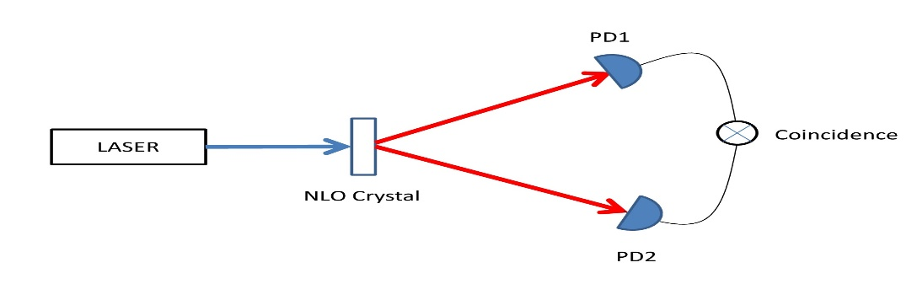
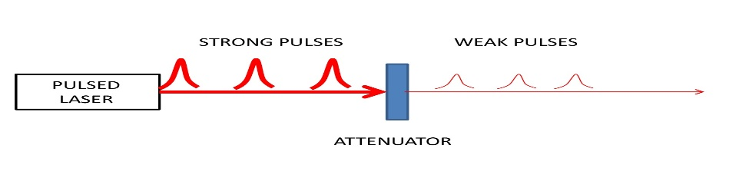
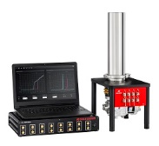
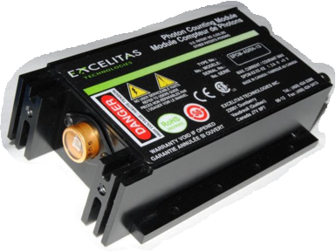
Physical Implementation
Source
Coherent Weak Laser Pulses
Heralded Single Photons
Entangled photons
Transmission Channel
Optical Fiber
Free Space
Detectors
Avalanche Photodiode SPD
Superconducting Nanowire SPD
Homodyne detectors

Slide 3
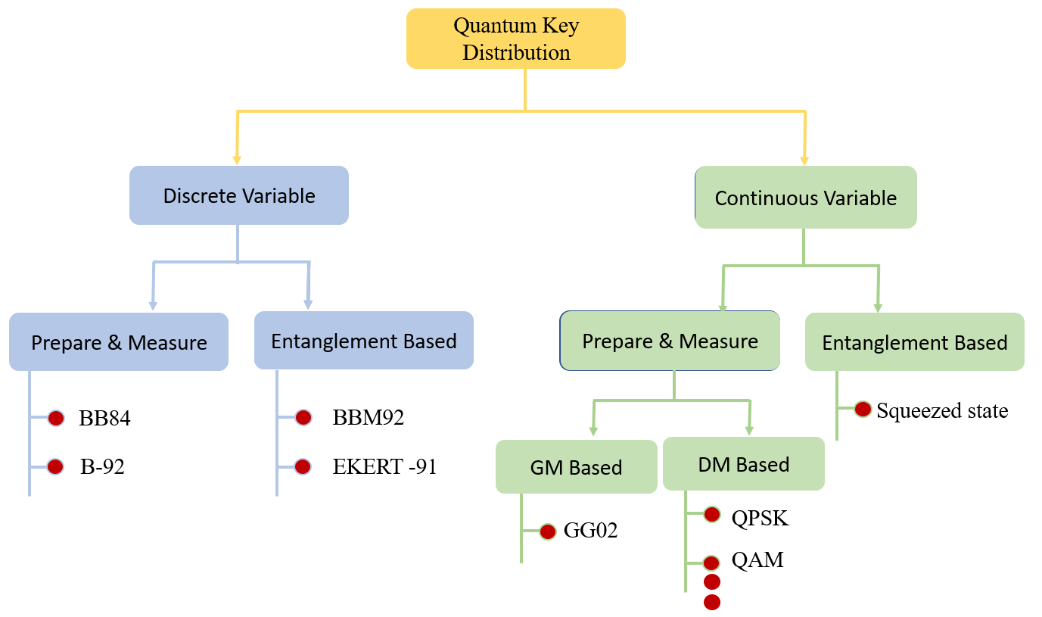
Classification of QKD

Slide 4
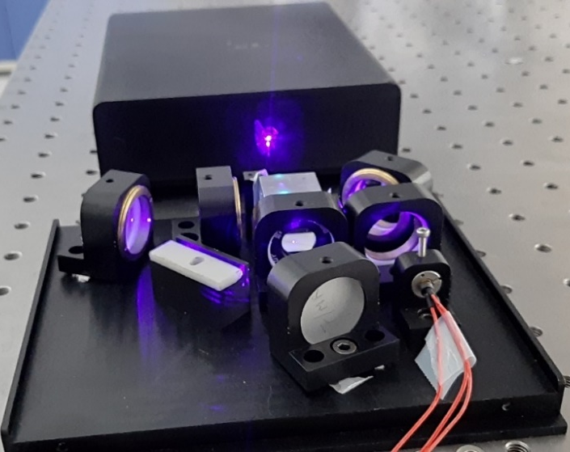
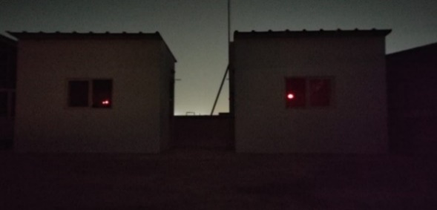
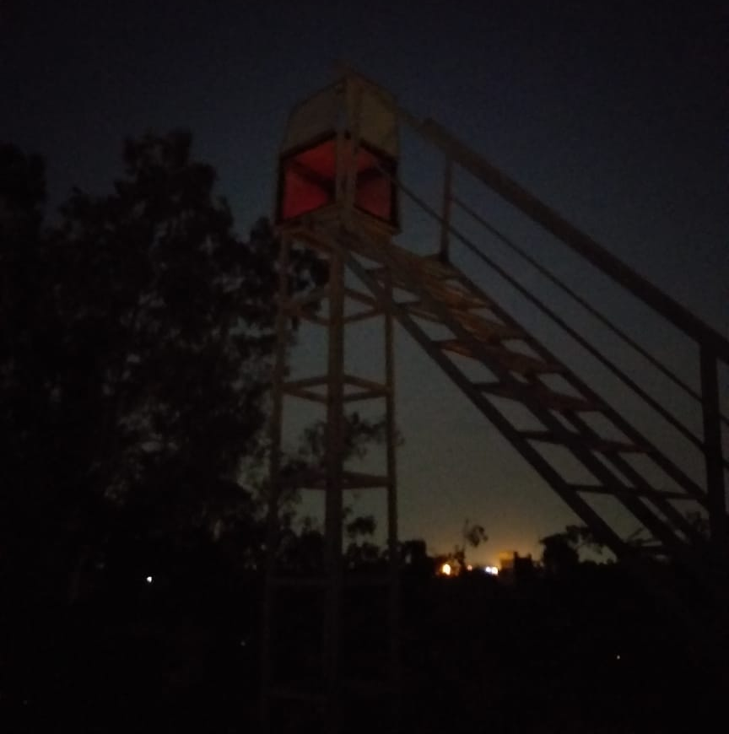
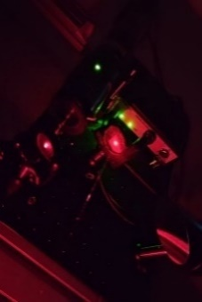
Progress
Weak Coherent Pulse
Implementation of BB84 QKD protocol in free space for 200 meters with weak coherent laser pulses, and heralded single photon source
Rigorous characterisation of mean photon number per pulse – JLWT 2024
Side channel for BB84, source and detection, using a new technique based on cross-correlation - IEEE J. Quantum Electron (2021, 2023)
New QKD protocol – CD Protocol – gives higher key rate compared to BB84/Decoy state protocol for same mean photon number per pulse – Optics Continuum (2022)
Entrapped Pulse CD Protocol - Adv. Quantum Technol. 2025, 2400685
Entangled Photons
Development of bright entangled photon source at 810 nm (10⁵ photon pairs per second) - Scientific Reports (2017), Advances in Quantum Technologies (2023)
Transmitter
Receiver
Reflector
Left: Field implementation
of free space QKD
~100 m
~100 m
Right: Compact entangled
photon source (810 nm)
developed at PRL

Slide 5
Progress….
Implementation of BBM92 QKD protocol in free space for 200 meters with entangled photons, Sift Key rate (~4.5 kbps) and Secure Key rate (~2 kbps), QBER < 5% and effect of aerosols on the key rate - Journal of Optics (2022)
End to end encryption for audio and video with Space Application Centre (ISRO), Ahmedabad for free-space channel of 300 meters using BB84 as well as BBM92 protocol (ISRO Press Release)
Integration of fibre-based QKD with free-space QKD – free-space to fibre and fibre to free-space (C-DOT Press Release)
10. Device Independent QKD protocol using entangled photons (arXiv:2307.02149)
11. Working on entanglement swapping in free-space atmospheric channel of ~200 m
CV QKD
12. Experimental Shot Noise Measurement Using the Imperfect Detection (IEEE J. of Quantum Electronics 2023)
13. Free space continuous variable Quantum Key Distribution with discrete phases, ~5 m in lab (Physics Open 2023)
14. Gaussian Modulated CV QKD through free space, ~5 m in lab (Post-processing of data – Information reconciliation)
15. Working on field implementation (~200 m atmospheric channel) of discrete phase and Gaussian modulation CV QKD
16. Effect of turbulence on key rate – ongoing
17. Experimental simulation of satellite downlink and uplink

Slide 6
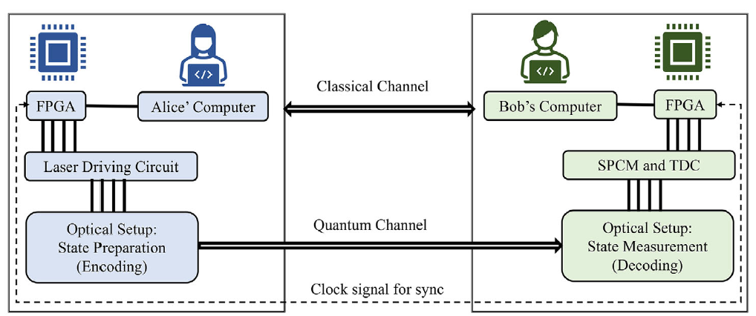
A General Schematic for P&M QKD

Slide 7
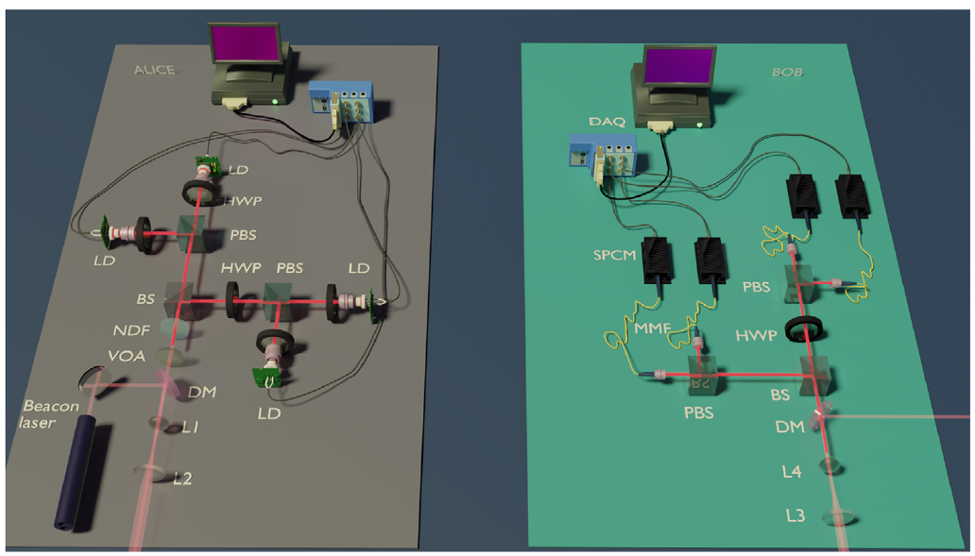
Experimental arrangement for CD-EPCD Protocol same as BB84-Decoy

Slide 8

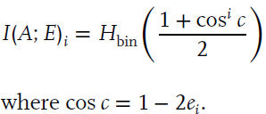
Key rates
Lim et al., Opt. Express 2017, 25, 11894
Assumption: No PNS, No USD

Slide 9
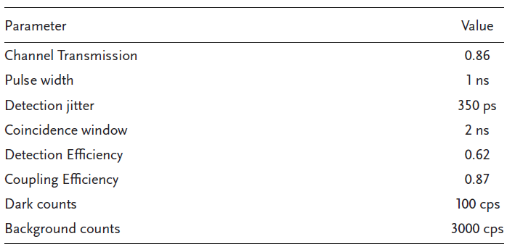
Experimental Parameters

Slide 10
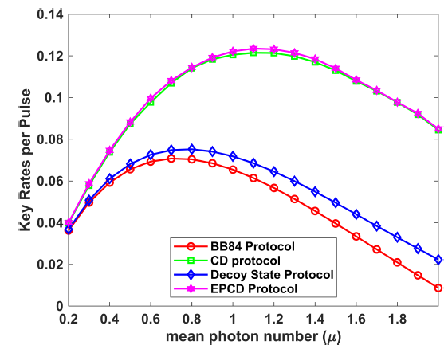
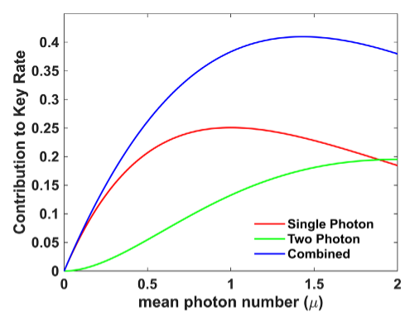
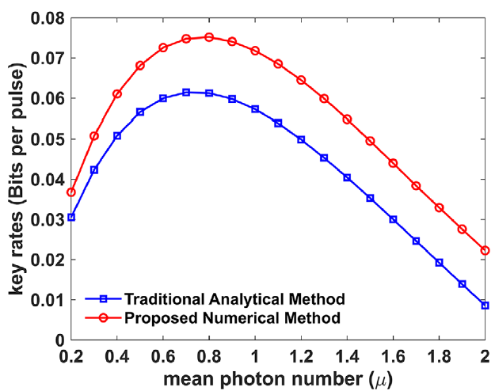
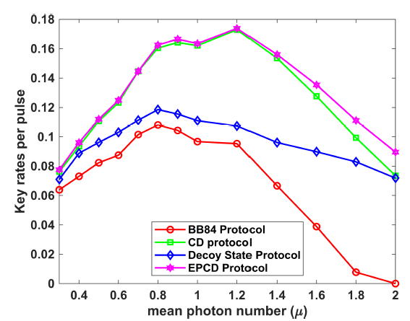
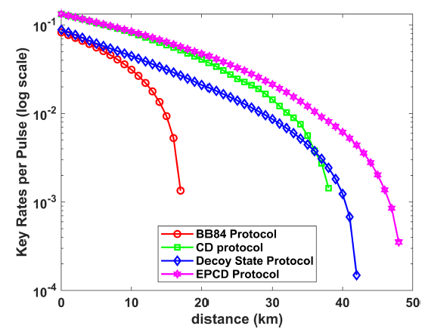
Experimental and theoretical results
We use SDP technique to find
The bounds on the yields and
errors to compute the bounds
on key rates

Slide 11
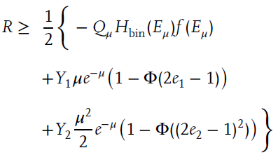
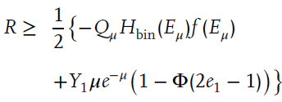
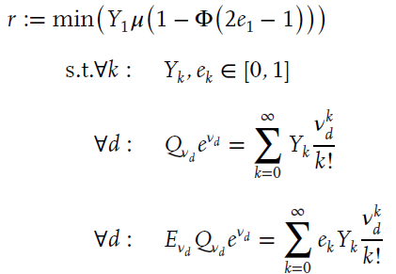
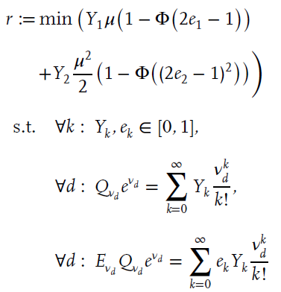
Key rates and Optimisation

Slide 12
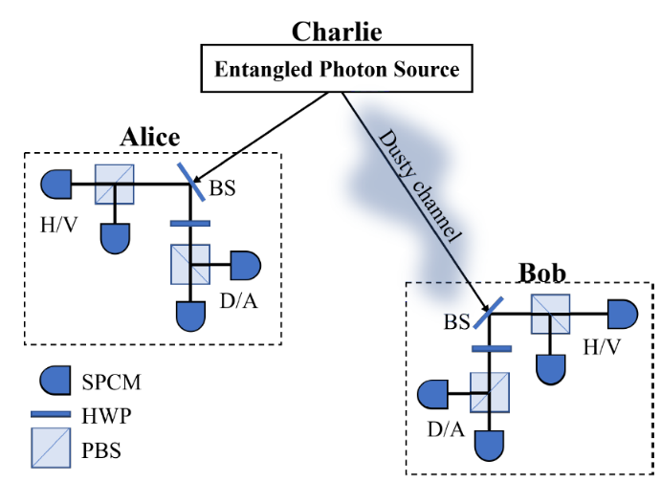
Entanglement distribution
over 200 meters

Slide 13
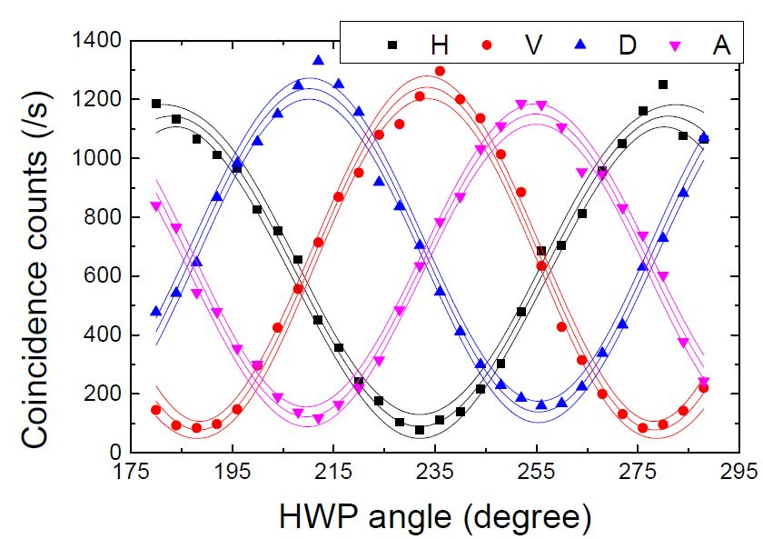
Entanglement Distribution over 200 meters
Correlation of polarization states between Alice and Bob
Coincidence window = 1 ns
Bell’s Parameter
S=2.54 ± 0.06
Polarization Visibility
H | V | D | A
94.2% | 93.66% | 83.33% | 87.53%

Slide 14
Parameter Estimation for BBM92 Protocol
Channel Transmissivity $\left(η_{Ch}\right)$=0.70 Overall Detector Efficiency$\left(η_{det}\right)$=0.4
Background Coincidences=40
TABLE: Showing QBER and Key Rate for BBM92 Protocol
 | H | V | D | A
H | 1023 | 41 | 603 | 501
V | 36 | 1167 | 661 | 592
D | 408 | 671 | 1287 | 76
A | 644 | 591 | 117 | 1140
BOB
ALICE
Average Sift Key Rate$\left(K\right)$ = Total CC in correct basis detectors = 4.5 kbps
QBER= CC in wrong detectors/total CC= 4%
Secure key rate ~ 1.7 kbps

Slide 15
Atmospheric conditions, mean and variance from midnight to 6 AM (typical measurement time for our experiments)
Date | Extinction (Mm-1) | Scattering (Mm-1) | PM2.5 (µg/m3)
08/05/2021 | 76.41±7.78 | 62.73±5.82 | 2.87±0.26
10/05/2021 | 48.67±6.70 | 40.16±6.15 | 1.68±0.24
Sarika et. al., Journal of Optics (2022)

Slide 16
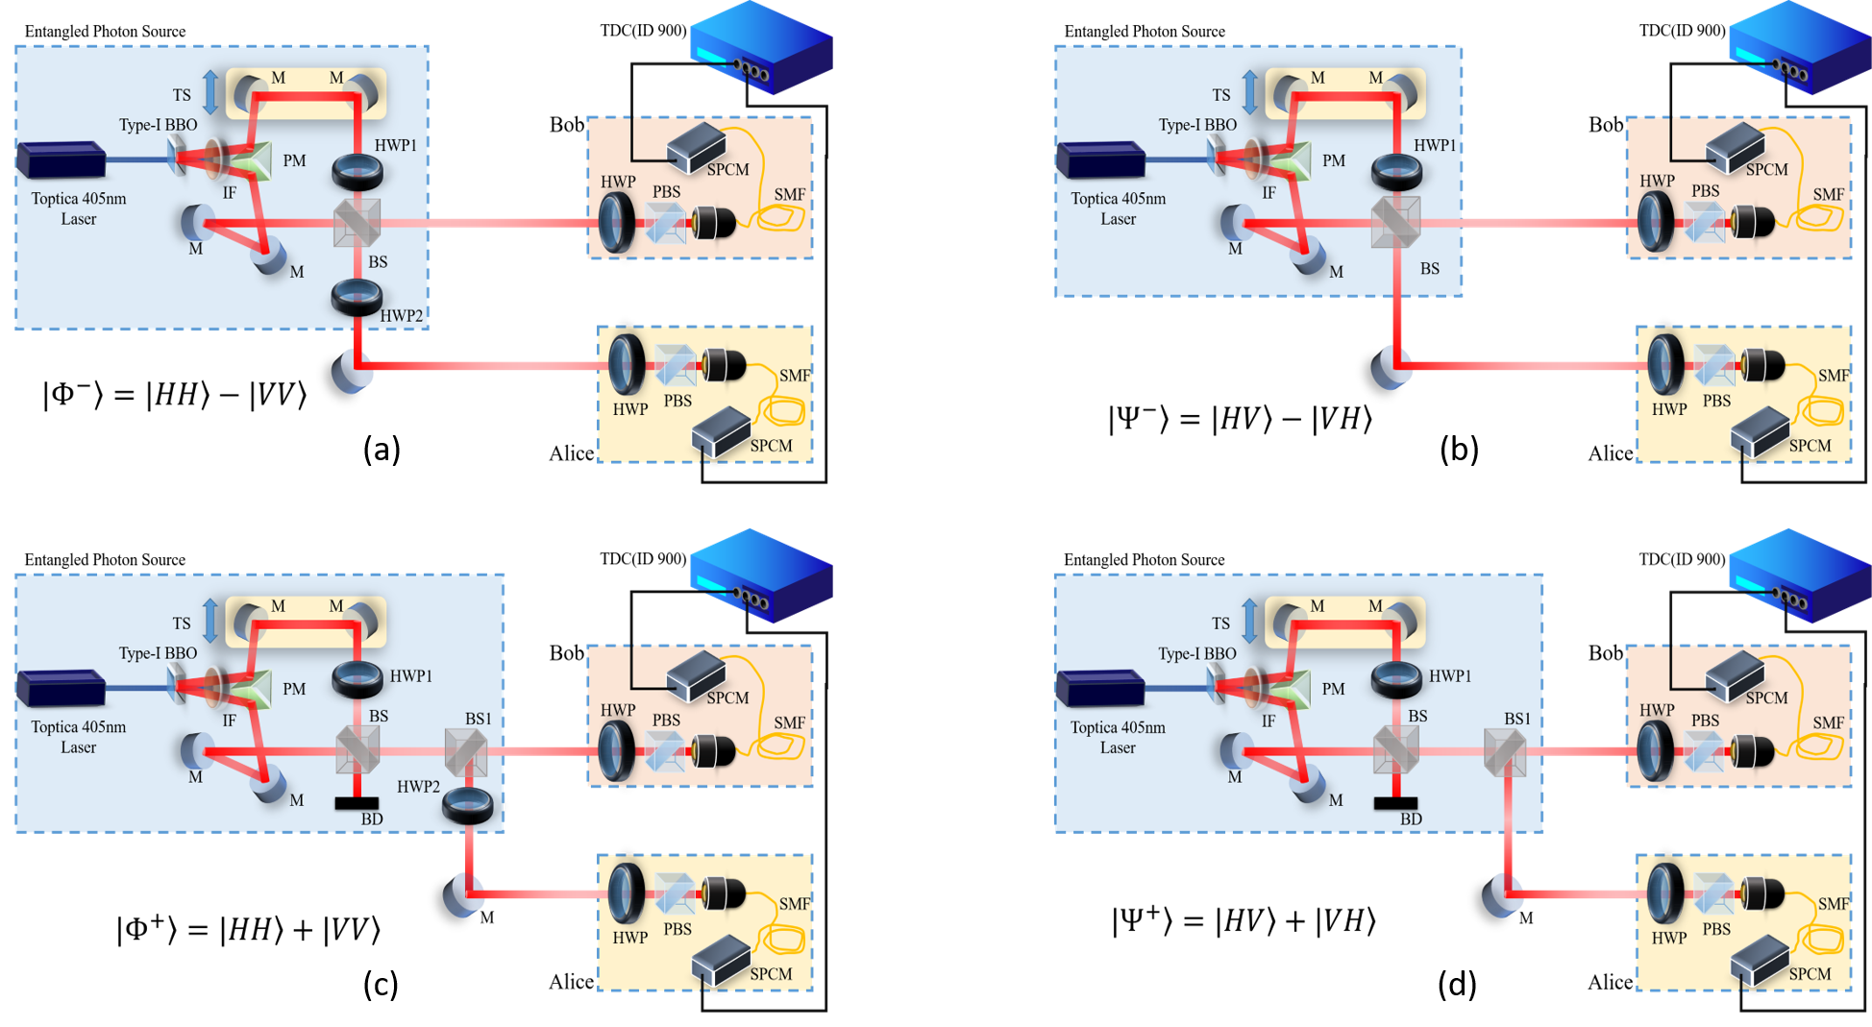
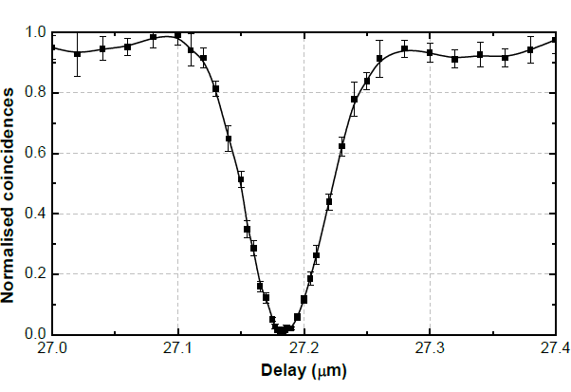
Creating Polarization Entanglement with varying visibility

Slide 17
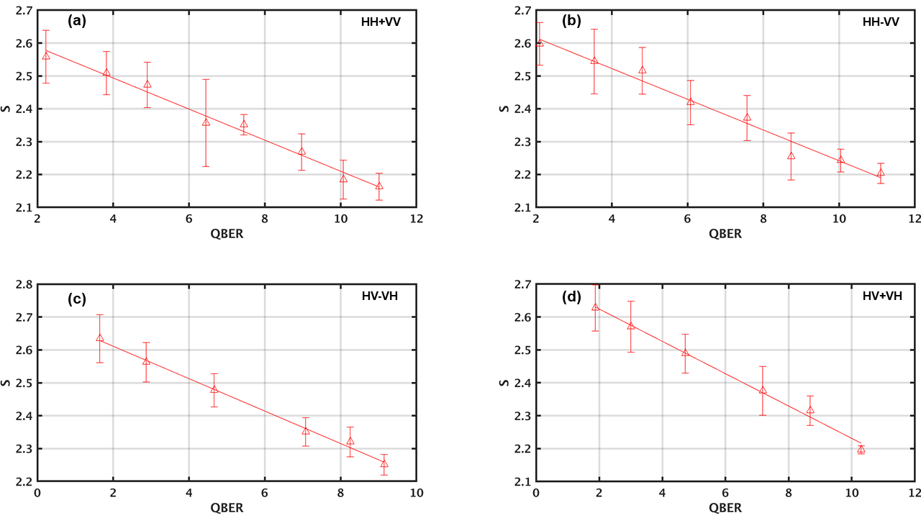

Variation of S with QBER

Slide 18
Non-zero secure key rate

Slide 19
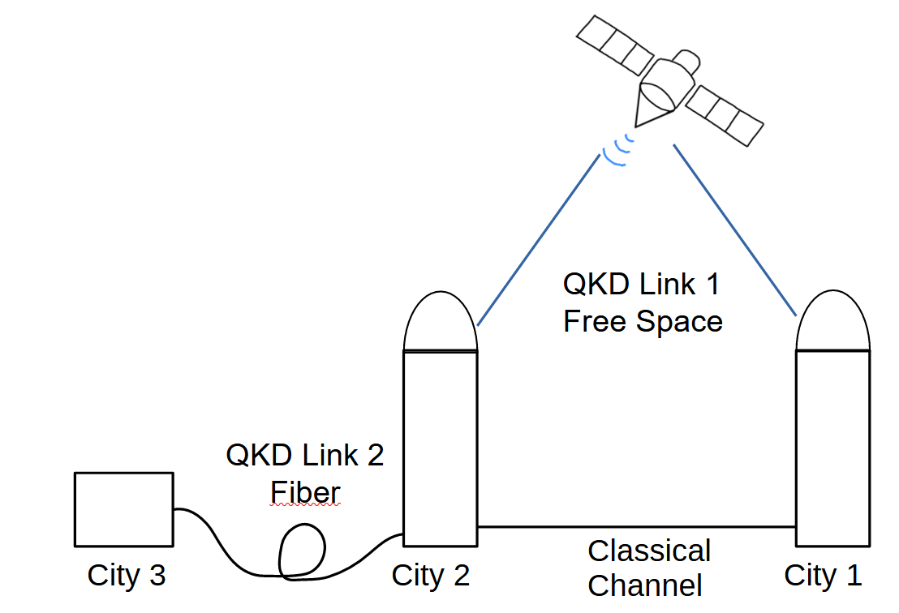
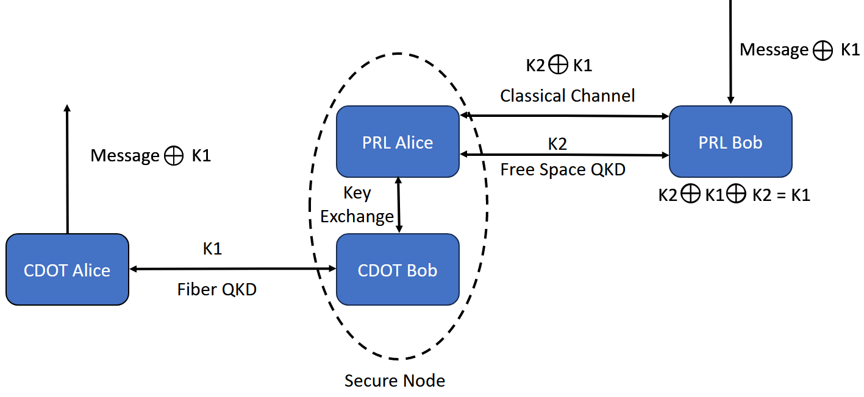
QKD Network: PRL CDOT QKD Integration

Slide 20
Future plan of work under QST Program @ PRL
Effect of turbulence and how to mitigate it for terrestrial and satellite communication
Simulating conditions for uplink and downlink to check the key rate for satellite based quantum communication
Development of Device Independent QKD protocols
Entanglement swapping and quantum teleportation in free space for 200 meters towards setting QC network
Using structured light such as - Vortex beam, Pencil beam, Gaussian Schell Model beam, Twisted Gaussian Schell Model beam - for robust and secure key distribution
Development of Photonic Quantum Computing since it is the best bet for quantum internet, World Wide Quantum Web (WWQW), the ultimate stage of quantum communication (China, Xanadu in Canada and Psi Quantum in USA, ORCA Computing in UK are making good progress)

Slide 21
Thank You
“The greater danger for most of us lies not in setting our aim too high and falling short; but in setting our aim too low, and achieving our mark.”
Michelangelo

Slide 22
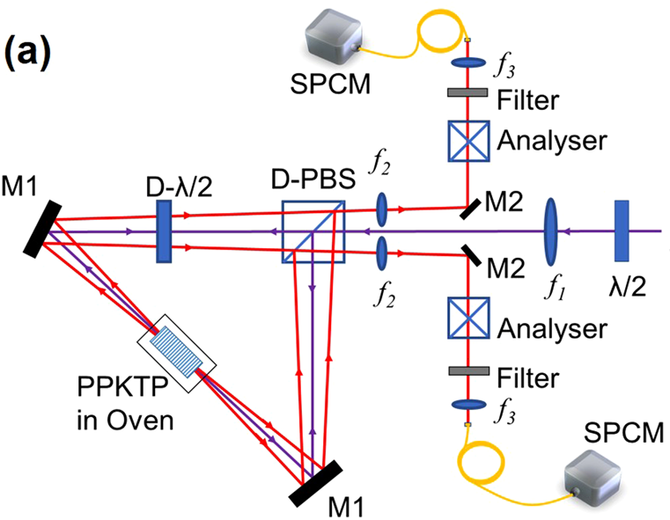

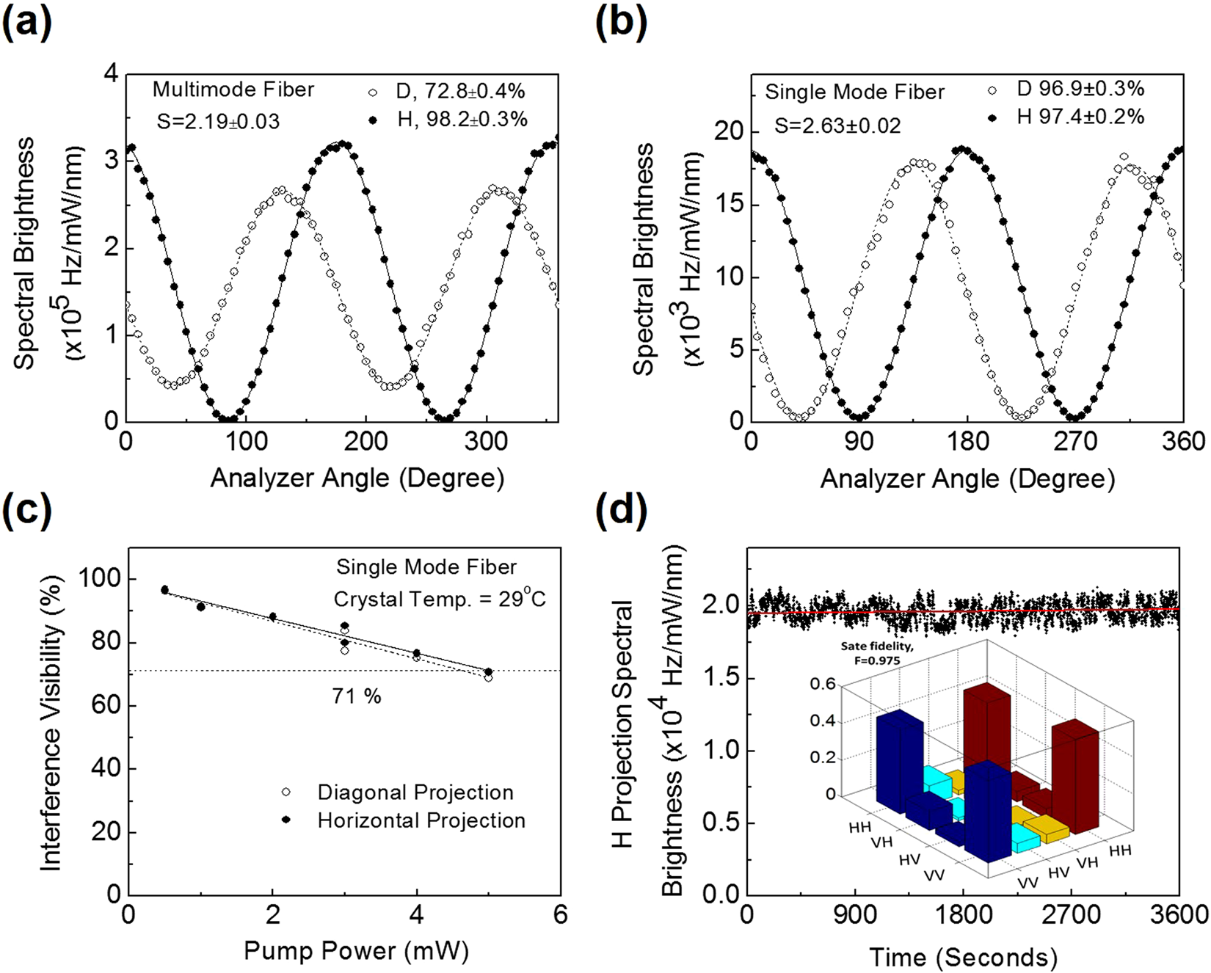
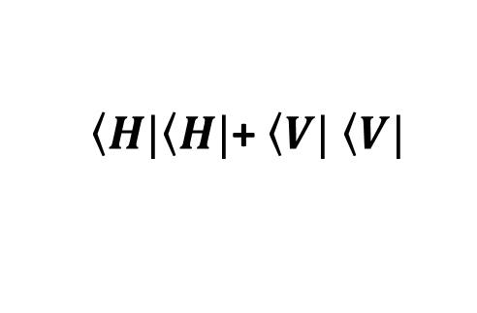
Entangled photon source
Prototype
Pump
@405 nm
$\left\langle H|\right.\left\langle H|\right.$+ $\left\langle V|\right.$ $\left\langle V|\right.$
QuantESS payload for entanglement
and HOM interferometer study in
space
Jabir et al “Robust, high brightness, degenerate entangled photon source at room temperature”, Scientific Reports 7 (1), 1-8 (2017)

Slide 23
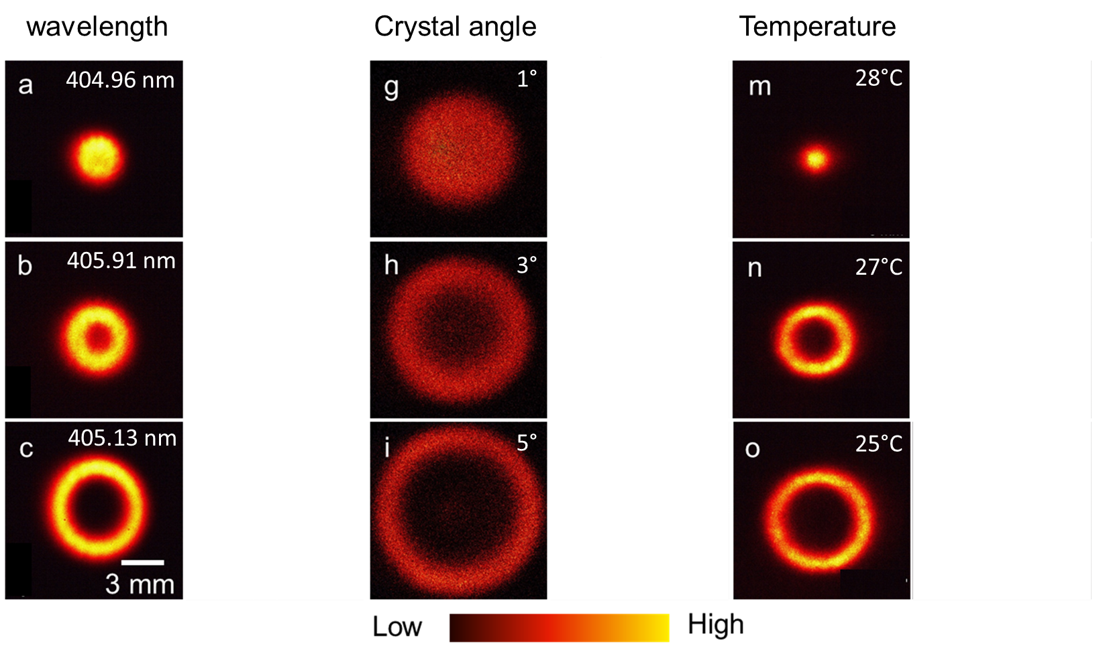
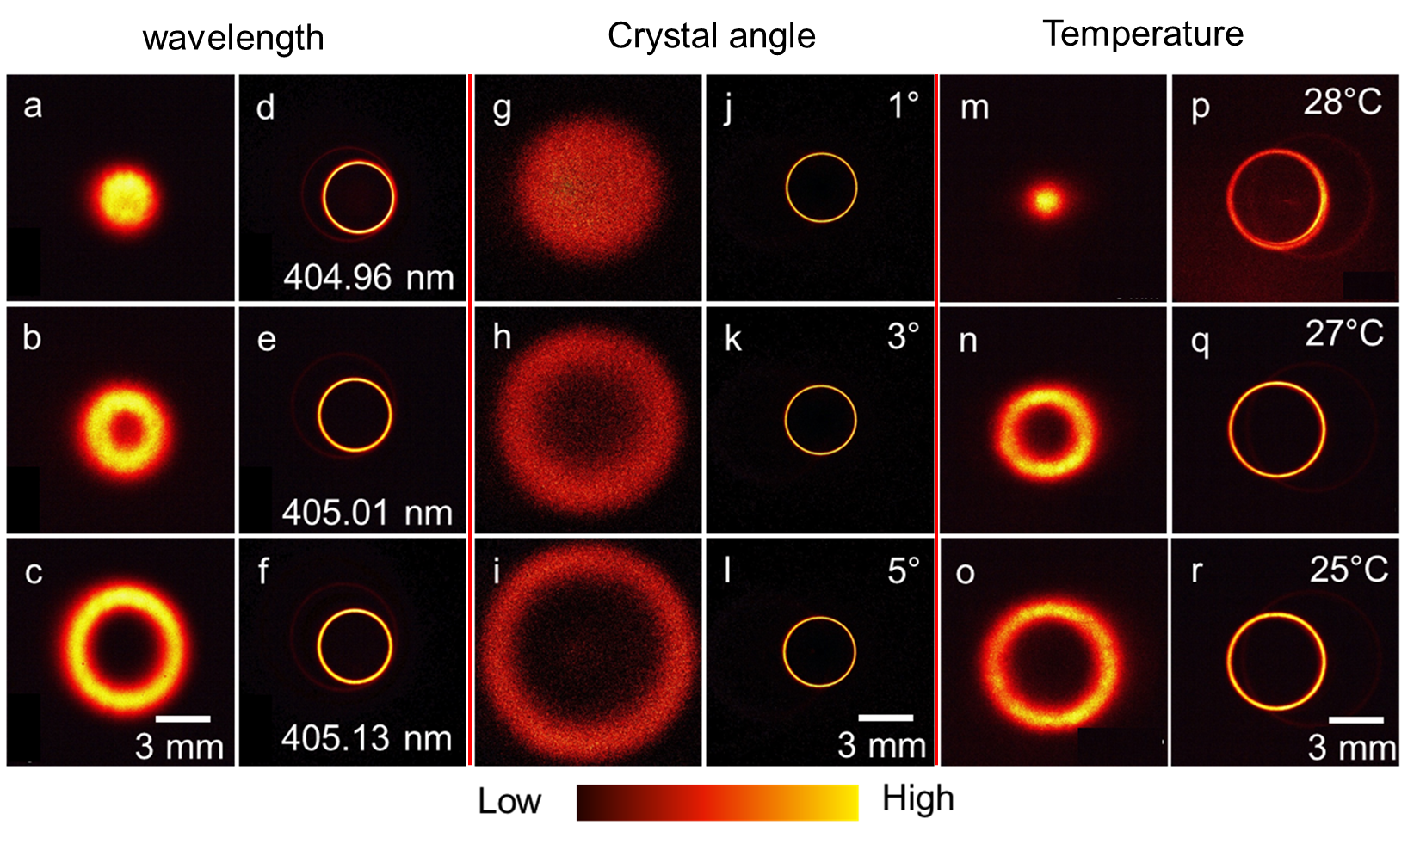
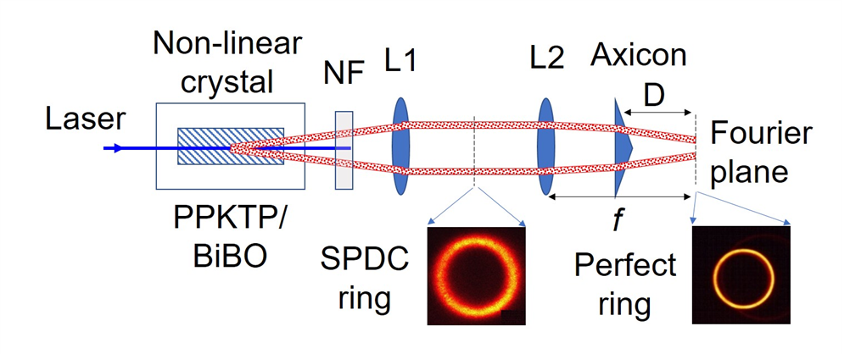
Neutralizing effect of phase-matching parameters on SPDC ring size
405.01 nm
Singh, S. et.al., Adv Quantum Technol. 2023, 6, 2200121.
Notes:
Change

Slide 24
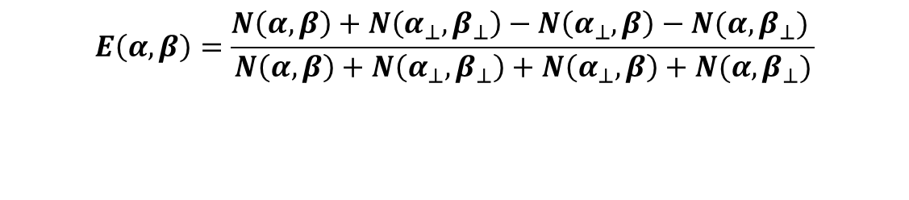
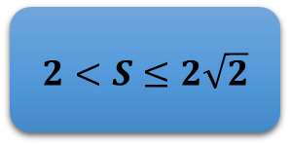

Bell-CHSH Violation
Gives indication about quantum entanglement
CHSH-Bell Parameter
$$S=|E\left(α,β\right)−E\left(α,β^{′}\right)+E\left(α^{′},β^{′}\right)+E(α^{′},β)|≤2$$
$α, α^{′}, β and β^{′}$ are the four different polarizer angles
Correlation Coefficient
$$E\left(α,β\right)=\frac{N\left(α,β\right)+N\left(α_{⊥},β_{⊥}\right)−N\left(α_{⊥},β\right)−N(α,β_{⊥}) }{N\left(α,β\right)+N\left(α_{⊥},β_{⊥}\right)+N\left(α_{⊥},β\right)+N(α,β_{⊥})}$$
For Entangled state having polarizer setting
$$α=0 α^{′}=45 β=22.5 β^{′}=67.5$$
$$2<S≤2\sqrt{2}$$
Bell-CHSH Violation

Slide 25
BBM92 Protocol
Entanglement Source
Alice
Bob
1 | 0 | 1 | 1 | 0 | 0
1 |  |  | 1 | 0 | 0
N |  |  | N | N | Y
1 |  |  | 1 | 0
Basis Selection
1 | 0 | 0 | 1 | 0 | 1
1 |  |  | 1 | 0 | 1
N |  |  | N | N | Y
1 |  |  | 1 | 0
Bit Values
✗
✗
✗
✗
Sifting
Error Checking
Key
110
110

Slide 26
Experimental Implementation of BBM92 Protocol
Entangled Photon Source, Launching Optics
Quantum Channel
Quantum Channel
Collecting Optics, Alice Detection Setup and Time Tagger
Collecting Optics, Bob Detection Setup and Time Tagger
ALICE
BOB
Classical Channel

Slide 27
Optical Setup for BBM92 Protocol
Entangled Photon Source
Launching Optics
To BOB
HWP
ALICE
BS
PBS
PBS
SPCM
Polarization State Analysis
Collecting Optics
SMF
BS
PBS
BOB
From ALICE
HWP
MMF
Oscilloscope
SPCM

Slide 28
Entanglement distribution over 200 meters

Slide 29
Entanglement Distribution over 200 meters
Correlation of polarization states between Alice and Bob
Coincidence window = 1 ns
Bell’s Parameter
S=2.54 ± 0.06
Polarization Visibility
H | V | D | A
94.2% | 93.66% | 83.33% | 87.53%

Slide 30
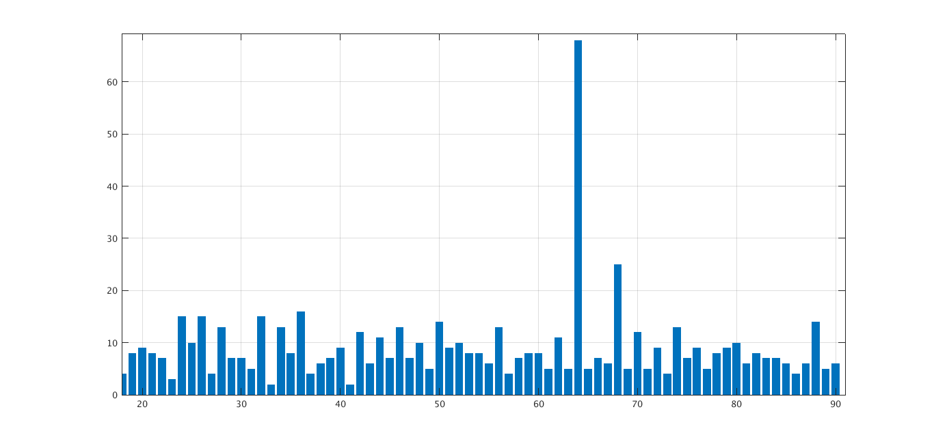
Temporal Filtering
C.C. Window = 1ns
Integration Time = 40ms
Counts
Delay x 10 ns
Delay from Alice’s H pol. state detector to Bob’s H pol. State detector = 648ns

Slide 31
Parameter Estimation for BBM92 Protocol
Channel Transmissivity $\left(η_{Ch}\right)$=0.70 Overall Detector Efficiency$\left(η_{det}\right)$=0.4
Background Coincidences=40
TABLE: Showing QBER and Key Rate for BBM92 Protocol
 | H | V | D | A
H | 1023 | 41 | 603 | 501
V | 36 | 1167 | 661 | 592
D | 408 | 671 | 1287 | 76
A | 644 | 591 | 117 | 1140
BOB
ALICE
Average Sift Key Rate$\left(K\right)$ = Total CC in correct basis detectors = 4.5 kbps
QBER= CC in wrong detectors/total CC= 4%
Secure key rate ~ 1.7 kbps

Slide 32
Atmospheric conditions, mean and variance from midnight to 6 AM (typical measurement time for our experiments)
Date | Extinction (Mm-1) | Scattering (Mm-1) | PM2.5 (µg/m3)
08/05/2021 | 76.41±7.78 | 62.73±5.82 | 2.87±0.26
10/05/2021 | 48.67±6.70 | 40.16±6.15 | 1.68±0.24
Sarika et. al., Journal of Optics (2022)

Slide 33
QKD Network: PRL CDOT QKD Integration

Slide 34
Press Release
Ministry of Communications
C-DOT & PRL demonstrate integration of indigenous Fiber based Quantum Key Distribution system with Free Space QKD system leading end to end quantum communication link in both Fiber and Free space as transport medium
Posted On: 05 MAR 2024 6:26PM by PIB Delhi
C-DOT & PRL Achieve Significant Milestone: In a first in the country, both the organizations demonstrate integration of CDOT’s indigenous Fiber based Quantum Key Distribution (QKD) system with Free Space QKD system from Physical Research Laboratory (PRL) leading to establishment of an end-to-end quantum
communication link involving both Fiber and Free space as transport medium.
The end-to-end quantum communication link with C-DOT’s Fiber-based QKD integrated with PRLs free space QKD was demonstrated to Prof. Ajay Sood, Principal Scientific Adviser to the Government of India and Dr Neeraj Mittal, Secretary Department of Telecommunications, Government of India during 2nd International Quantum Communication Conclave held at Vigyan Bhawan, New Delhi.
…………….

Slide 35
Future plan of work under QST Program @ PRL
Effect of turbulence and how to mitigate it for terrestrial and satellite communication
Simulating conditions for uplink and downlink to check the key rate for satellite based quantum communication
Development of Device Independent QKD protocols
Entanglement swapping and quantum teleportation in free space for 200 meters towards setting QC network
Using structured light such as - Vortex beam, Pencil beam, Gaussian Schell Model beam, Twisted Gaussian Schell Model beam - for robust and secure key distribution
Development of Photonic Quantum Computing since it is the best bet for quantum internet, World Wide Quantum Web (WWQB), the ultimate stage of quantum communication (China, Xanadu in Canada and Psi Quantum in USA, ORCA Computing in UK are making good progress)

Slide 36
Thank You
“The greater danger for most of us lies not in setting our aim too high and falling short; but in setting our aim too low, and achieving our mark.”
Michelangelo

