Slide 1
Semi-device-independent self-testing of unitary operations
Prabuddha Roy
Korea Institute for Advanced Study
Seoul, South Korea
ICQIST 2025
09th -13th December 2025

Slide 2
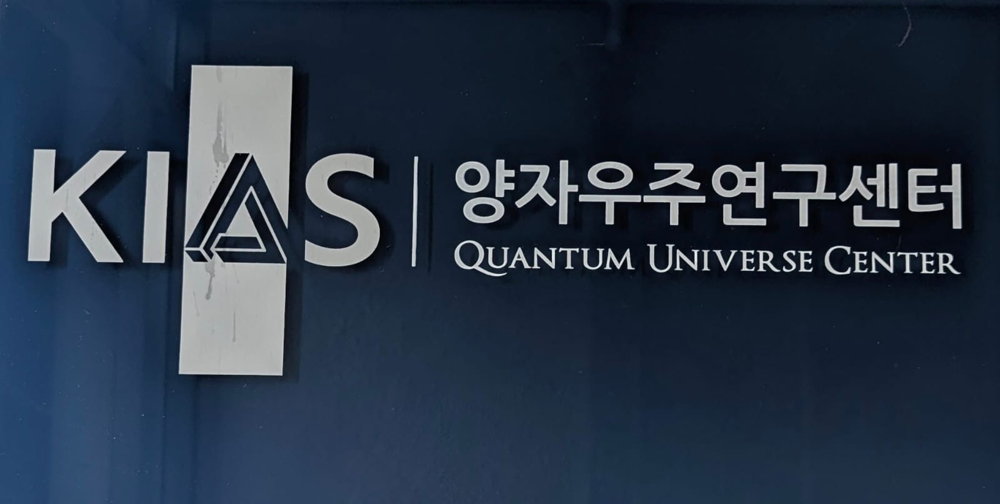
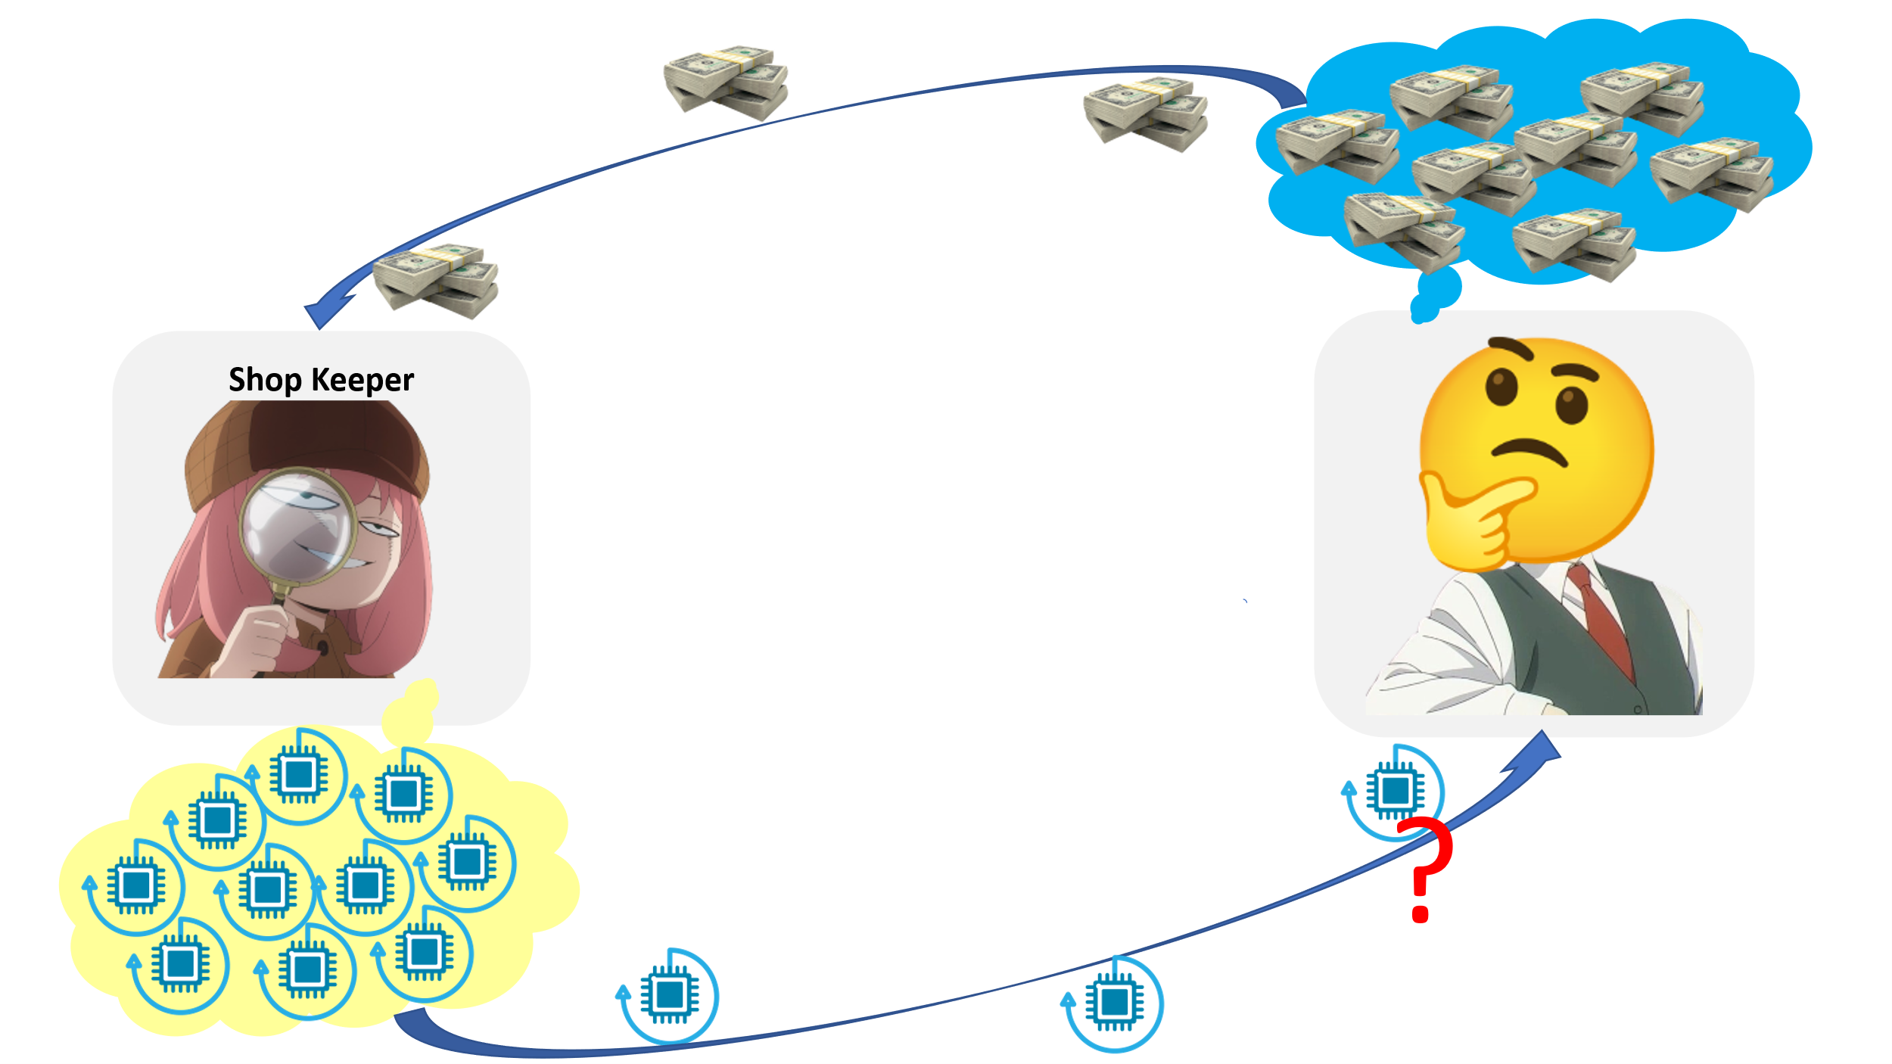
Characterisation of untrusted Quantum devices:
Can we trust the shopkeeper?

Slide 3
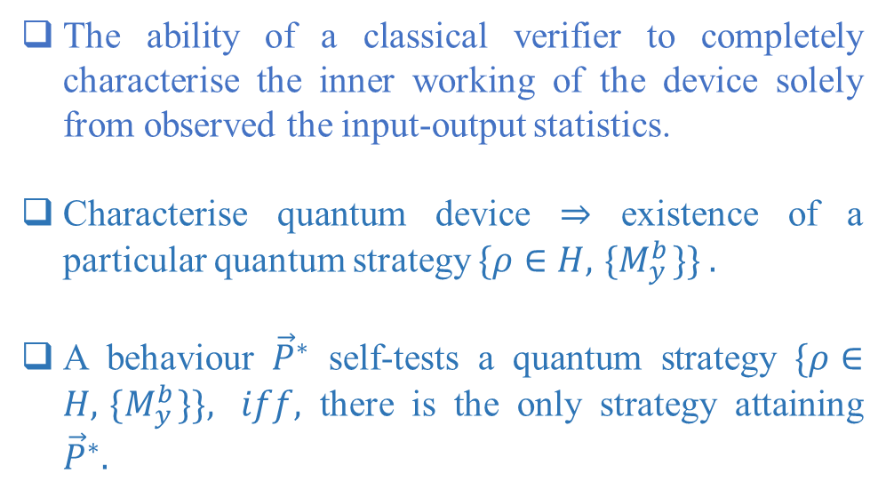




Characterisation of untrusted Quantum devices: self-testing
$$x∈X$$
$$y∈Y$$
The ability of a classical verifier to completely characterise the inner working of the device solely from observed the input-output statistics.
Characterise quantum device ⇒ existence of a particular quantum strategy$\{ρ∈H, { \{M}_{y}^{b}\}\} .$
A behaviour ${\vec{P}}^{∗}$ self-tests a quantum strategy $\{ρ∈H, { \{M}_{y}^{b}\}\}, iff,$ there is the only strategy attaining ${\vec{P}}^{∗}.$
$$b$$
Behaviour:
$$\vec{P}∈\{p(b|x,y)\}$$
D. Mayers and A. Yao, Quantum Information and Computation 4, 273 (2004); I. Supic and J. Bowles, Quantum 4, 337 (2020).

Slide 4




Certification beyond DI-Bell tests: semi-DI self-testing
Loophole-free Bell violations,
High detection efficiencies,
Low noise,
Precise spacelike separation,
Perfect isolation from unwanted degrees of freedom.
$$x∈X$$
$$y∈Y$$
Semi-DI prepare-measure self-testing:
No need for spacelike separation
Simpler to implement
Requires upper bound on dimension
$$b$$
$$\vec{P}≡\{p\left(b | x,y\right)\}$$

Slide 5




Semi-DI Self-testing: prepare-measure random-access-code (PMRAC)
$$x∈{\left\{0,1\right\}}^{n}$$
$$y∈\{1,2,…,n\}$$
$$ρ_{x}$$
$$Bob$$
$$Alice$$
$$Λ_{x}$$
$$Π_{b|y}$$
$$b∈\{0,1\}$$
Alice and Bob uncorrelated
Quantum systems of fixed dimension, but otherwise uncharacterized
The amount of information communicated from the Alice to Bob is assumed to be upper bounded.
A. Ambainis, D. Leung, L. Mancinska, M. Ozols, arXiv: 0810.2937(2009).

Slide 6
Semi-DI Self-testing: related works
Self-testing quantum states and measurements in the prepare-and-measure scenario, A. Tavakoli, J. Kaniewski, T. Vértesi, D. Rosset, and N. Brunner, Physical Review A 98, 062307 (2018).
Self-testing mutually unbiased bases in the prepare-and-measure scenario, M. Farkas, J. Kaniewski, Physical Review A, 99(3), 032316 (2019).
Experimentally feasible semi-device-independent certification of four-outcome positive-operator-valued measurements, P. Mironowicz, M. Pawłowski, M. Pawłowski , Physical Review A, 100(3), 030301 (2019).
Semi-device-independent self-testing of unsharp measurements, N. Miklin, J. J. Borkała, Marcin Pawłowski, Physical Review Research, 2(3), 033014 (2020).
Self-testing nonprojective quantum measurements in prepare-and-measure experiments, A. Tavakoli, M. Smania, T. Vértesi, N. Brunner, M. Bourennane, Science Advances, 6(16), eaaw6664 (2020).
A universal scheme for robust self-testing in the prepare-and-measure scenario, N. Miklin, M. Oszmaniec, Quantum, 5, 424 (2021).
Self-Testing in Prepare-and-Measure Scenarios and a Robust Version of Wigner’s Theorem, M. Navascues, K. F. Pál, T. Vértesi, M. Araújo, Physical Review Letters, 131(25), 250802 (2023).
Unconditionally verifiable blind quantum computation, J. F. Fitzsimons, and E. Kashefi, Physical Review A 96, 012303 (2017).
Any gate of a quantum computer can be certified device-independently, S. Sarkar, arXiv:2508.20185 (2025).

Slide 7








Motivation: semi-DI Self-testing of unitary operations
$$y∈\{1,2,…,n\}$$
$$x∈{\left\{0,1\right\}}^{n}$$
$$ρ_{x}$$
$$Alice$$
$$Bob$$
$$Λ_{x}$$
$$Π_{b|y}$$
$$b∈\{0,1\}$$
The state preparation of semi-DI prepare-measure scenario consists of CPTP maps (unitary operations).
Due to noise and/or trust concerns, certification of the unitaries is needed.
Device-independent self-testing offers the strongest certification; however, we introduce a more practically viable semi-device-independent self-testing method.

Slide 8

Variant of PMRAC:
$$x∈{\left\{0,1\right\}}^{n}$$
$$y∈\{1,2,…,n\}$$
$$ρ_{x}$$
$$Bob$$
$$Alice$$
$$Λ_{x}$$
$$one qubit comm$$
$$Π_{b|y}$$
$$ρ$$
$$b=x_{y}∈\{0,1\}$$
Alice and Bob are correlated.
State Preparation:
$$ρ_{x}=Λ_{x}(ρ)$$
Communication channel:
Quantum
Measurement : $Π_{b|y}$
$$\sum_{b}{Π_{b|y}}=I$$
The guessing probability of the game:$p\left(b=x_{y} | x, y\right)=Tr[ρ_{x}Π_{b|y}]$
A. Tavakoli, J. Pauwels, E. Woodhead, and S. Pironio, PRX Quantum 2, 040357 (2021) .

Slide 9

3-bit variant of PMRAC:
$$x∈{\left\{0,1\right\}}^{3}$$
$$y∈\{1,2,3\}$$
$$ρ_{x}$$
$$Alice$$
$$Bob$$
$$Λ_{x}$$
$$one qubit comm.$$
$$Π_{y}^{b}$$
$$ρ$$
$$b=x_{y}$$
What is the optimal winning probability in quantum theory?
How the optimal winning probability self-tests unitary operation?
Average quantum success probability :
$$S_{Q}=\frac{1}{24}\sum_{y=1}^{3}{\sum_{x={\left\{0,1\right\}}^{3}}{Tr\left[ρ_{x}Π_{y}^{b}\right];}}$$
$$Π_{y}^{b}=\frac{I_{2}+{\left(−1\right)}^{b}B_{y}}{2}$$
where

Slide 10
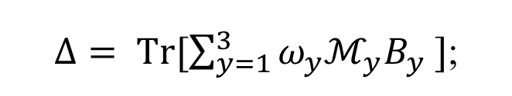



3-bit variant of PMRAC : sum-of-squares optimization
Final expression of success probability:
$$Δ=\sum_{y=1}^{3}{ Tr [\left(N_{y}−M_{y}\right)B_{y}]}$$
where
$$S_{Q}=\frac{1 }{2}+\frac{Δ }{48}$$
$M_{1}=−ρ_{000}−ρ_{011}+ρ_{101}+ρ_{110}$;
$$M_{2}= −ρ_{000}+ρ_{011}−ρ_{101}+ρ_{110};$$
$M_{3}=−ρ_{000}+ρ_{011}+ρ_{101}−ρ_{110}.$
$$N_{1}=ρ_{001}+ρ_{010}−ρ_{100}−ρ_{111};$$
$$N_{2}=ρ_{001}−ρ_{010}+ρ_{100}−ρ_{111};$$
$$N_{3}=−ρ_{001}+ρ_{010}+ρ_{100}−ρ_{111}.$$
[$M_{i},{M_{j}]}_{i≠j} =0;{ M}_{1}={−M_{2}M}_{3}$
$${[N}_{i},{N_{j}]}_{i≠j}=0;{ N}_{1}={−N_{2}N}_{3}$$
$Δ= Tr[\sum_{y=1}^{3}{ω_{y}ℳ_{y}B_{y}} ]$;
Correlation function:
where $ℳ_{y}$= $\frac{(N_{y}−M_{y} )}{ω_{y }}$ ; $ω_{y }=\left\|N_{y}−M_{y}\right\| ∀ y∈[3].$
Maximization condition:
$ℳ_{y}=B_{y} ∀ y$.

Slide 11

3-bit variant of PMRAC : SOS optimization condition:
Theorem 1. The optimal quantum success probability $S_{Q}^{opt}$of the variant of $3$-bit PMRAC certifies the following statements.
The states in set $ρ_{\{x|⊕_{2}x=0\}}$ and $ρ_{\{x|⊕_{2}x=1\}}$ are mutually orthogonal satisfying $\sum_{x}{ρ_{\{x|⊕_{2}x=0\}}}=\sum_{x}{ρ_{\{x|⊕_{2}x=1\}}}=I_{2}⊗I_{2}$
$Tr\left[ρ_{x},ρ_{x^{′}}\right]=\left\{\begin{aligned}0 ∀x∈{\left\{0,1\right\}}^{3},x^{′}=\overline{x} \\ \frac{1}{3} otherwise\end{aligned}\right.$
Bob's observable $B_{y}=\sqrt{\frac{3}{8}}\left(N_{y}−M_{y}\right)∀ y∈[3]$where $M_{y}$ and $N_{y}$ are two-qubit operators.

Slide 12


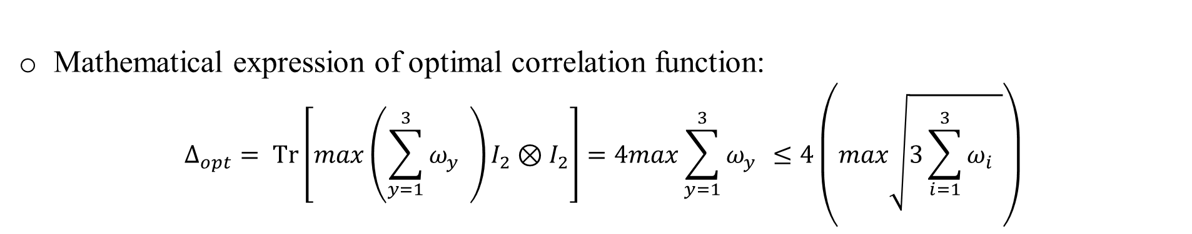
3-bit variant of PMRAC : sum-of-squares optimal bound
Mathematical expression of optimal correlation function:
$$Δ_{opt}= Tr\left[max\left(\sum_{y=1}^{3}{ω_{y }}\right)I_{2}⊗I_{2}\right]=4max\sum_{y=1}^{3}{ω_{y }≤4\left(max\sqrt{3\sum_{i=1}^{3}{ω_{i }}}\right)}$$
Optimal value of the correlation function:
$$Δ_{opt}=8√6$$
Condition for optimality on states:
$$Tr[ρ_{000}ρ_{111}]=Tr[ρ_{011} ρ_{100} ]=Tr[ρ_{101}ρ_{010}]=Tr[ρ_{110} ρ_{001}]=0$$
Optimal winning success probability:
$$S_{Q}^{opt}=\frac{1}{2}+\frac{1}{\sqrt{6}}≈0.908$$

Slide 13

3-bit variant of PMRAC : unitary certification
Theorem 2. For optimal quantum success probability $S_{Q}^{opt}$ of the $3$-bit variant of PMRAC, the following statements hold.
The initial shared state between Alice and Bob is maximally entangled state in the form
$ρ=\frac{1}{4}(I_{4}−Q_{1}⊗Q_{2}−P_{1}⊗P_{2}−R_{1}⊗R_{2} )$
where $\{P_{1},Q_{1}, R_{1}\}$and $\{P_{2}, Q_{2},R_{2}\}$ are the sets of mutually anti-commuting qubit operators.
ii. Alice's unitary operators are $U_{000}=I_{2} ,U_{011}=iQ_{1},U_{101}=−iP_{1}$, and $U_{110}=−iR_{1}$, are mutually anticommuting, and a grand unitary $U_{G}=\frac{1}{\sqrt{3}}(−I_{2}+U_{011}+U_{101})$exists, which gives
$$U_{G}^{†} \{ { ρ}_{000},{ ρ}_{ 011} , ρ_{110}, ρ_{101}\} U_{G}→ \{ρ_{001},ρ_{010},ρ_{100},ρ_{111}\}$$

Slide 14
3-bit variant of PMRAC : unitary certification
State preparation:
$$ρ_{x_{1}x_{2}x_{3}}=\left(U_{x_{1}x_{2}x_{3}}^{†}⊗I_{2}\right) ρ_{AB} \left(U_{x_{1}x_{2} x_{3}}⊗I_{2}\right) ∀ x_{1},x_{2},x_{3}∈\{0,1\}$$
Transformation within same basis:
Trivial as mutually orthogonal
$${ ρ}_{000}+{ ρ}_{ 011}+ ρ_{110}+ ρ_{101}={ ρ}_{111}+{ ρ}_{ 100}+ ρ_{001}+ ρ_{010}=I_{2}⊗I_{2}$$
Transformation within different basis:
$$U_{G}^{†} \{ { ρ}_{000},{ ρ}_{ 011} , ρ_{110}, ρ_{101}\} U_{G}→ \{ρ_{001},ρ_{010},ρ_{100},ρ_{111}\}$$
Requirements:
$$\left(U_{G}^{†}⊗I_{2}\right)M_{1}\left(U_{G}⊗I_{2}\right)=−N_{1}; \left(U_{G}^{†}⊗I_{2}\right)M_{2}\left(U_{G}⊗I_{2}\right)=−N_{2}; \left(U_{G}^{†}⊗I_{2}\right)M_{3}(U_{G}⊗I_{2})=N_{3}$$
Grand unitary:
$U_{G}=\frac{−I_{2}+iQ_{1}−iP_{1}}{\sqrt{3}}=\frac{1}{\sqrt{3}}( −I_{2}+U_{011}+U_{101})$

Slide 15
3-bit variant of PMRAC : example
State's components :
$M_{1}={ σ}_{x}⊗σ_{x}; M_{2}=σ_{y}⊗σ_{y}; M_{3}=σ_{z}⊗σ_{z};$
${ N}_{1}=\frac{1}{3}\left(−σ_{x}⊗σ_{x}+2σ_{y}⊗σ_{x}+2σ_{z}⊗σ_{x}\right); N_{2}=\frac{1}{3}(−σ_{y}⊗σ_{y}+2 σ_{x}⊗σ_{y}+ 2σ_{z}⊗σ_{y});$
$$N_{3}=\frac{1}{3}(−σ_{z}⊗σ_{z}+2σ_{x}⊗σ_{z}+2σ_{y}⊗σ_{z})$$
Bob's local observables:
$B_{1}=\frac{1}{\sqrt{6}}\left(−2σ_{x}+σ_{y}+σ_{z}\right)⊗σ_{x}; { B}_{2}=\frac{1}{\sqrt{6}}\left(−2σ_{y}+σ_{x}+σ_{z}\right)⊗σ_{y};$
$$B_{3}=\frac{1}{\sqrt{6}}(−2σ_{z}+σ_{x}+σ_{y})⊗σ_{z}$$
This fixes the unitaries
$U_{011}=iσ_{x}; U_{101}=−iσ_{y}; U_{110}=−iσ_{z}; U_{G}=\frac{1}{\sqrt{3}}(−I_{2}+iσ_{x}−iσ_{y})$.

Slide 16
Applications:
Quantum
circuits
Delegated
quantum
computing
Dimension
Witness
Quantum
communication

Slide 17
Outlook!
We introduce a variant of PMRAC game and derive the optimal winning success probability of the game.
We then demonstrate the optimal success probability self-tests Alice’s unitary operations and the shared state between Alice and Bob.
Sub-optimal winning success probability of variant of PMRAC game
Shared state between Alice-Bob may be inappropriate.
Implementation of the unitaries are faulty.
Imperfect implementation of Bob’s measurement device.
Any of the above conditions, whether individually or collectively, are responsible for the lower success probability.

Slide 18
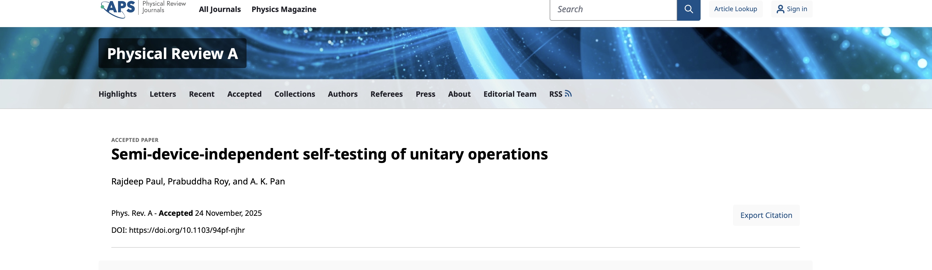

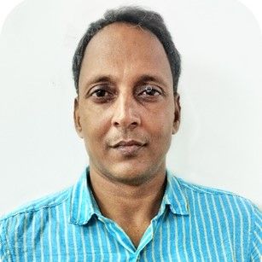
Collaborators:
Rajdeep Paul
PhD Student, IIT Hyderabad
Alok Kumar Pan
Associate Professor, IIT Hyderabad

Slide 19
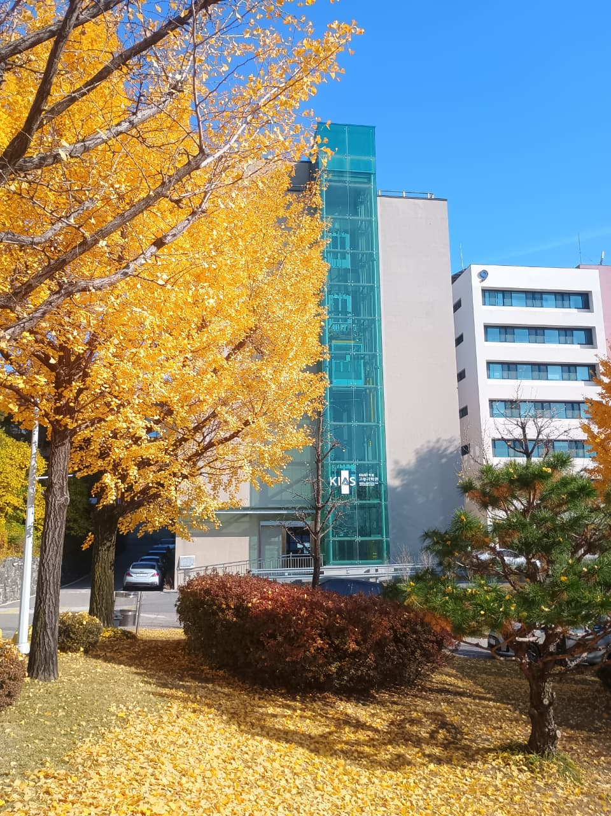
Thank You

